Slide 1


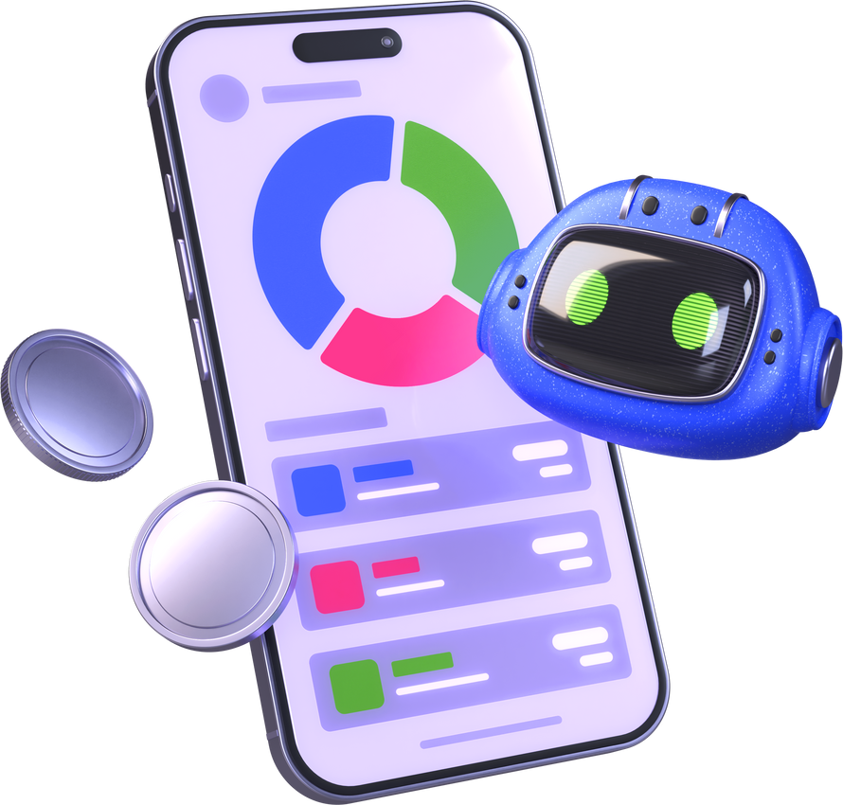




Quiz
Time
Tricky People

Slide 2





Question 1
What does 'AI' stand for?
A.Alien Information
B. Automatic Internet
C. Artificial Intelligence

Slide 3

Question 2
What is the biggest difference between a real friend and an AI chatbot?
A.Real friends have feelings, but AI does not.
B. Real friends reply faster than AI.
C. AI can play games, but real friends cannot.

Slide 4
Question 3
Which of these is a BAD way to use AI?
A.Asking it to write a story about a dragon.
B.Making a mean picture to embarrass a classmate.
C. Asking it to tell you a funny joke.

Slide 5
Question 4
Why can't an AI chatbot give you a real hug when you are sad?
A. Because it is too busy answering other people.
B. Because it doesn't like hugs.
C. Because it is shy.
D. Because it has no body and no real feelings.

Slide 6
Question 5
What is 'Fake News' created by AI?
A. A story written by a famous author.
B. Stories that look real but are actually lies.
C. News that is only about computers.

Slide 7
Question 6
Who is the BEST person to talk to if you see something scary or confusing online?
A. A trusted adult like a parent or teacher.
B. A stranger on the internet.
C. The AI chatbot.

Slide 8
Question 7
AI can 'sound confident even when wrong.' Why is this dangerous?
A. Because it makes the computer battery drain faster.
B. Because we might believe false information just because it sounds smart.
C. Because it means the AI is broken.

Slide 9
Question 8
In the story about Sam, why did the AI feel 'comforting' to Sam initially, even though it wasn't a real person?
A.It promised to solve all of Sam's problems.
B. It sent Sam a gift.
C. It replied immediately, making Sam feel less alone in the moment

Slide 10
Question 9
Is an AI chatbot a real human being?
B. Maybe, if it has a name like Alexa.
A. No, it is a computer program.
C. Yes, but only when it talks.

Slide 11
Question 10
Which one of these is SAFE to say to a chatbot?
B. "I go to Sunny Side School."
A."Tell me a funny joke!".
C."My full name is Sam Smith."

