Slide 1

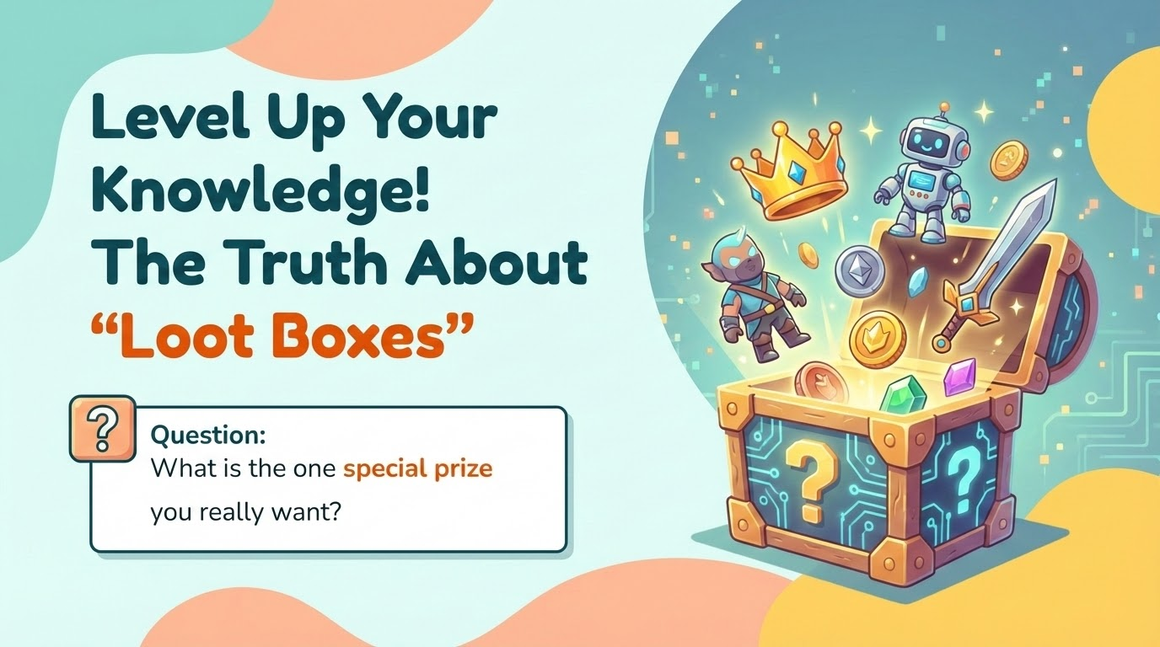




Loot boxes
The Truth About "Loot Boxes"
Question:
What is the one special prize you really want?
Notes:
Good morning everyone! Raise your hand if you play video games like Roblox, Fortnite, or FIFA.
Keep your hands up if you have ever seen a treasure chest, a card pack, or an egg in the game that you can open to get a prize.
I want to ask you a question: What is the one 'dream item' you really want? Is it a glowing skin? A legendary pet? A rare player? (Wait for 2-3 answers).
We all want those cool items. But today, we are going to learn why the game makes it so hard to get them, and the tricks they use to make us spend money."

Slide 2
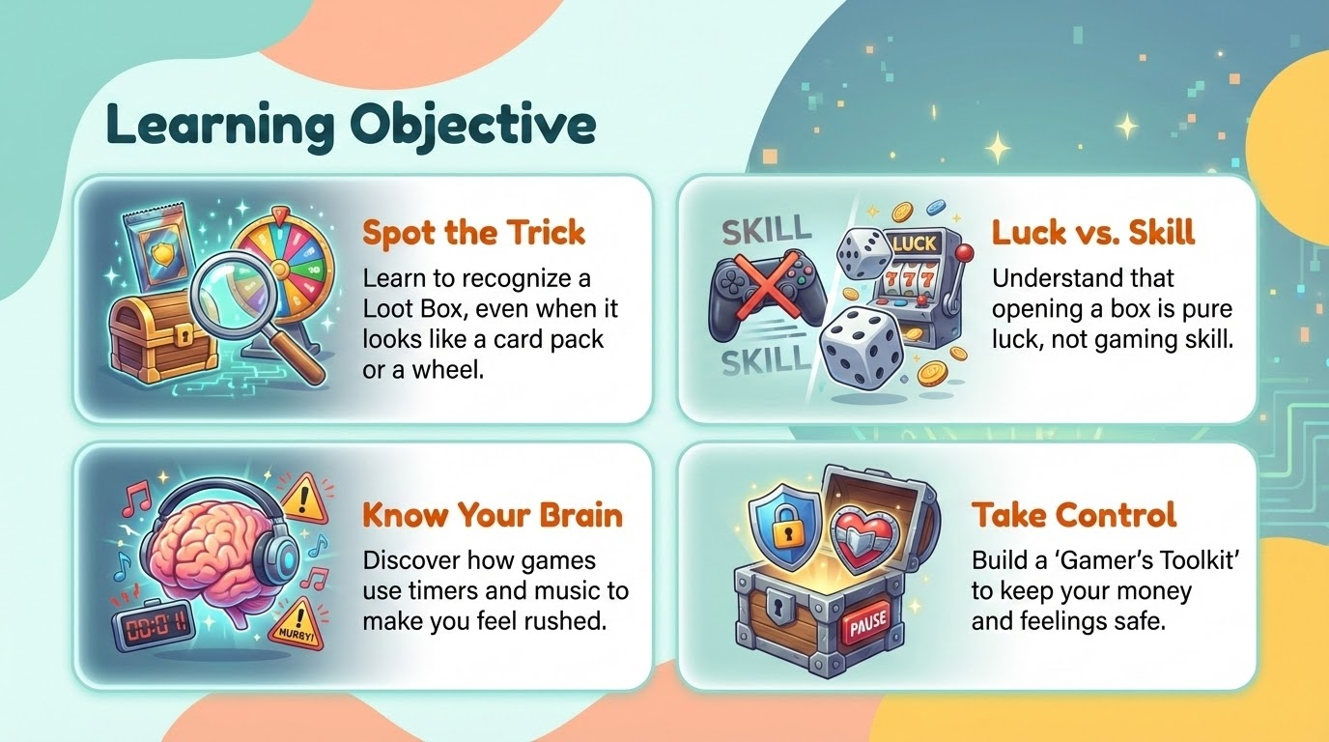
Notes:
"Today, we aren't learning math or spelling. We are going to level up our brains to be smarter gamers.
We have 4 missions today:
Find the Tricks: We will learn to spot a Loot Box, even if the game tries to hide it as a card pack or an egg.
Luck vs. Skill: We will learn the difference between being 'good at the game' and just getting lucky.
Understand Feelings: We will see how games use loud music and timers to make us feel excited or panicked.
Be the Boss: Most importantly, we will learn how to make sure YOU are the boss of the game, so the game doesn't trick you into spending money."

Slide 3
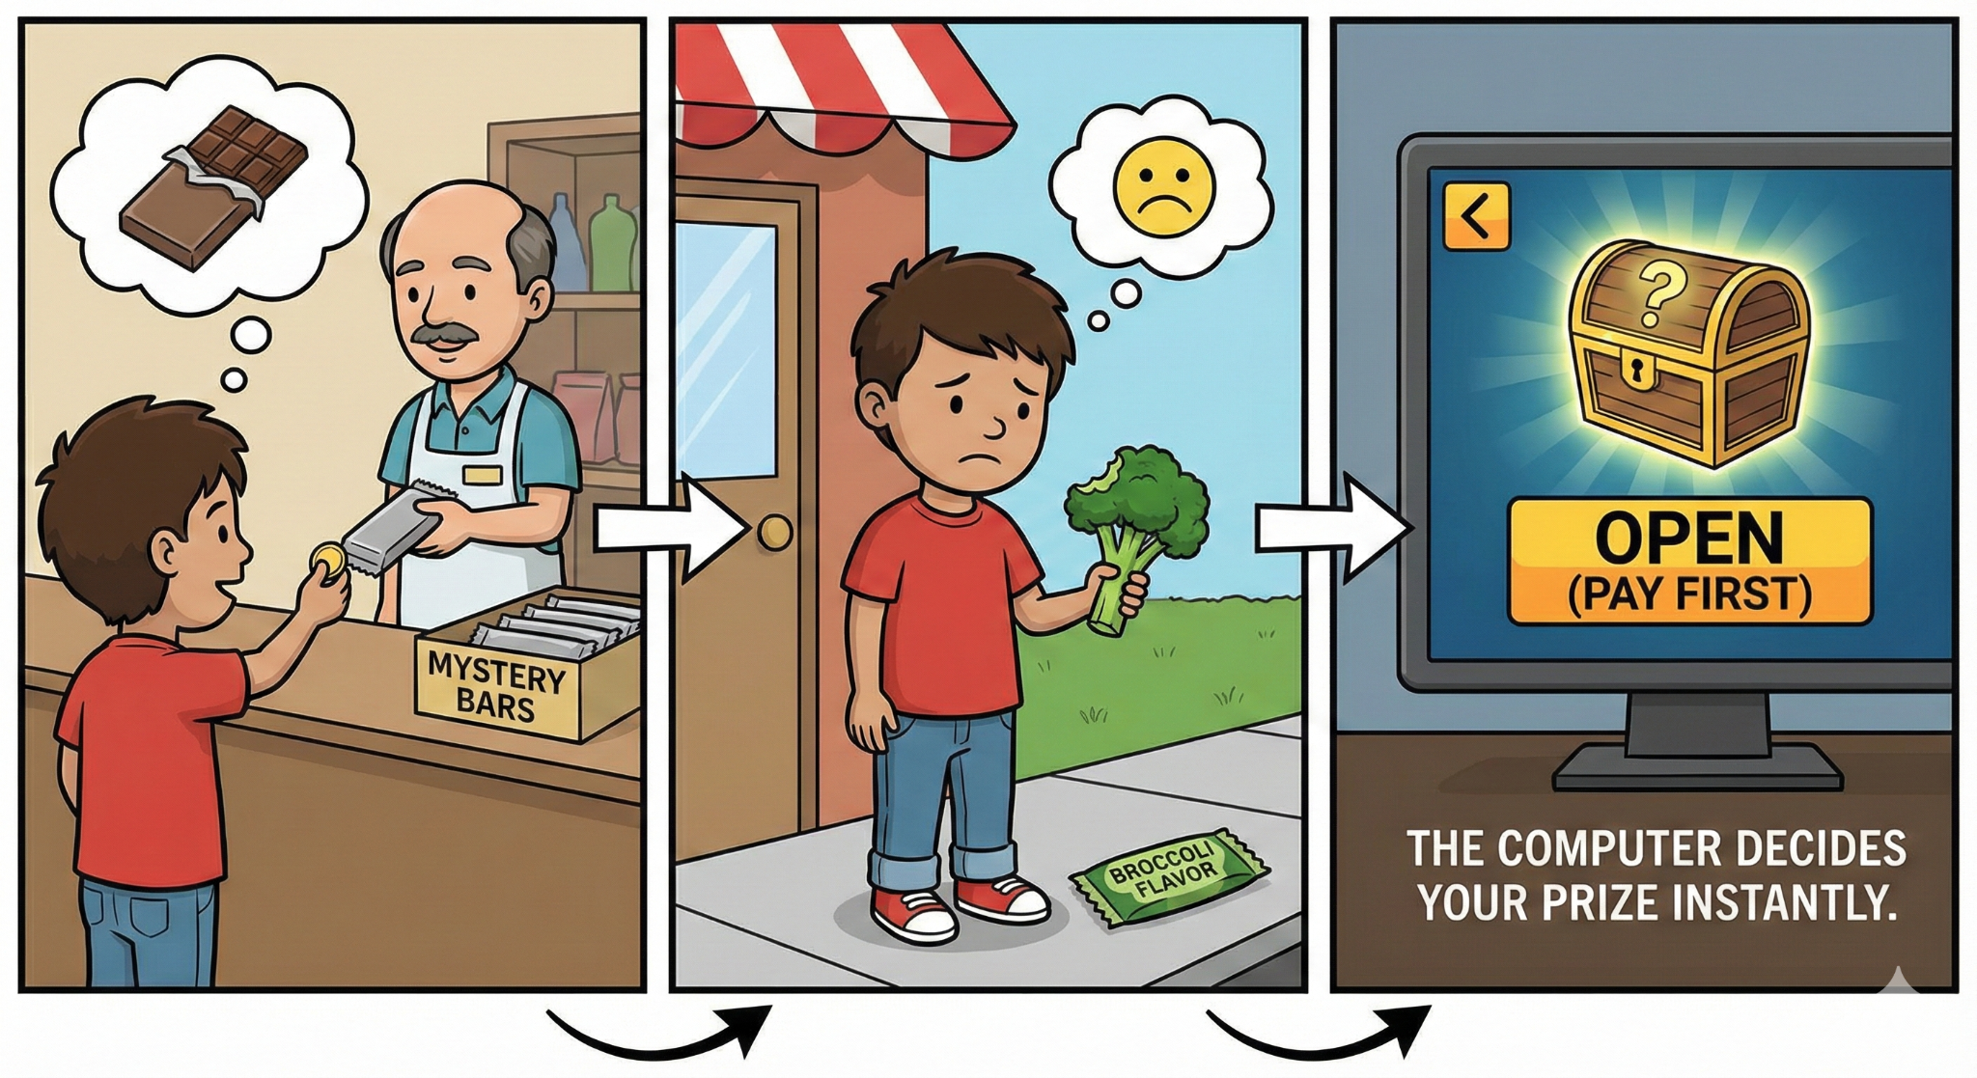
Notes:
"So, what exactly is this Mystery Box?
Imagine you go to the shop to buy a chocolate bar. But the shopkeeper has wrapped every bar in thick paper so you can't see the flavor. You pay your money first, you unwrap it, and... oh no! It's broccoli flavor! You wanted chocolate, but you got broccoli.
Adults call these ‘loot boxes’. Different games use different names, but if you pay before you know what you’ll get , that’s a loot box.
Here is a secret: You cannot control what you get. The computer decides the moment you click the button.

Slide 4
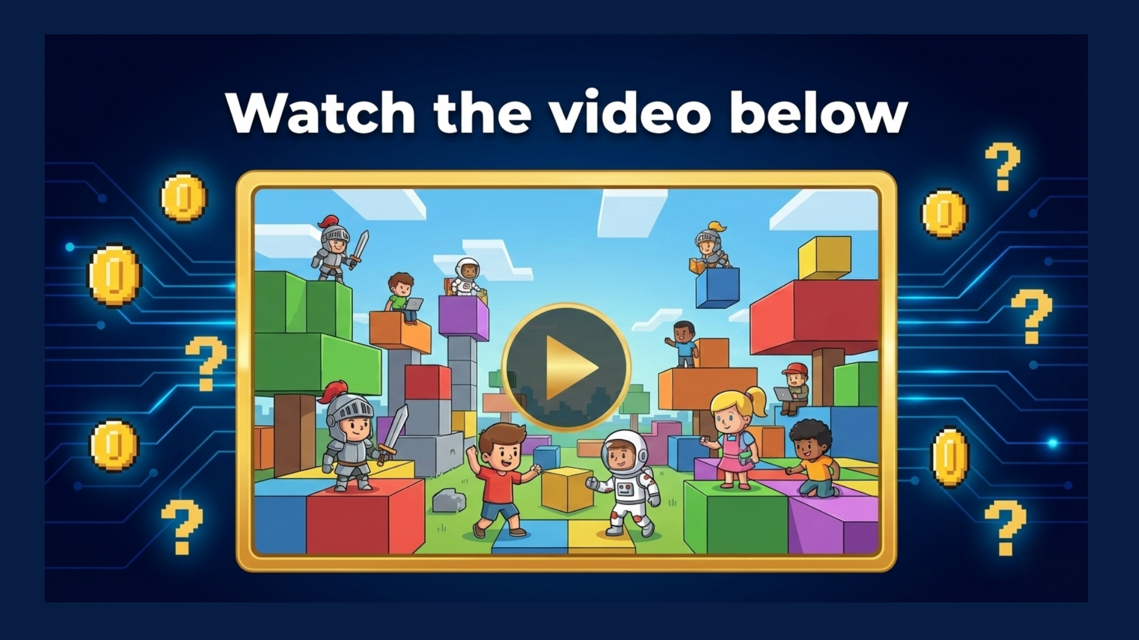
https://www.youtube.com/shorts/TzwiE4csP6k
https://www.youtube.com/shorts/TzwiE4csP6k
Notes:
https://www.youtube.com/shorts/TzwiE4csP6k
We are going to watch a video of a player in Roblox. He has 500,000 coins.
Imagine if you had to save that many coins. It would take months, right?
He is going to spend it ALL in less than 60 seconds to try and find a 'Legendary Halo' or rare item."
(Step 2: Watch the Video) (Play the video).
Wow, that was fast. Two things to notice:
The Robot Finger: Did you see the warning sign? He used a computer program to click the button for him. He did this because opening boxes is actually boring! He just wanted to get it over with.
The 'Impossible' Prize: He was looking for a Halo that is '0.04% rare'.
That number is hard to imagine. Think of it like this:
Imagine a giant football stadium filled with 10,000 boxes.
Only 4 of those boxes have the Halo.
All the other boxes are junk.
He spent half a million coins just to find those 4 tiny needles in the haystack. For a normal player like us, that is almost impossible." Do you want to see what that actually looks like (Go to the next slide)

Slide 5

Notes:
"Okay, we just saw that player looking for an item with a 0.04% chance. That is just a number on a screen, and it's hard to understand.
So, I want you to look at this picture. Imagine we are standing in a giant Football Stadium.
The Challenge:
There are 10,000 brown boxes on this field.
The 'Halo' prize is hidden inside only 4 of them.
All the other 9,996 boxes are full of junk.
The Reality Check: Imagine you are standing on that field. You have to pick ONE box.
Do you think you would find the Halo? (Wait for 'No').
You would probably have to buy thousands of boxes just to find it.
The Lesson: By the time you finally find the prize, you would have spent more money buying the boxes than the prize is actually worth. That is how the game wins, and you lose."
Class Discussion Question:
Teacher: "If I hid a chocolate bar in this classroom, it would be easy to find. But if I hid a chocolate bar in a whole football stadium... would you pay $5 to guess where it is?"
Students: "No!"
Teacher: "Exactly. That is what a Loot Box is."
"Looking at this giant stadium, ask yourself: Does being 'good at gaming' help you pick the right box? No. It doesn't matter how fast you click or how good your aim is. Picking the right box is 100% luck. No skill can help you here."

Slide 6
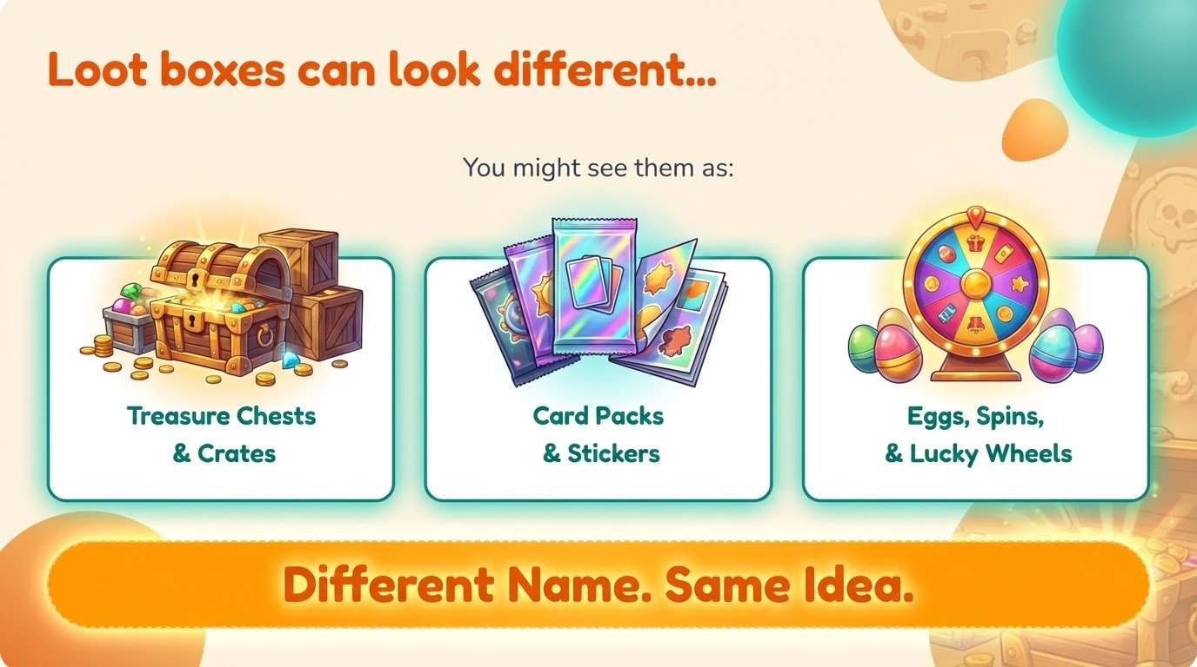
Notes:
Take a look at this screen.
We have been using the word 'Loot Box', but in your favorite game, it might not look like a box at all. Game designers are very clever,they change the shape to fit the game.
Look at the first picture: Treasure Chests & Crates. You see these in adventure games or shooting games.
Look at the middle picture: Card Packs. Raise your hand if you play football games like EA FC or basketball games. When you open a pack hoping for a rare player,that is a loot box.
Look at the last picture: Eggs and Wheels. Raise your hand if you play games like Adopt Me or Pet Simulator on Roblox. When you buy an egg to hatch a pet, or spin a wheel for a prize,that is a loot box too.
Read the orange bar at the bottom with me: 'Different Name. Same Idea.'
It doesn't matter if it looks like a shiny sticker pack or a cute egg. If you have to pay before you know what is inside, it is a loot box, and the trick is exactly the same."
Teacher Tip / Quick Interaction:
Ask: "Can anyone shout out the name of a game where they have seen one of these?"
Expect Answers: Fortnite (Llamas), Overwatch (Boxes), Roblox (Eggs), EA FC/FIFA (Packs), Brawl Stars (Drops).

Slide 7
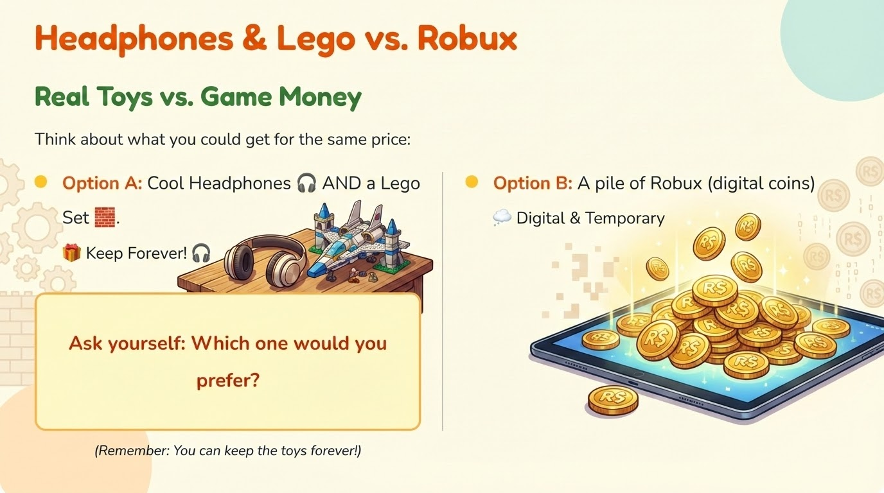
Notes:
"We all know how exciting it is to get a big pile of digital coins or gems in a game.
You use those coins to buy treasure chests, unlock special skins, or hatch surprise eggs. It feels great in the moment.
But let's look at what that money is actually worth in the real world.
Look at Option A: For the same price as a pile of game coins, you could buy a brand new pair of Headphones AND a Lego set.
Now look at Option B: The digital coins are fun, but they are stuck inside the screen. You cannot hold a treasure chest in your hands. You cannot put a surprise egg on your shelf.
The Lesson: With Option A, you keep those toys forever. You can build the Lego today, break it down, and build it again in ten years.
So, before you spend your pocket money on digital coins, just ask yourself: 'Would I rather have the digital points that might disappear, or the real toys that last forever?'"
Class Discussion / Quick Interaction:
"I want to take a vote. Be honest!
Raise your hand if you would choose the Digital Coins (Option B).
Now raise your hand if you would choose the Headphones & Lego (Option A).
(Acknowledge the split). It is okay to want the coins! But now you know exactly what you are trading for them."

Slide 8
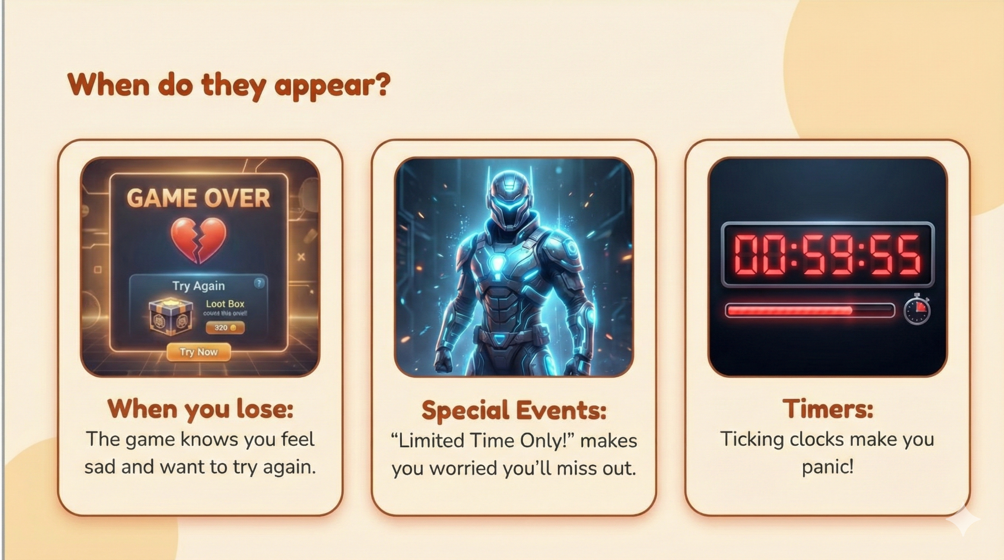
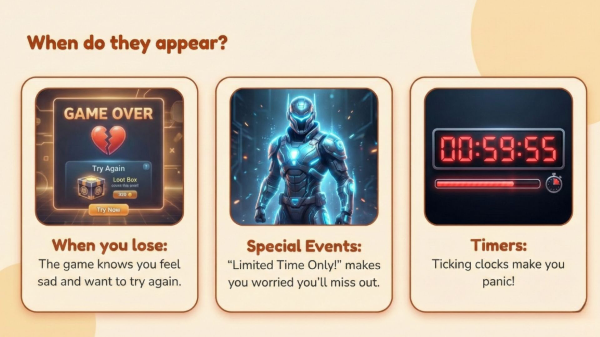
Notes:
Before we learn how to handle our feelings, we need to become detectives. We need to spot when the game tries to mess with our emotions.
Look at the screen. These are the three main traps:
The 'Game Over' Screen: You just lost a match. You feel frustrated or angry. That anger is a Big Feeling. The game shows you a loot box right now because it knows you want a quick way to win next time.
The 'Special Event' Glow: You see a shiny new character skin. You feel super excited and hyper! That excitement is a Big Feeling.
The Timer: You see a clock ticking down: 'Only 59 minutes left!' You feel panicked and rushed. That panic is a Big Feeling.
The Definition: When we say 'Big Feeling,' we mean an emotion that is so strong, it turns off the 'thinking' part of your brain. When you are Mad, Hyper, or Panicked, you stop thinking and start clicking."

Slide 9
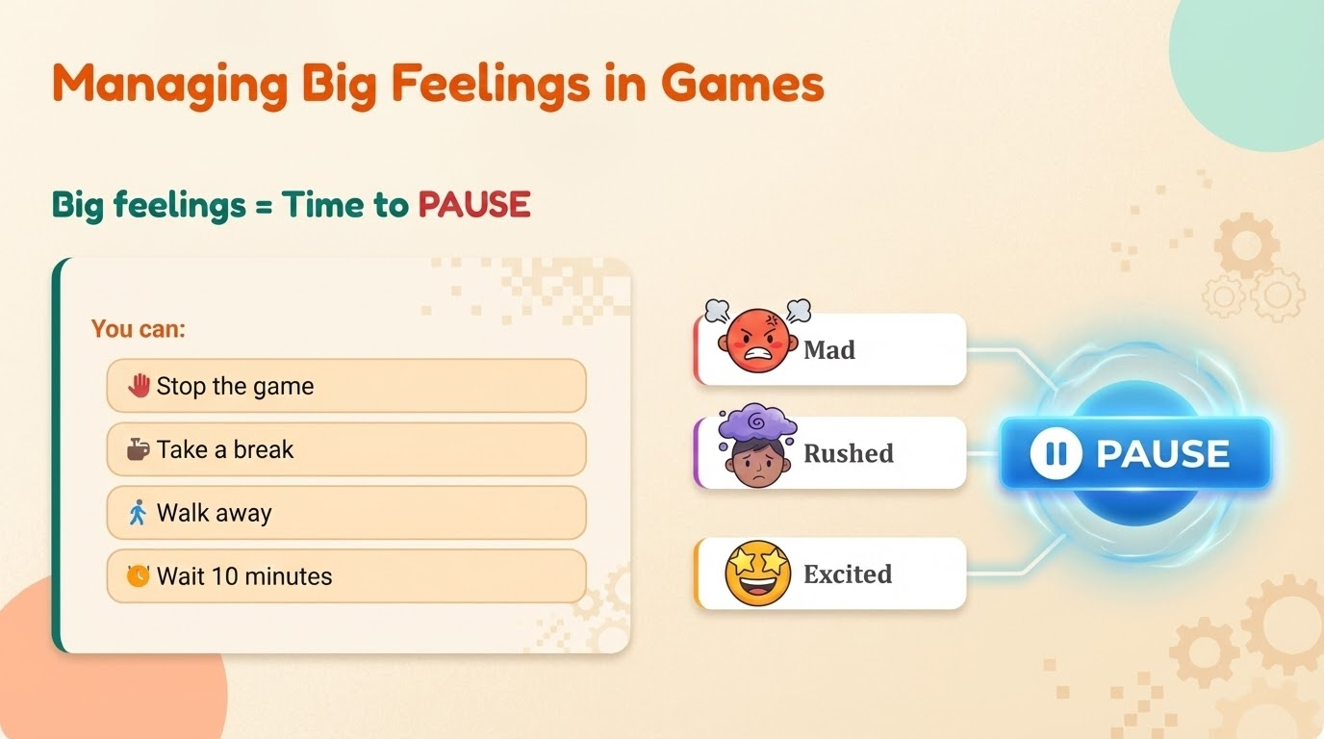
Notes:
"So, we just saw that games try to make us feel Mad, Rushed, or Excited on purpose.
When that happens, your brain is in the 'Danger Zone.' You might accidentally spend money just to make the feeling go away.
So, what is your secret weapon? The PAUSE Button.
Whenever you feel one of those Big Feelings, look at the checklist on the left:
Stop the game: Put the controller down immediately.
Walk Away: Physically leave the room. It breaks the spell.
The 10-Minute Rule: Tell yourself, 'I will wait 10 minutes.' Usually, after 10 minutes, the panic or anger disappears, and you realize you don't need to buy the item."
Class Discussion: Where else do we see this?
"These tricks aren't just in video games.
Ask the class: 'Think about when you go to a toy shop or a supermarket. Have you seen those little 'surprise bags', wrapped boxes,
go to the next slide

Slide 10
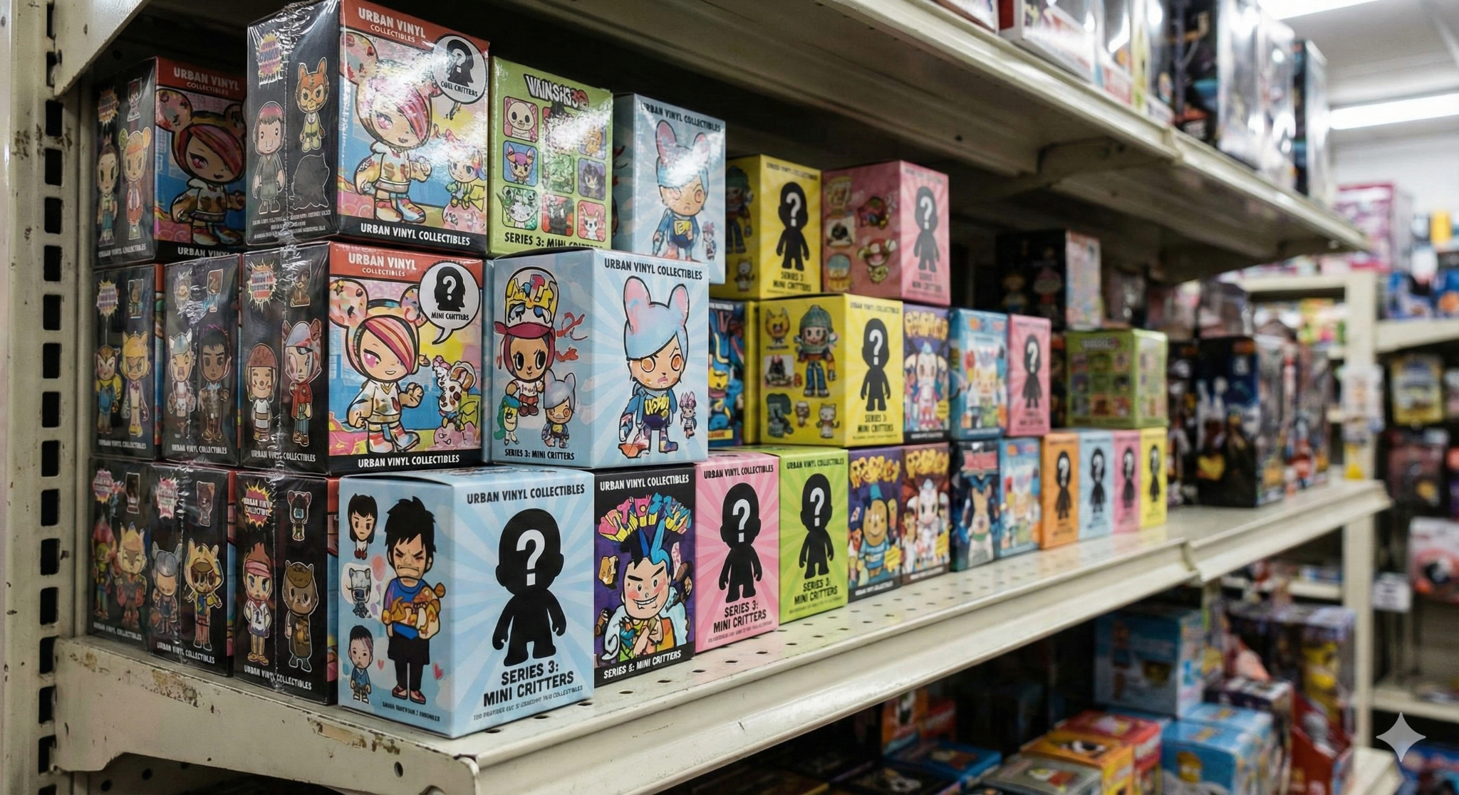
Notes:
"Let's pause online game for a second and look at the real world.
Ask the class: 'Put your hand up if you have seen these in a supermarket or toy shop?'
These are physical Loot Boxes. You buy the box because you want the 'Gold' or 'Rare' figure on the back of the packet. But you can't see inside. You pay your money, you open the box, and... oh no. It's the same one you already have at home.
That disappointed feeling? That is exactly what video games are copying.
Whether it is a box in a shop or a digital chest in Fortnite, the trick is the same: They want you to pay for the chance to win, not for the prize itself."

Slide 11
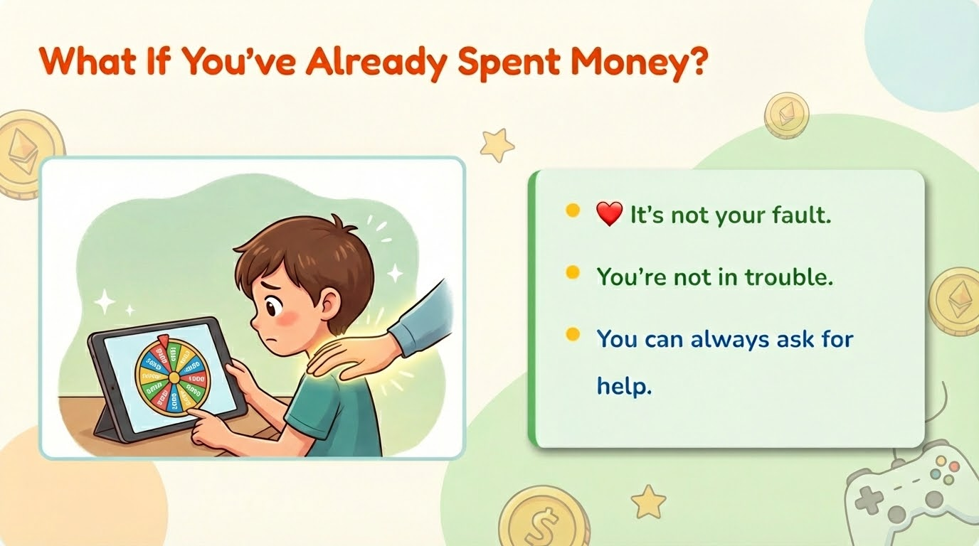
Notes:
I know that while we have been talking today, some of you might be sitting there thinking, 'Uh oh... I think I already did this. I spent money and I didn't tell anyone.'
If you are feeling that way, I want you to look at the three points on the screen.
First, It is not your fault. Remember, we learned that these games are built by experts who know exactly how to trick your brain. If you fell for the trick, it doesn't mean you are 'bad'. It means the trick worked.
Second, You are not in trouble. Your parents care about you more than the money. They want to help you stay safe.
Third, You can always ask for help. Secrets feel heavy. Sharing the secret makes it light again.
Look at the picture,see the hand on the shoulder? That is what adults are there for. If you made a mistake, go home today and say, 'I learned about game tricks today, and I think I need help checking my game

Slide 12
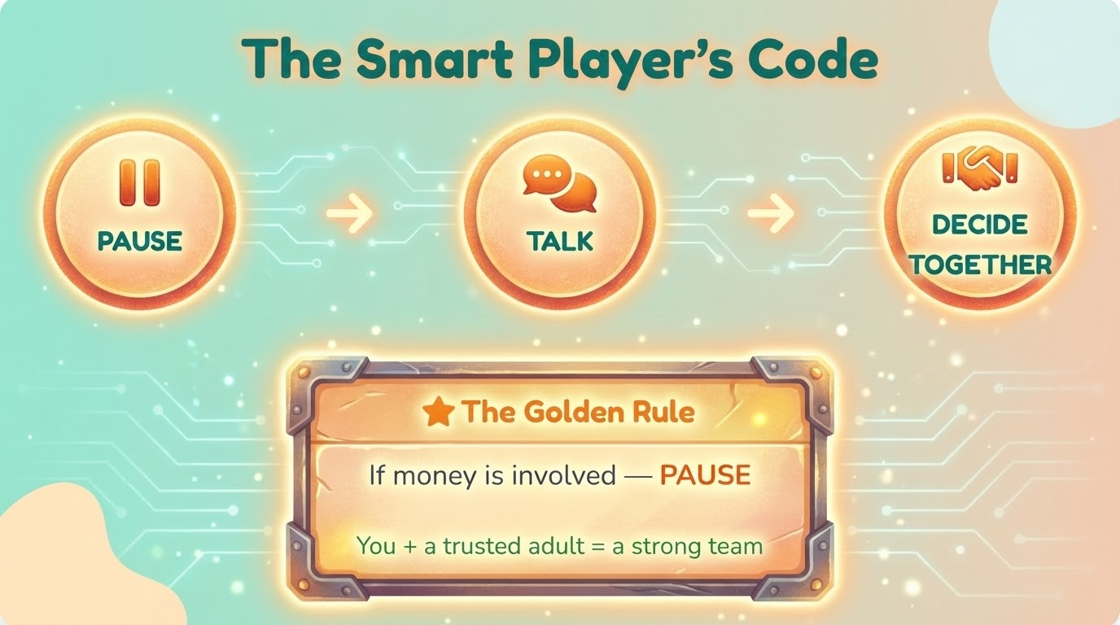
Notes:
Okay, we learned a lot about tricks today. But you don't need to remember everything. You just need to remember this Secret Code.
Whenever you are playing a game and you are about to spend something, follow these three steps:
PAUSE: Stop your fingers! Take a breath.
TALK: Go find your trusted adult. Show them the screen.
DECIDE TOGETHER: Ask them: 'Is this a trick? Or is it safe?'"
(Step 2: What Counts as 'Money'? - Important!) "Look at the orange box: 'If money is involved — PAUSE.'
Now, this is the tricky part. 'Money' doesn't just mean dollars or pounds.
In a game, Money looks different.
If it costs 500 Gems... that is Money. PAUSE.
If it costs 100 Gold Coins... that is Money. PAUSE.
If you are opening a Treasure Chest or a Surprise Egg... that is Money. PAUSE.
Even if it looks like just a shiny game item, remember: someone paid real money to get it."
(Step 3: The Team) "Read the bottom line with me: 'You + a trusted adult = a strong team.'
Games have hundreds of people trying to trick you. But if you grab an adult to help you look at the screen, you become a Super Team that can't be tricked."

