Slide 1
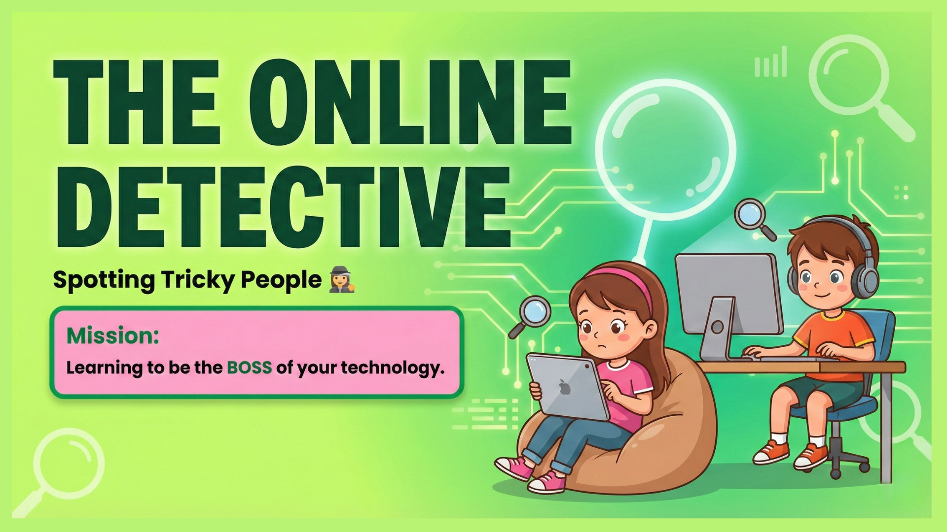
Notes:
"Good morning everyone. Today, we are going to be detectives.
"We all use the internet for games, homework, or watching videos. But, just like in the real world, there are strangers online.
"Today is not about banning games or taking away iPads. It is about learning how to spot 'Tricky People' strangers who might try to trick you.
"We are going to learn the clues to spot them, so you understand why we avoid strangers online, even if they seem friendly

Slide 2
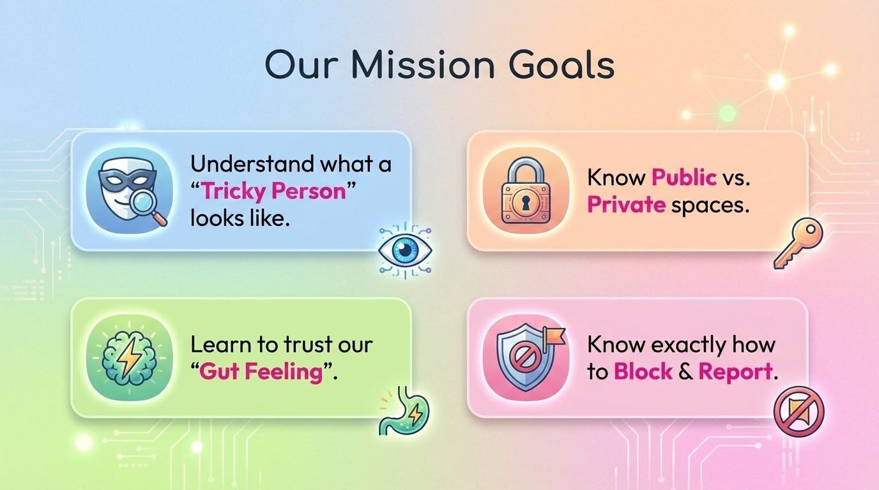
Notes:
"These are our goals for the next 30 minutes.
"First, we are going to learn to spot 'Tricky People
"Second, we will learn why public spaces are safer than private chats.
"Third, we will talk about a special alarm system you have inside your own body called your 'Gut Feeling.'
"And finally, we will make sure you know exactly which buttons to press to stay safe. By the time we finish, you will be amazing detectives online.

Slide 3
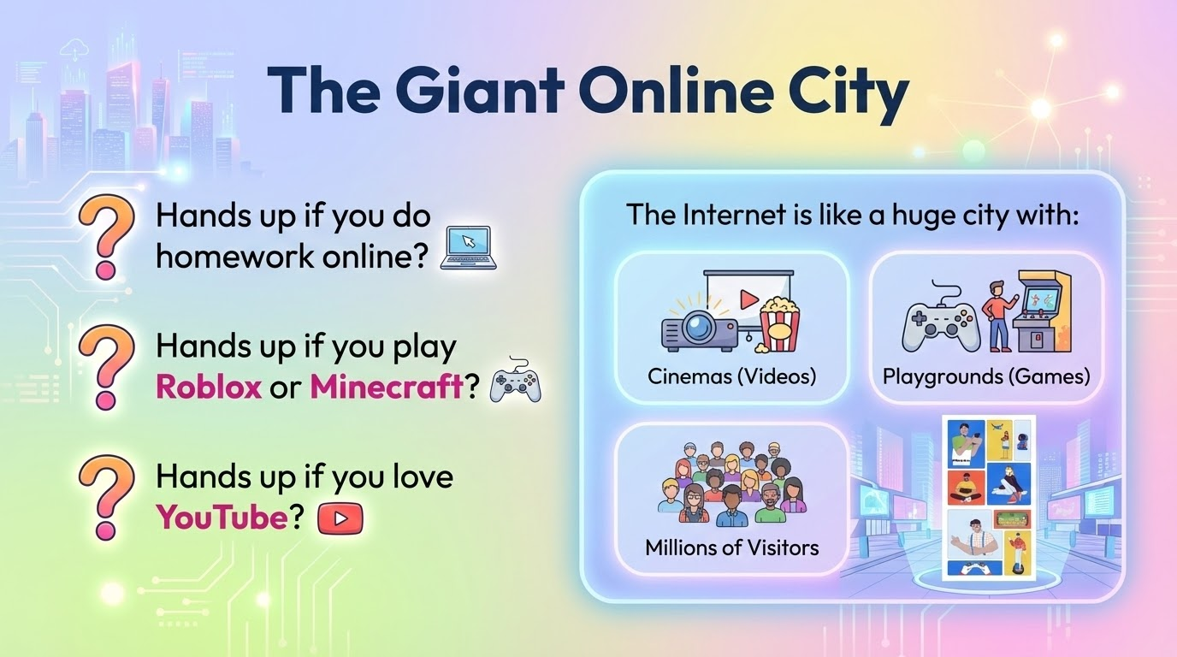
Notes:
"Let's start with a check-in. Hands up if you love playing Roblox, Minecraft or any other games online? Keep them up... okay, now hands up if you prefer just relaxing and watching funny clips on YouTube?
"Whether you are building a house in a game or just watching videos, we are all visiting the same place: the Online World.
"I want you to imagine the internet is like a gigantic city. It has millions of people in it every single day. Some are playing, some are working, and some are chatting.
"Now, because this city is so big, there are people there we know, like our friends and family, but there are also millions of strangers. Today, we are going to talk about a specific type of stranger. We call them 'Tricky People.'
"We don't call them 'Monsters' because usually, they don't look scary at all. In fact, they can seem really friendly. We call them 'Tricky People' because... they use tricks to make you think they are your friend. They might joke with you, offer you help in a game, or seem really cool, but their goal is to trick you into breaking safety rules."

Slide 4
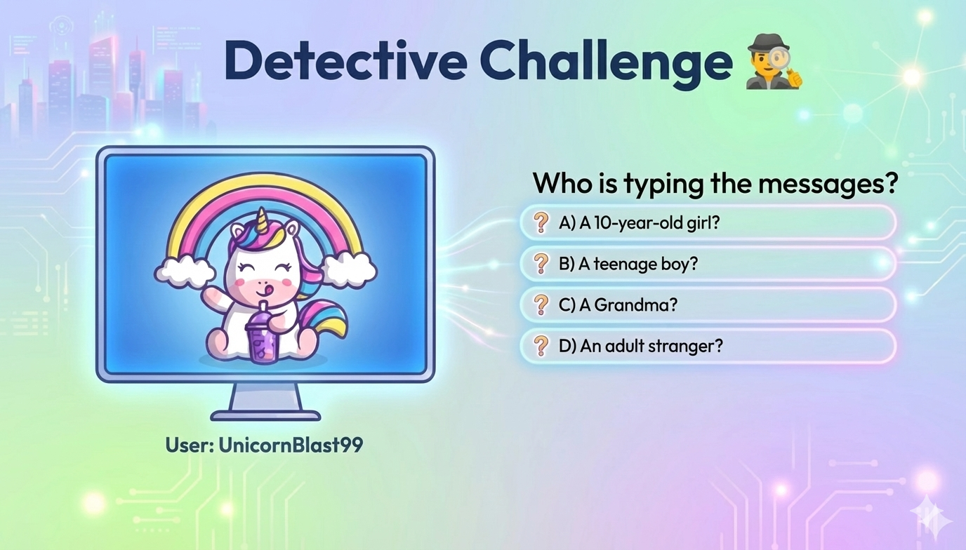
Notes:
"Here is your first Detective Challenge. Look at this profile: 'UnicornBlast99'. They have a cute picture; they use lots of emojis.
"I want you to guess who is actually sitting behind the keyboard typing the messages. "Raise your hand if you think it's A ,a 10-year-old girl? "Raise your hand if you think it's B, a teenager? "How about C, could it be a Grandma? "Or D, an adult stranger?
"Okay, hands down. The correct answer is... we have absolutely no idea. It could be any of them. Even a grandma can choose a unicorn picture! An adult man can choose a princess picture." It could just be anyone at all and we can never ever really know who it is.

Slide 5
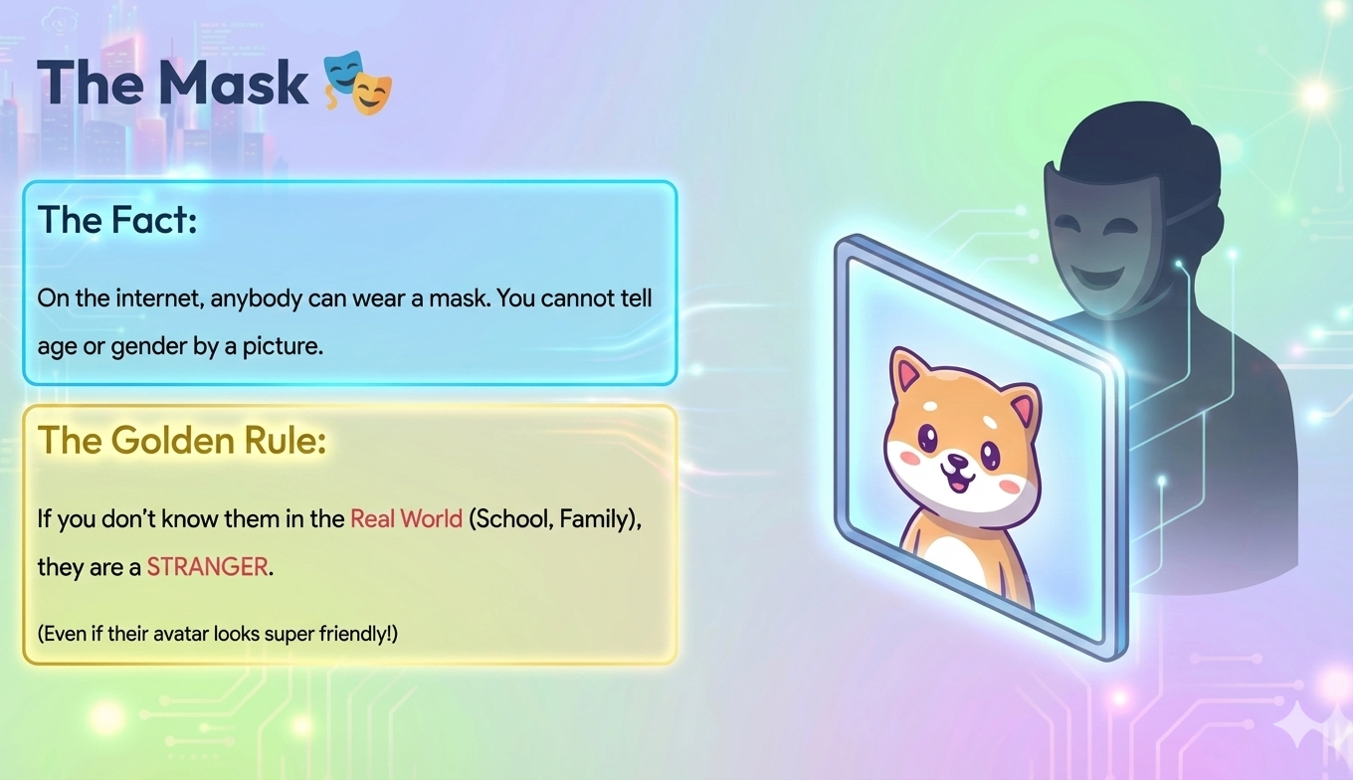
Notes:
"This leads us to our first major rule today: We never trust a profile picture.
"On the internet, anybody can wear a mask. A 'Tricky Person' knows that if they used their real photo, you wouldn't talk to them. So, they pick a mask,a cool avatar or a cute name to make you feel safe.
"So, here is the definition of a stranger online: If you do not know them in the real world,if you don't see them at school or in your family,they are a stranger. Even if you have played a game with them every day for six months, if you haven't met them in real life, you don't know who they really are."

Slide 6
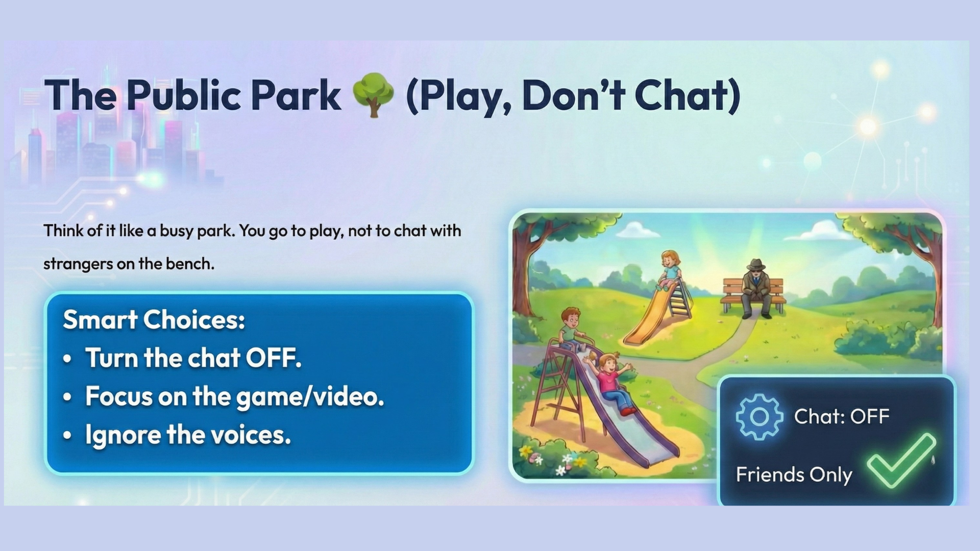
Notes:
I want you to picture a busy park in your head.
"Imagine you go there with your friends to play football or go on the swings. You are there to have fun and play the game.
"There might be strangers sitting around the park, but you wouldn't stop your game to go and tell them your life story, would you? Of course not. You would ignore them and keep playing with your friends.
"The internet is exactly the same.
"When you are in a game like Roblox, or watching a video on Youtube or some other app, you are in a Public Place. 'Public' means anyone in the world can be there at the same time as you.
"Just like in the real park, you are there to play the game, build your house, or watch the video. You are not there to talk to the strangers. So always as a first rule if you can switch off the chat function, do that first. Ask an adult on how to do this.

Slide 7
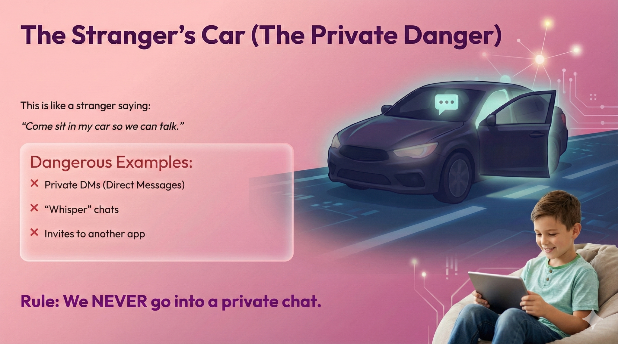
Notes:
"Now, here is the big danger.
"Imagine if that stranger at the park stood up and said: 'Hey, it is too noisy here. Come sit in my car so we can talk just the two of us.'
"You would run away immediately, right? You know that is dangerous because it is Private. No one can see you inside a car.
"In the online world, a 'Private Chat' or a 'Direct Message' (DM) is exactly the same as getting into that stranger's car.
"Tricky People want to move you to a private chat so they can hide. They want to say things to you that they don't want other people to see.
"They might say, 'Send me a friend request,' or 'Let's chat on a different app.'
"So, the rule is simple: We do not chat with people we don't know.
"If a stranger asks you to chat in private, do not answer.. Stop what you are doing and go tell a trusted adult straight away."

Slide 8
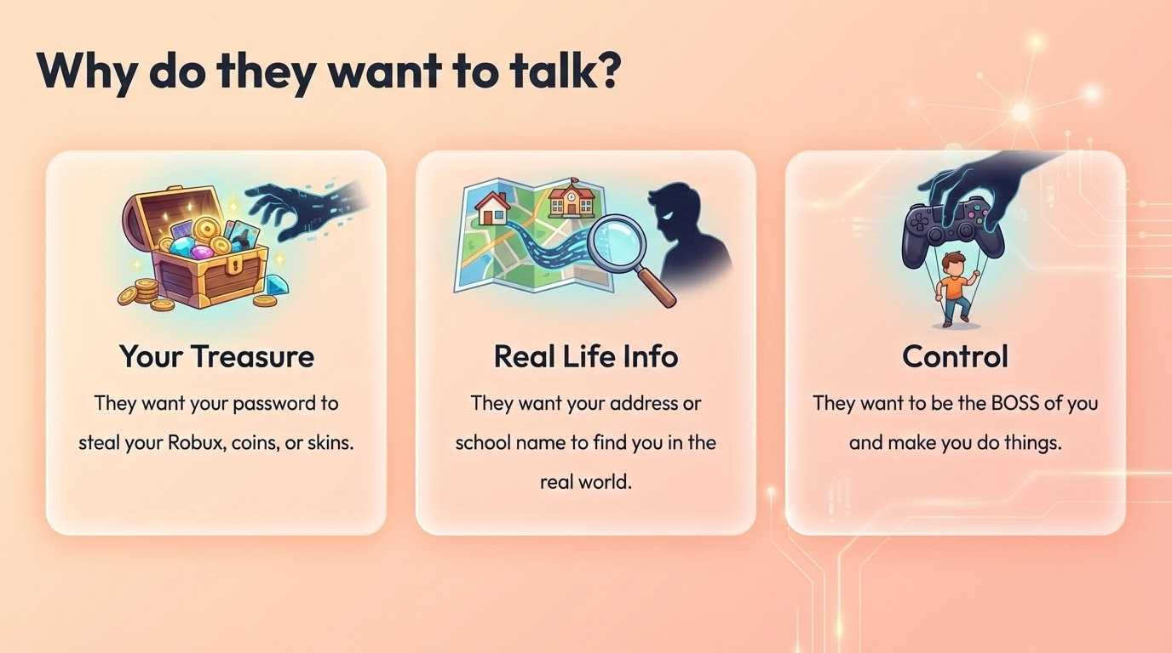
Notes:
"You might be thinking, 'I don't have any money, so why would a stranger talk to me?'
"Actually, you have three things they want.
"1. Your Digital Treasure. "For the gamers, this is easy to understand. Your Roblox pets or Minecraft worlds are valuable. You worked hard for them. Tricky people want to trick you into giving them your password so they can log in and steal them.
"But even if you don't play games, you still have treasure. "Think about your YouTube history, your digital drawings, or your school work. "If a stranger gets your password, they can come in and delete everything you have made. They want to break into your account and mess up your hard wor
2. Your real life info : Keep Your Location Secret Online
Sometimes people online might ask:
"What school do you go to?"
"What street do you live on?"
Never tell them!
These answers tell strangers where to find you. A bad person could use this information to look for you or trick you by pretending they know you.
Only share where you live or go to school with people you know in real life, like your family and friends.
If someone online asks where you are, stop talking to them and tell a parent, teacher, or trusted adult right away.
3. They Want to Be the Boss
Sometimes people we don't know might try to get us to do things like:
Keep a secret from your mom or dad
Send them a picture
Say something mean to a friend
Why would they do this? They're testing to see if you'll listen to them.
Think about real life: If someone tries to make you do something wrong like at school, at the park, or anywhere else, you would say no and tell a trusted adult like a teacher or your mom and dad, right?
It's the same thing online! You're in charge of what you do.
If someone asks you to do something that feels weird or wrong, you can:
Say no
Stop talking to them
Tell a parent or trusted adult right away
You have the power to make good choices both in real life and online and this is also why we don't chat with strangers online!

Slide 9
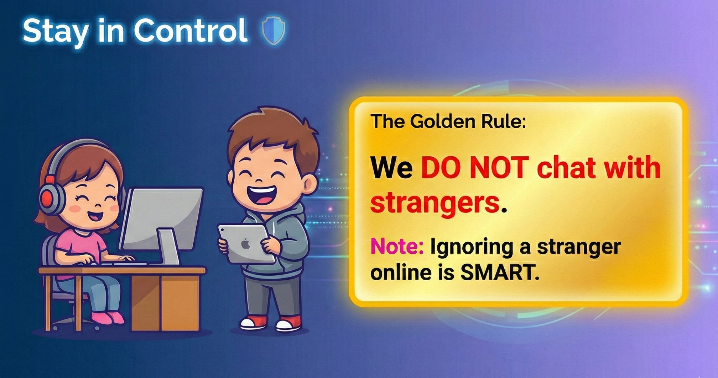
Notes:
You're the Boss of Your Screen!
The most important rule is: We don't chat with strangers online.
You can still:
Play your games
Watch videos
Have fun!
But you don't need to type back to people you don't know.
In real life, we're polite. If someone says hello, you say hello back.
But online is different! If a stranger messages you saying "Hi!" or "What's your name?" or "Wanna be friends?"you don't have to answer.
Ignoring strangers online is NOT rude,it's smart! It keeps you safe and keeps your game fun.
Remember: Just because someone can send you a message doesn't mean you have to reply.
Now let's say it together:
"I am the boss of my screen!"
"I don't chat with strangers online!"

Slide 10
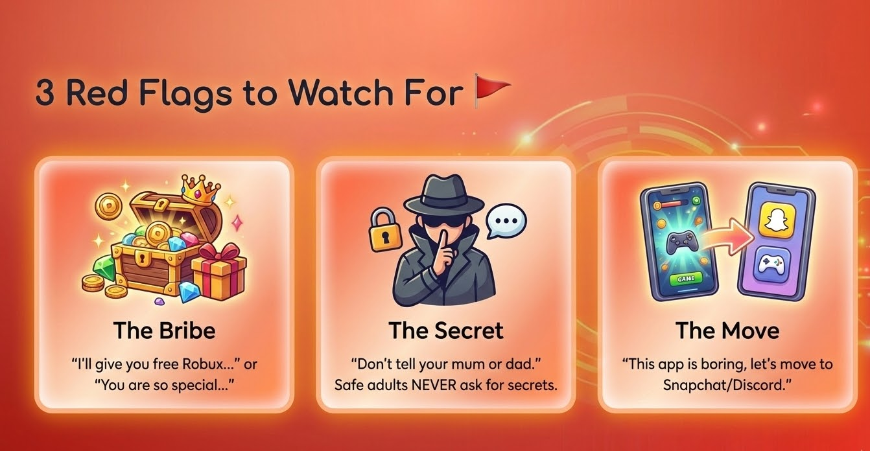
Notes:
If a stranger messages you online, watch out for these 3 tricky things:
Red Flag 1: The Bribe
This is when someone tries to give you something to make you trust them. They might promise you free things like Robux, game skins, gift cards, or toys. But sometimes the bribe is just nice words. They might say things like "You're so much smarter than your parents" or "You're my only friend who gets me." They're saying these things to trick you into trusting them so you'll do what they say.
Red Flag 2: The Move
This is when someone says "This chat is boring, let's talk on Snapchat instead" or "Add me on WhatsApp." Remember, they're trying to get you away from the safe place into a private place where no one else can see what they're saying. Don't go with them to a different app!
Red Flag 3: The Secret-This is the Most Important One!
If someone ever says "Don't tell your parents" or "Keep this between us" or "This is our secret", that's the biggest warning sign! Safe adults are always happy for your parents to know who you're talking to. If someone asks you to keep a secret from your parents or teachers, stop talking to them and tell a trusted adult right away!

Slide 11
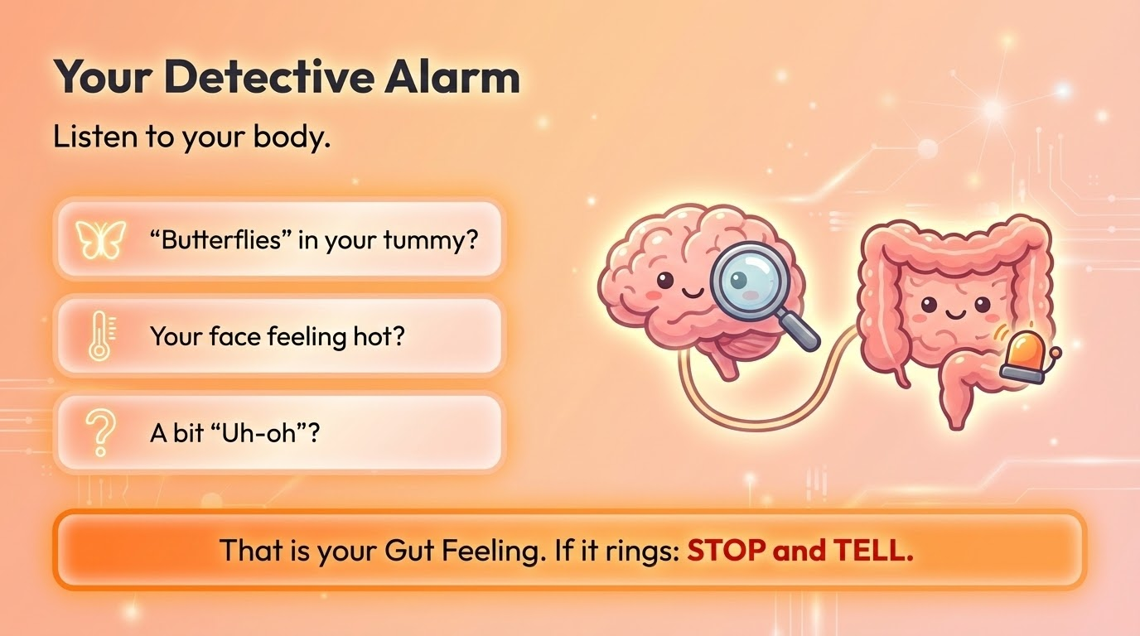
Notes:
We just learned not to share information about ourselves with strangers online. But tricky people are good at pretending to be nice. They might not ask for personal information right away. So how do we know if someone is safe or not?
Detectives have tools like magnifying glasses. But you have something even better already inside you, your Gut Feeling!
What's a Gut Feeling?
Have you ever felt:
Butterflies in your tummy?
Your face getting hot?
Your heart beating faster?
That "Uh-oh, something's not right" feeling?
Quick question: Can you think of a time when you had that "Uh-oh" feeling? Maybe when you were about to do something you knew wasn't right, or when something felt strange? Raise your hand if you've ever felt that!
That's your body's way of warning you that something might be wrong!
Your brain is super smart. Sometimes it spots danger before you even realize it, and it sends a signal to your body. It's like your own superpower.
So here's what to do: If you're online and someone asks you for a photo, asks you to keep a secret, or says anything that gives you that wiggly "Uh-oh" feeling, LISTEN TO IT!
That feeling means:
STOP what you're doing
Don't reply to the message
Close the app or device
Tell a trusted adult right away
Your gut feeling is there to protect you-always trust it!

Slide 12
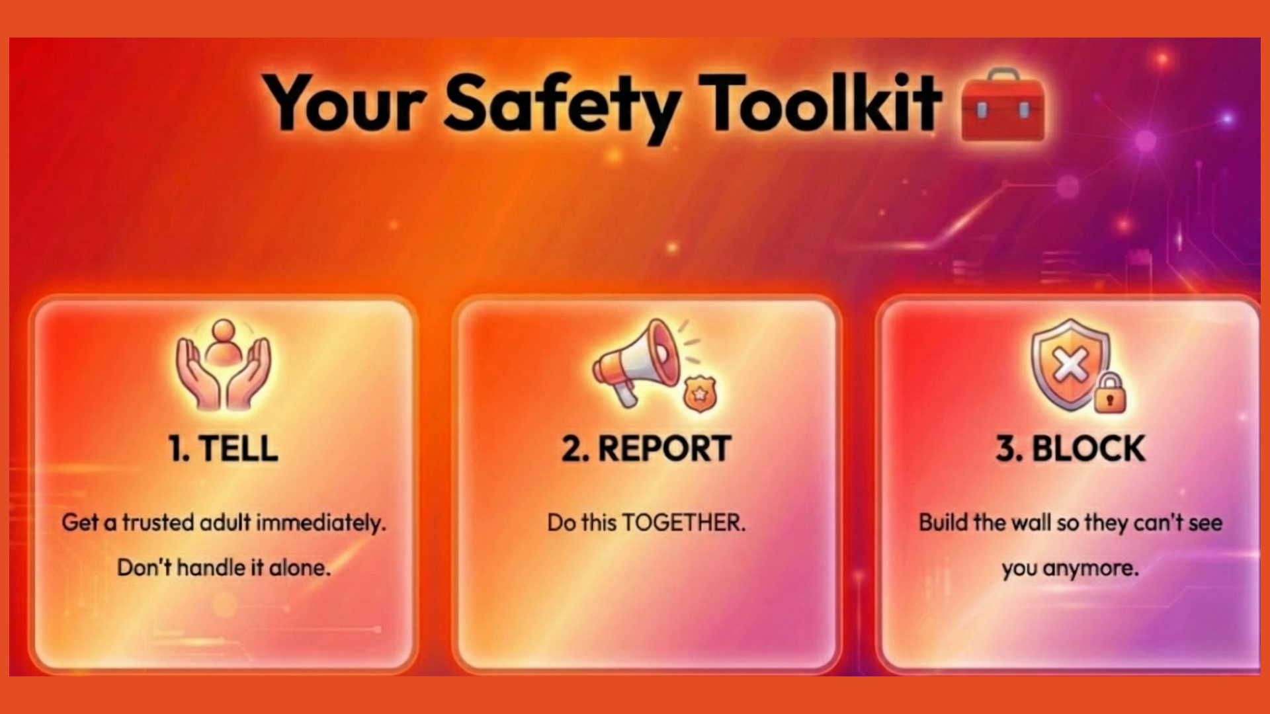
Notes:
We've learned how to spot tricky people, but what should you do if you actually meet one?
Now first let me ask you something: What's the first thing you do when you get into a car?
[Wait for answers: "Put on a seatbelt!"]
Exactly! You put on your seatbelt! You don't wait until there's a problem to look for it, right? You put it on straight away so you're ready and safe.
It's the same with games and apps online. Before you start playing any new game or app, ask yourself: "Where is the Block button? Where is the Report button?"
Find these buttons when everything is calm, so you know exactly where they are if something goes wrong. They're your safety buttons, just like a seatbelt!
Now, If You See a Tricky Person, Follow These 3 Steps:
Step 1: STOP and TELL
Don't try to handle it by yourself. Stop what you're doing and get a trusted adult right away. Bring them to the screen to show them what happened.
Step 2: REPORT (Do this with your adult)
Reporting is like calling the police for the internet. It sends the tricky person's messages to the people who run the game so they can stop that person from bothering other kids too. Your adult will help you do this the right way.
Step 3: BLOCK
After you report them, you block them. This builds a wall so they can't message you or see you anymore.
Let's say it together: STOP and TELL → REPORT → BLOCK

Slide 13
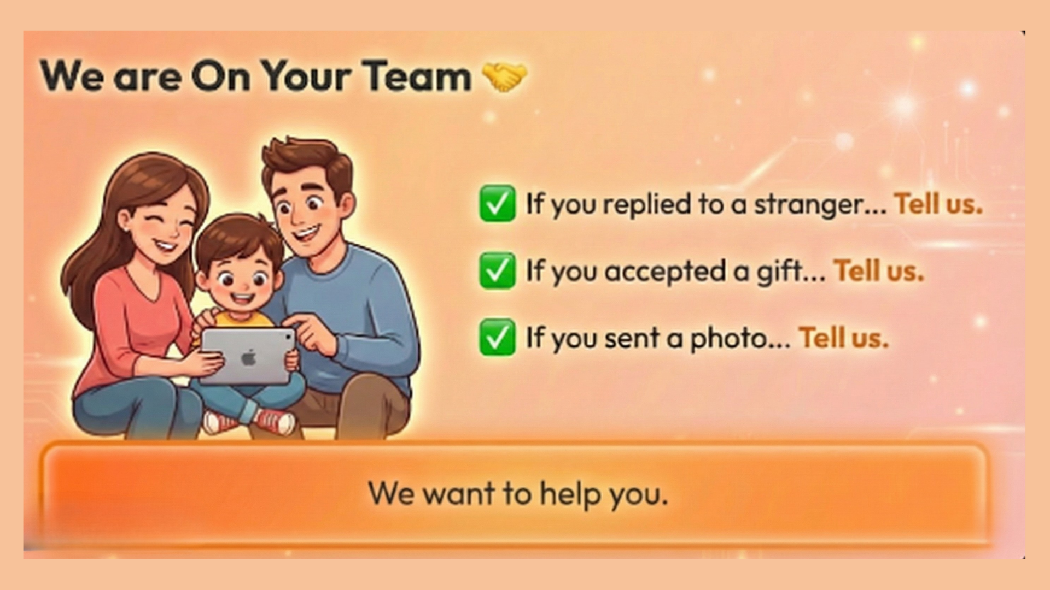
Notes:
The Most Important Thing You Need to Know
This is the most important part of everything we've talked about today. Please listen carefully.
Sometimes, kids don't tell their parents or teachers about tricky people because they're worried. They think things like:
"Mum will take my tablet away"
"I'll get in trouble"
"They'll be angry at me"
But here's what I need you to know:
If a tricky person bothers you online, they are the one doing something wrong,not you.
Even if you made a mistake,even if you:
Replied to them
Accepted something from them
Sent them a photo
Broke a rule
PLEASE TELL US ANYWAY.
Your parents and teachers will not be angry at you. We will be glad you told us because now we can help you! We can block that person and make it stop.
We are on your team. Our job is to keep you safe, not to punish you.
You will never get in trouble for telling the truth about someone being tricky online. You did the brave thing by telling us.

Slide 14
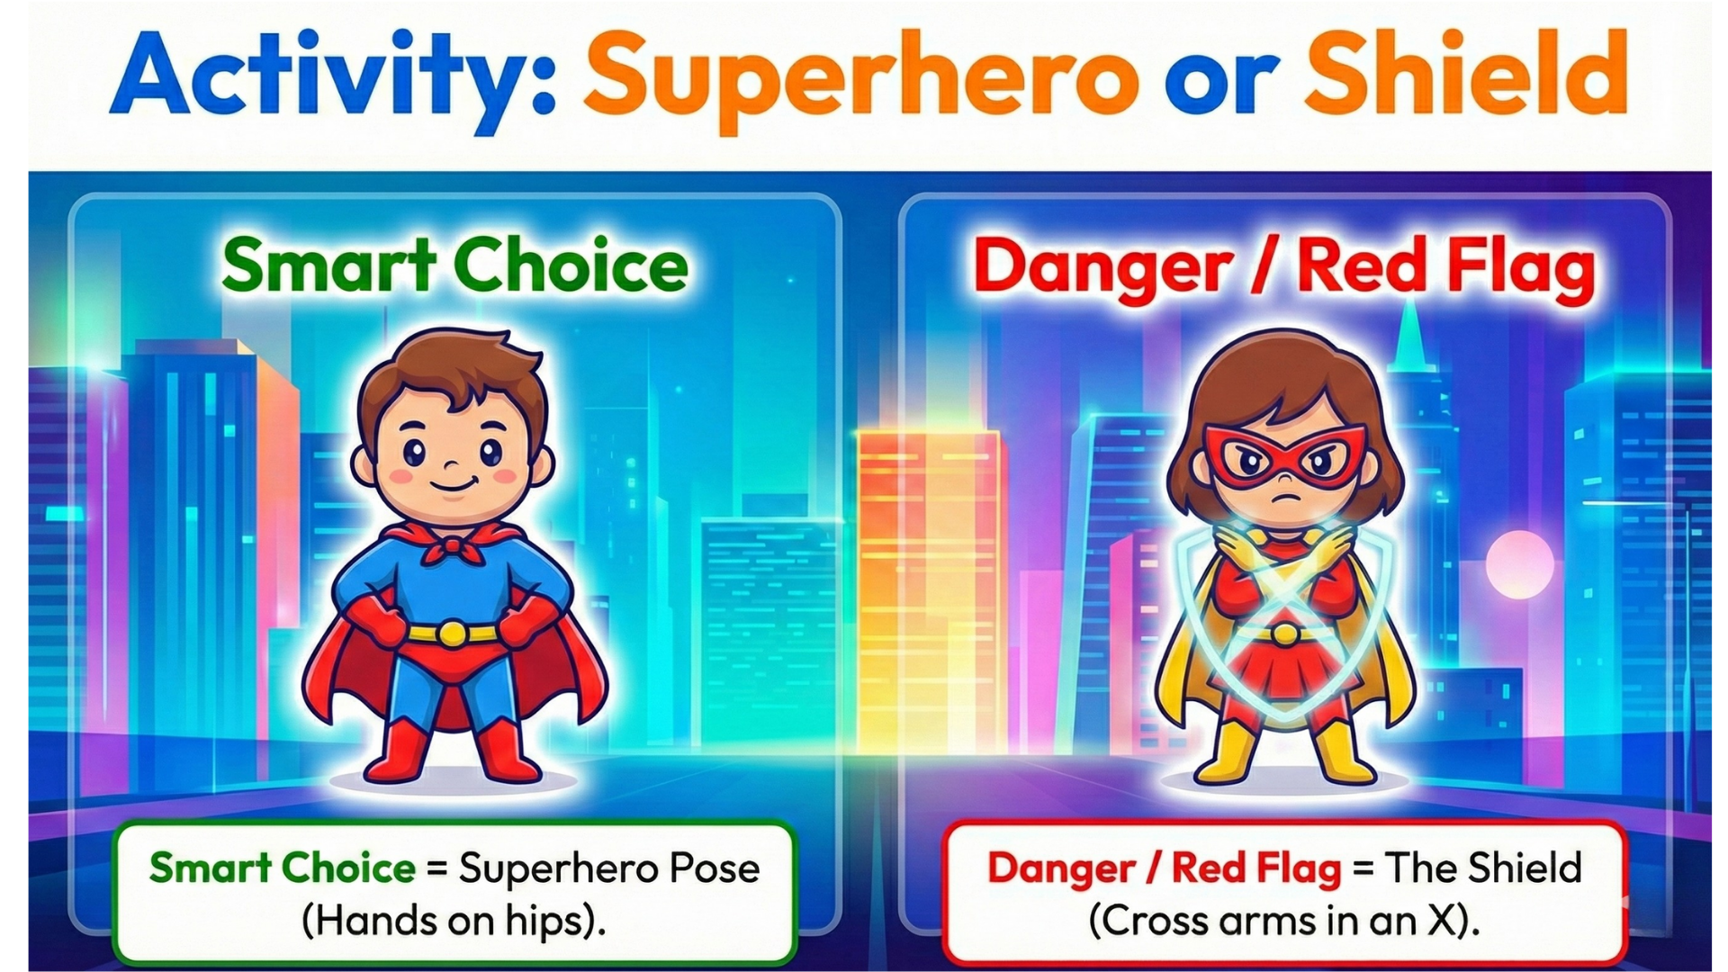
Notes:
Okay, detectives. Let's play 'Superhero vs. The Shield.'
"Here is how it works: I will read a story.
"If it is a Smart Choice, I want to see your Superhero Pose! Put your hands on your hips. [Teacher demonstrates]
"If it is a Danger, I want to see your Shield! Cross your arms in a big X to block it. [Teacher demonstrates]
"Ready? Listen carefully.
"Scenario 1: You are playing a game. You decide to turn the chat OFF because you just want to build your house in peace. "Show me: Is that a Smart Superhero choice, or a Danger Shield?" (Wait for action) "SUPERHERO POSE! Correct. You are the boss of your game. You made a smart choice.
"Scenario 2: A player messages you and says: 'I have a secret cheat code. Add me on Snapchat and I will whisper it to you.' "Show me: Do you stand like a Superhero, or do you put up your Shield?" (Wait for action) "SHIELDS UP! (The X) Correct! That is a stranger trying to move you to a private chat. We block that danger immediately.
"Scenario 3: Someone asks for your school name. You get a weird feeling in your tummy. You STOP playing and go tell your Mum straight away. "Show me: Superhero or Shield?" (Wait for action) "SUPERHERO POSE! Yes! Asking for help is the biggest superhero move you can make. You kept yourself safe. Great job, everyone."

Slide 15
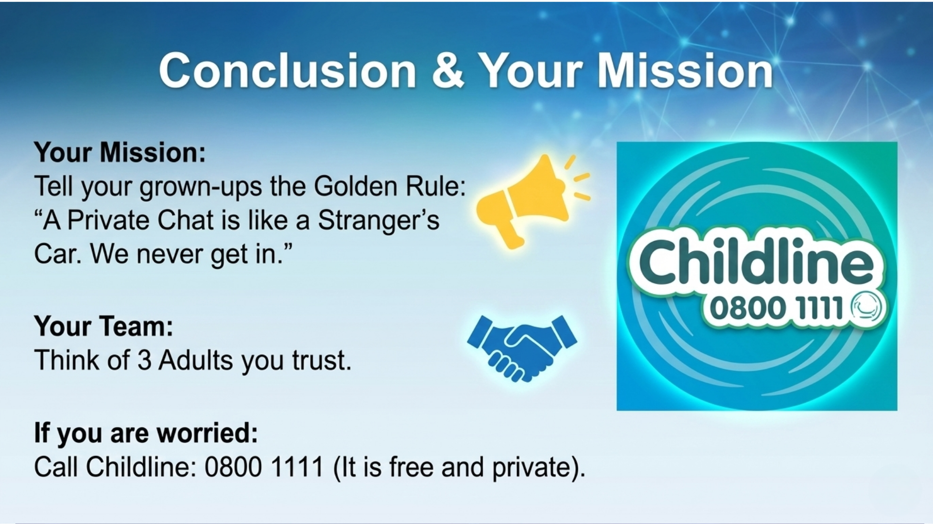
Notes:
"You are all Online Detectives now. You know how to spot the clues.
"Your mission today is to go home and teach your grown-ups one simple rule. Tell them: 'A Private Chat is like a Stranger's Car. We never get in.'
"If you explain it like that, they will understand exactly what you mean.
"Finally, I want you to lock in your 'Safety Team.' Think of three adults you trust. It could be Mum, Dad, a teacher, or a grandparent.
"But, if something happens and you feel like you can't talk to them, you can always call Childline on 0800 1111. It is free, and they are there just to listen to children.
"Remember: You are the Boss of your Screen.
"Thank you for listening, Detectives. Class dismissed!"

