Slide 1



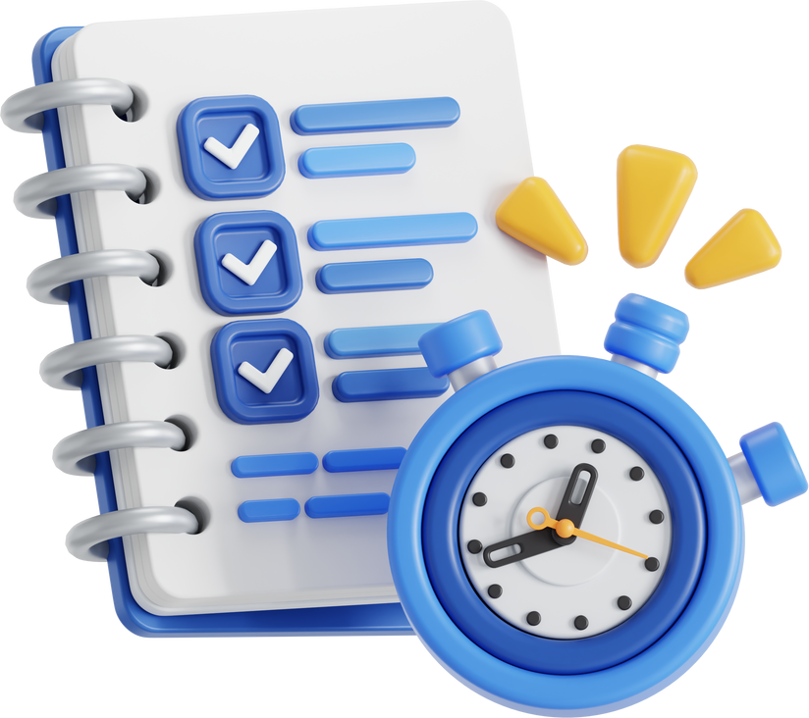
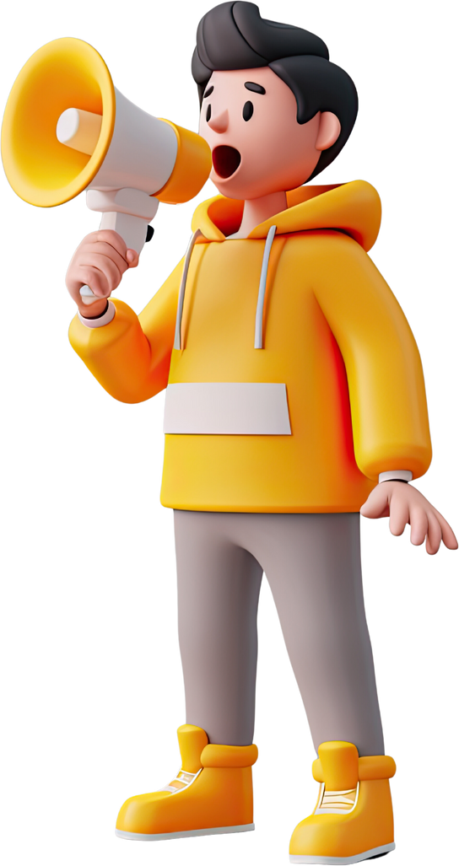
QUIZ TIME

Slide 2

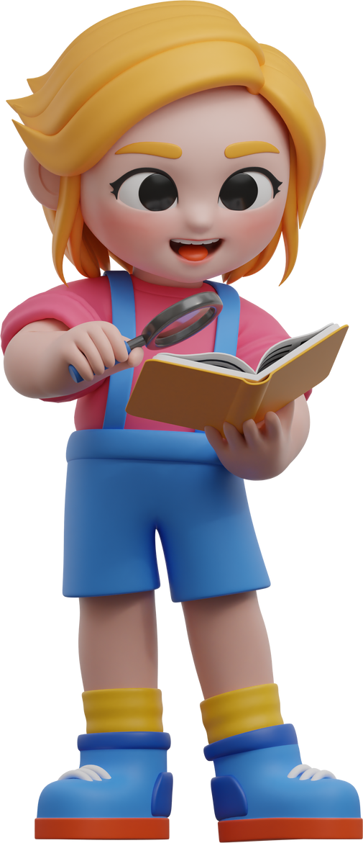

Let’s begin!

Slide 3

Question 1
What are the 'Puzzle Pieces' mentioned in the lesson that you should keep safe?
B. Your full name, address, and school
A. The high score you got in a game
C. The name of your game character
D. Your favorite color and food
Notes:
Correct answer : B
These are specific details that can identify you in the real world and allow strangers to find you.
Other choice
A = This is game data, not personal identity information.
C = This is public information in the game and is generally safe to share.
D = These are preferences, not sensitive personal data.

Slide 4

Question 2
If a stranger online asks 'Which school do you go to?', what is the safest rule to follow?
B. Ask them which school they go to first
A. Lie and say a different school
C. Ignore, Block and tell an adult
D. Say 'I can't tell you'
Notes:
Correct answer : C
This is the complete safety response: it stops the stranger contacting you again and alerts a trusted adult to the danger.
Other choice
A = Lying still involves talking to the stranger, which keeps the conversation going.
B = This is dangerous as it engages in conversation with a stranger.
D = Responding still engages the stranger; it's better to cut off contact entirely.

Slide 5

Question 3
In the lesson, playing an online game like Roblox or watching Youtube is compared to being in which place?
A. A friend’s house
B. A public park
C. A private bedroom
D. A locked classroom
Notes:
Correct answer : B
Online games are full of strangers, just like a busy public park, making them public spaces.
Other choice
A = Clubhouses are usually private for members, whereas games are open to the public.
C = While you might physically be in a bedroom, the digital space is not private.
D = Classrooms are supervised environments, unlike the open nature of many online games.

Slide 6

Question 4
Why is a video call with your grandma considered a 'Private Space'?
A. Because the internet connection is secure
B. Because you are outside
C. Because you are using a tablet
D. Because only people you know and trust are invited
Notes:
Correct answer : D
Private spaces are defined by the fact that strangers are not allowed in, only trusted family or friends.
Other choice
A = Security is important, but 'private space' refers to the social environment and who is present.
B = Being outside usually makes a space more public, not private.
C = The device used doesn't determine privacy; who is on the call does.

Slide 7

Question 5
Which of these is an unsafe username?
A. FastRunner2024
B. Tom_Year5_London
C. MegaBuilder99
D. CoolCat_7
Notes:
Correct answer : B
This username reveals the user's real name, age (Year 5), and city, which are all 'puzzle pieces.'
Other choice
A = This is likely a nickname and doesn't necessarily identify the specific person.
C = This is a generic nickname that doesn't reveal personal identity.
D = This is a safe nickname that uses a generic interest.

Slide 8
Question 6
How do you know if you are in a public space online?
A. If you are using a password, it is private
B. If you are wearing pajamas, it is private
C. If you are playing at night, it is private
D. If there are people you don't know in the game, it is public
Notes:
Correct answer : D
The presence of strangers is the key factor that makes a digital space public.
Other choice
A = Even password-protected accounts access public servers with strangers.
B = Your physical clothing doesn't change the digital environment.
C = Time of day does not make a public game private.

Slide 9

Question 7
Why is a password compared to a toothbrush?
B. You should never share it with anyone
A. You should buy a colorful one
D. You should keep it in the bathroom
C. You should use it twice a day
Notes:
Correct answer : B
Just like sharing a toothbrush is gross and unhygienic, sharing a password is unsafe.
Other choice
A = The appearance doesn't matter for the safety analogy.
C = While true for toothbrushes, you use passwords whenever you log in.
D = You definitely should not keep your passwords in the bathroom!

Slide 10

Question 8
Who is the ONLY person allowed to know your password besides you?
A. Your best friend
B. Your teacher
C. Your brother or sister
D. Your parent or carer
Notes:
Correct answer : D
Parents or carers are your 'security guards' and need access to help keep you safe.
Other choice
A = Friends can have arguments or accidentally share secrets, so they shouldn't know it.
B = Teachers generally don't need your personal account passwords.
C = Siblings are not the adults responsible for your safety.

Slide 11

Question 9
Which of the following is the STRONGEST password based on the lesson's advice?
A. MyNameIsSam
B. Password1234
C. CharlieDog123
D. FishBananaTractor9!
Notes:
Correct answer : D
It follows the rule: three random words that don't belong together, plus a number and a symbol.
Other choice
A = This is a sentence that contains personal information.
B = This is a very common password that computers guess instantly.
C = This likely uses a name and pet name, which are easy to guess.

Slide 12
Question 10
What makes 'CharlieDog' a weak password?
A. It uses a pet's name which is easy to guess
B. It doesn't have any letters
C. It is a random word
D. It is too long to type
Notes:
Correct answer : A
Pet names are personal information ('puzzle pieces') that people often know or can easily guess.
Other choice
B = It is made entirely of letters, which is actually part of why it's weak (needs numbers/symbols).
C = It is NOT random if it is the name of your pet.
D = Length actually makes a password stronger, not weaker.

