Slide 1



Slide 2

HOW TO PLAY
Listen Carefully
-
Move to your choice
-

Slide 3


QUESTION
1

Slide 4


A big button pops up in a game
It says:

Slide 5


QUESTION
2

Slide 6

A video your teacher shared
to help you learn.

Slide 7


QUESTION
3

Slide 8

A Picture says:
“You won’t believe this!”

Slide 9
QUESTION
4

Slide 10
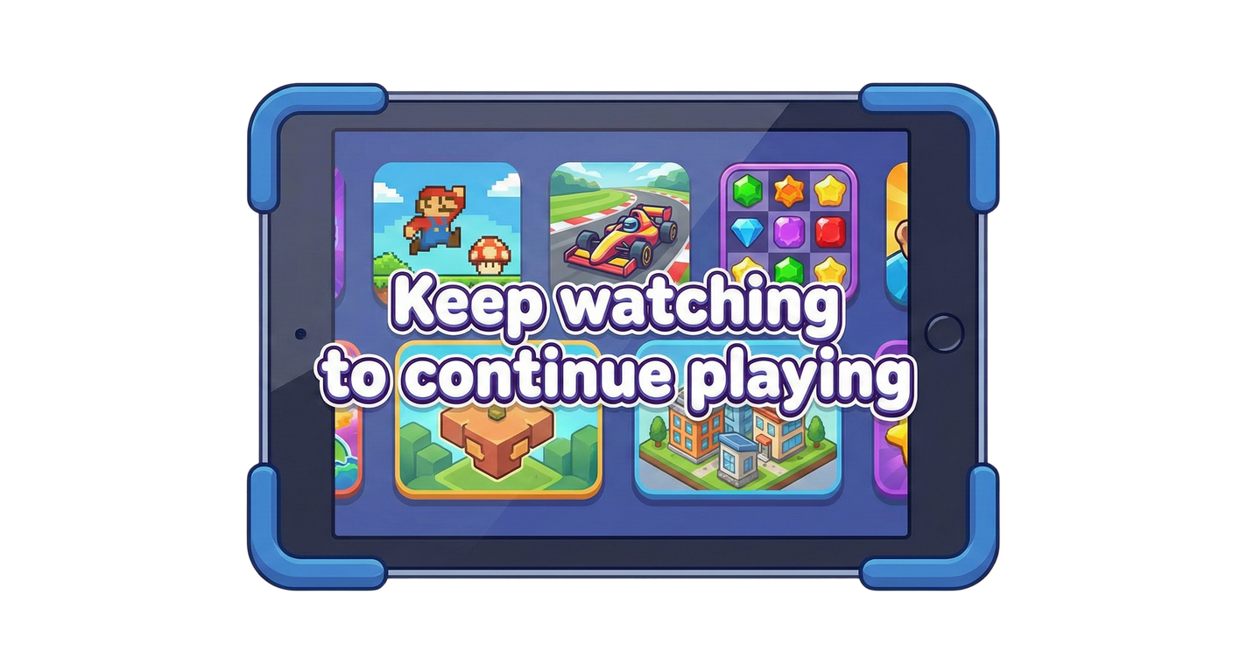
A game stops and says:
You must watch a video to keep playing

Slide 11
QUESTION
5

Slide 12



Something exciting pops up
and you feel
rushed

Slide 13
QUESTION
6

Slide 14
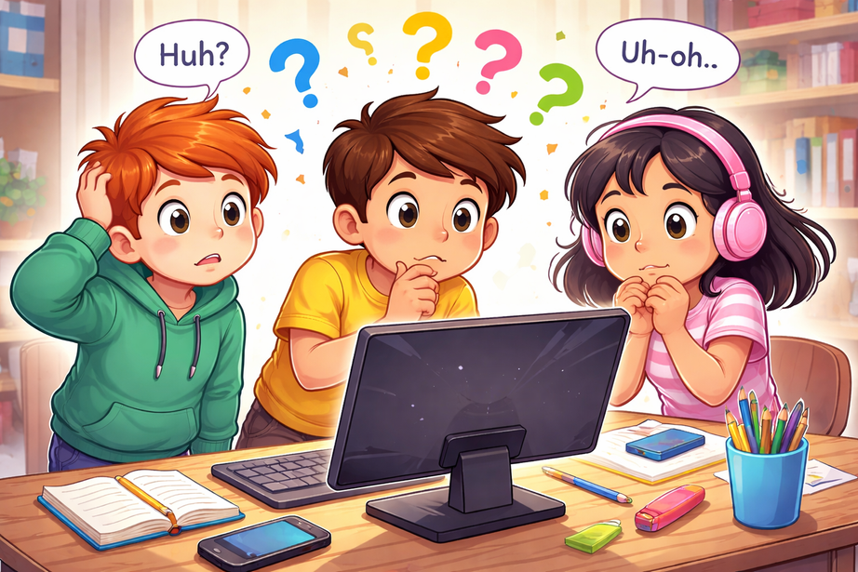
Something Pops up
and you are not sure what will happen next

Slide 15






REMEMBER
You can always skip and ask a grown up
Stop
Think
Ask

Slide 16

THANK YOU FOR
PLAYING
SEE YOU NEXT TIME!

