Slide 1
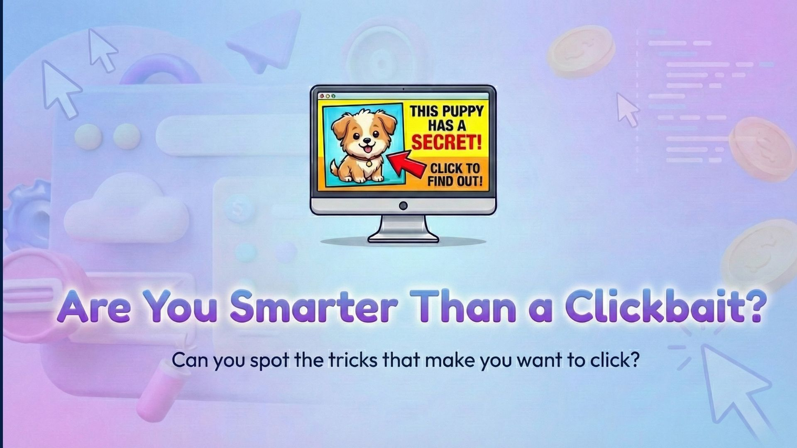
Notes:
“Hands up if you watch TV.”
(Wait.)
“Hands up if you play games or watch videos on a tablet.”
(Wait.)
“Today we are going to learn about something that happens in all of those places.
We are going to learn how some things try to get our attention, and what we can do about it.”

Slide 2
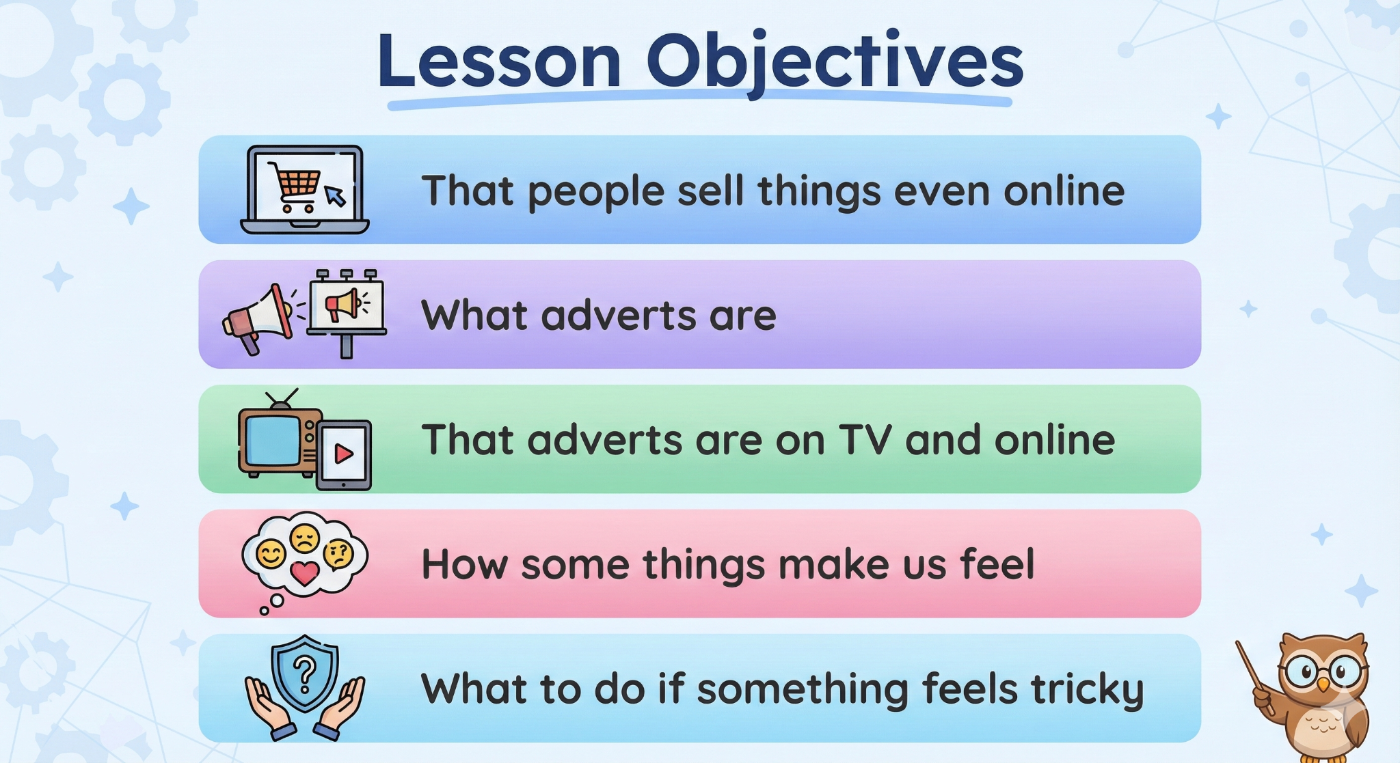
Notes:
“Let’s look at what we are learning today.
First, we are going to learn that people sell things.
Next, we are going to learn what adverts are and why people make them.
Then, we will learn that adverts are not just on TV, they are also online.
We will also talk about how some online things can make us feel.
Finally, we will learn what to do if something feels tricky or confusing.
Give me a thumbs up if you are ready to be good noticers today.”
Transition
“Let’s start with something we all already understand.”

Slide 3
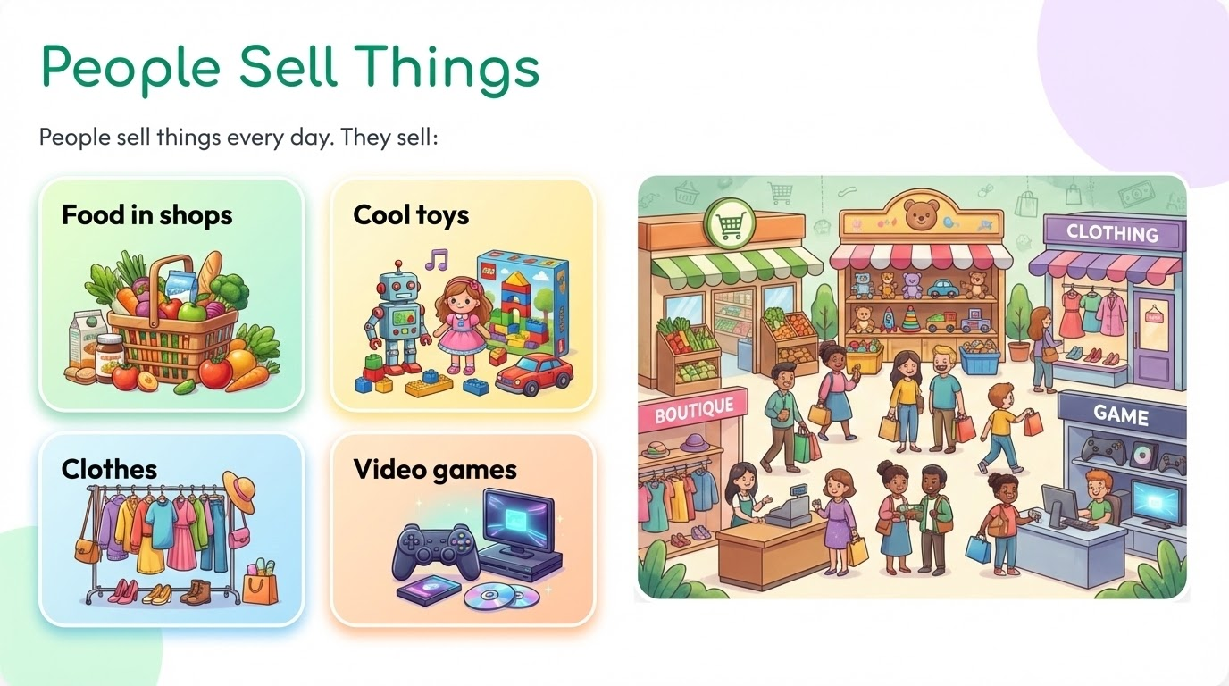
Notes:
“People sell things every day.
They sell food in shops.
They sell toys.
They sell clothes, games, and books.
I want you to think for a moment.
What is something you have seen being sold recently?”
(Call on 3 children.)
“Yes, all of those are things people want other people to buy.”
Transition
“But if people want to sell something, they need a way to show it to others.”

Slide 4



How Do People Show Things?
They use ADVERTS!
Notes:
“When people want to show something they are selling, they use something called an advert.
Everyone say the word with me: advert.”
(Children repeat.)
“An advert is made to make you notice something.
It wants your eyes.
It wants your ears.
It wants you to remember the thing.”
Check question
“Does an advert want you to forget it, or remember it?”
Transition
“Now let’s think about where we usually see adverts.”

Slide 5
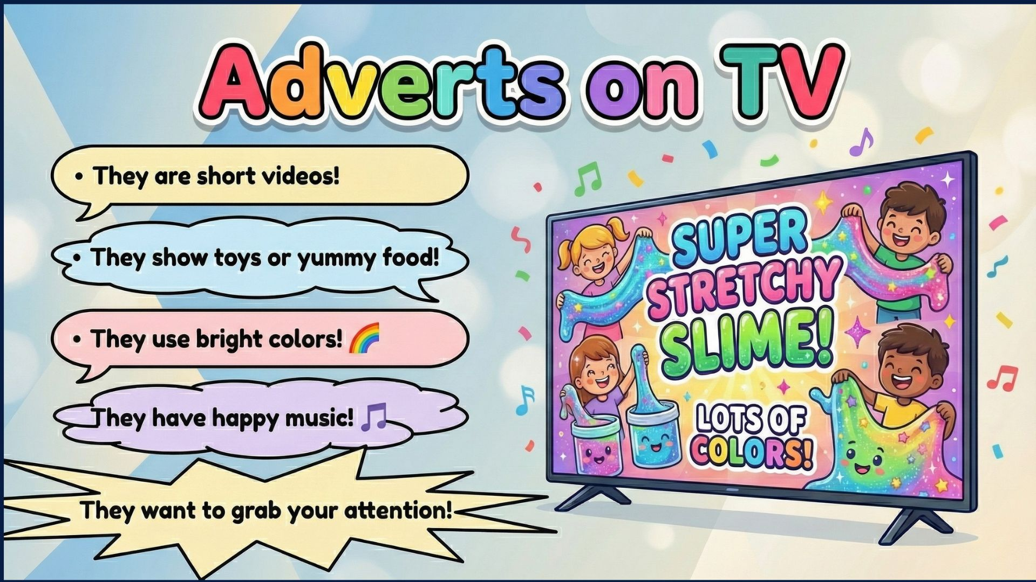
Notes:
“Think about watching TV at home.
You are sitting comfortably, watching a programme you enjoy.
Then something happens.
The programme stops, and short videos come on instead.
These videos are often louder than the programme.
They have bright colours, fast movement, and happy or excited voices.
These are called TV adverts.
Aks the class
Why do you think TV adverts are so colorful and eye catching?
They are loud because they want to wake up your ears.
They are colourful because they want to wake up your eyes.
They are exciting because they want your brain to pay attention.
The people who made the advert know that if it is quiet or boring, you might not notice it.
But if it is loud, bright, and fun, your eyes and ears look straight at it.
That helps you remember what they are showing.
So TV adverts are loud, colourful, and exciting because they are trying to grab your attention and help you remember the product.”
Quick classroom check (optional but recommended)
“Put your hand up if you think adverts want you to ignore them.”
(Lower hands.)
“Put your hand up if you think adverts want you to be looking at them.”
(Reinforce.)
“Yes. Adverts want attention.”
Transition to next slide (say aloud)
“Now here is something really important.
TV adverts use sound and colour to get attention.
But adverts do not only use TV anymore.
People now watch videos and play games on tablets and phones too.
So let’s see what happened to adverts when people stopped only watching TV and started using screens.”

Slide 6
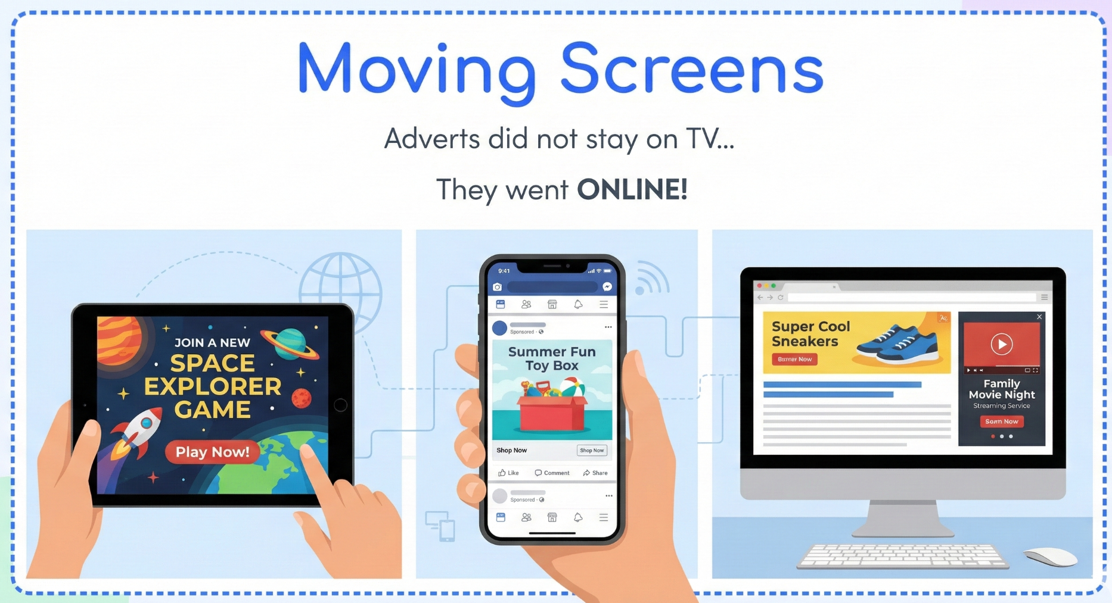
Notes:
“So, on the last slide, we learned something important.
We learned that TV adverts are loud, colourful, and exciting on purpose.
They want our eyes to look and our ears to listen.
They want our brain to notice them.
Now here is the next part of the story.
A long time ago, most people only watched adverts on TV.
But now, people do not only watch TV anymore.
People use tablets.
People use phones.
People use computers.
People play games and watch videos on different screens.
So adverts did not stay on the TV.
They moved.
They followed people onto new screens.”
(Point to each image as you speak.)
“Here, we can see adverts on a tablet.
Here, we can see adverts on a phone.
And here, we can see adverts on a computer.
They are still doing the same job.
They still want attention.
They still want you to look, watch, or click.
The big difference is this.
On TV, adverts just play.
Online, adverts often want you to click.”
Classroom check question
“Put your hand up if you have ever seen something online that wanted you to press a button.”
(Wait, acknowledge hands.)
“Yes. That happens to lots of people.”
Transition to next slide (say clearly)
“So now we know something new.
Adverts moved from TV to online screens.
And online adverts often want clicks.
On the next slide, we are going to look more closely at where these online adverts pop up and what they can look like.”

Slide 7
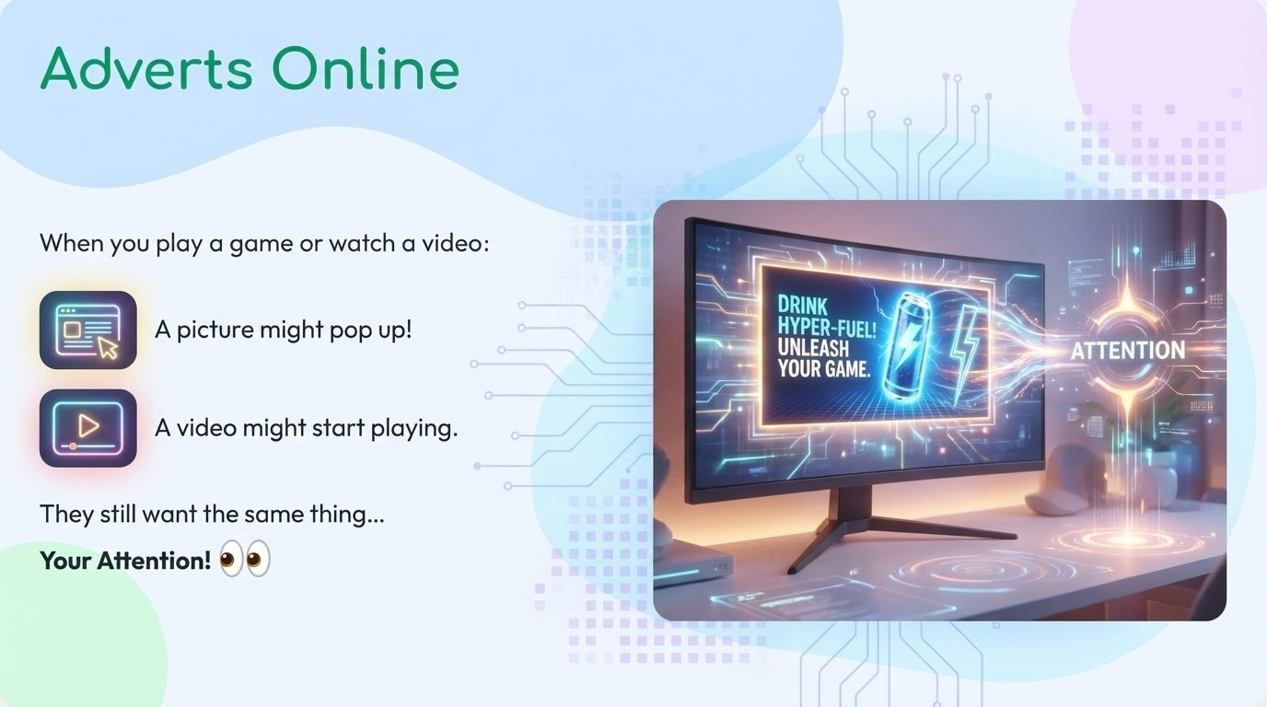
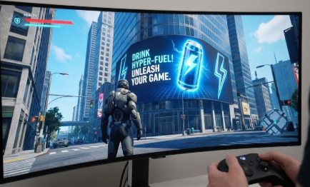
Notes:
“Now that we know adverts moved onto different screens, let’s look at where we might see them.
When you are playing a game, sometimes a picture pops up.
When you are watching a video, sometimes it stops and another video appears.
When you are using an app, sometimes a picture slides onto the screen.
These can all be adverts.
They might look fun.
They might look exciting.
They might look like part of the game or video.
But they are still adverts.
They are still trying to get your attention.”
Classroom question
“Put your hand up if you have ever been playing a game and something suddenly popped up on the screen.”
(Wait and acknowledge.)
“Yes, that happens to lots of people.”
Transition to next slide
“Now here is something important to know.
Online adverts do not always look like adverts.
That can make them tricky to spot.”

Slide 8
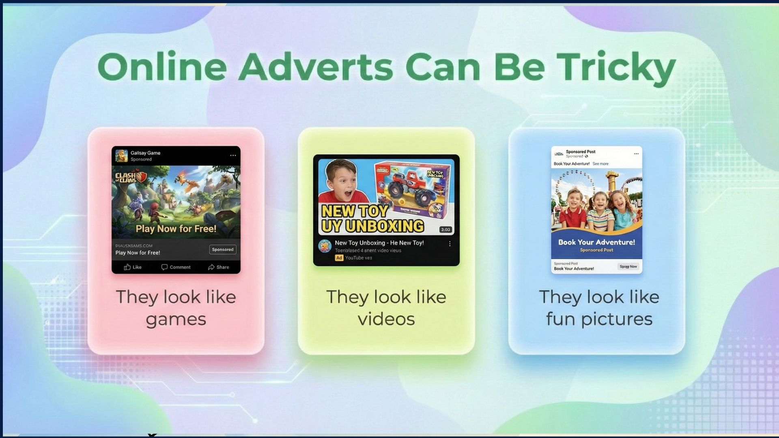
Notes:
“Online adverts can be tricky because they do not always say, ‘Hello, I am an advert.’
Sometimes they look like a game you can play.
Sometimes they look like a video you want to watch.
Sometimes they look like a picture you really want to touch.
This can make it harder to tell what they are.”
Classroom question
“Do you think that makes online adverts easier to spot, or harder to spot?”
(Encourage choral response: harder.)
“Yes, harder.”
Transition to next slide
“So if online adverts are tricky to spot, we need to understand why they really want us to click

Slide 9
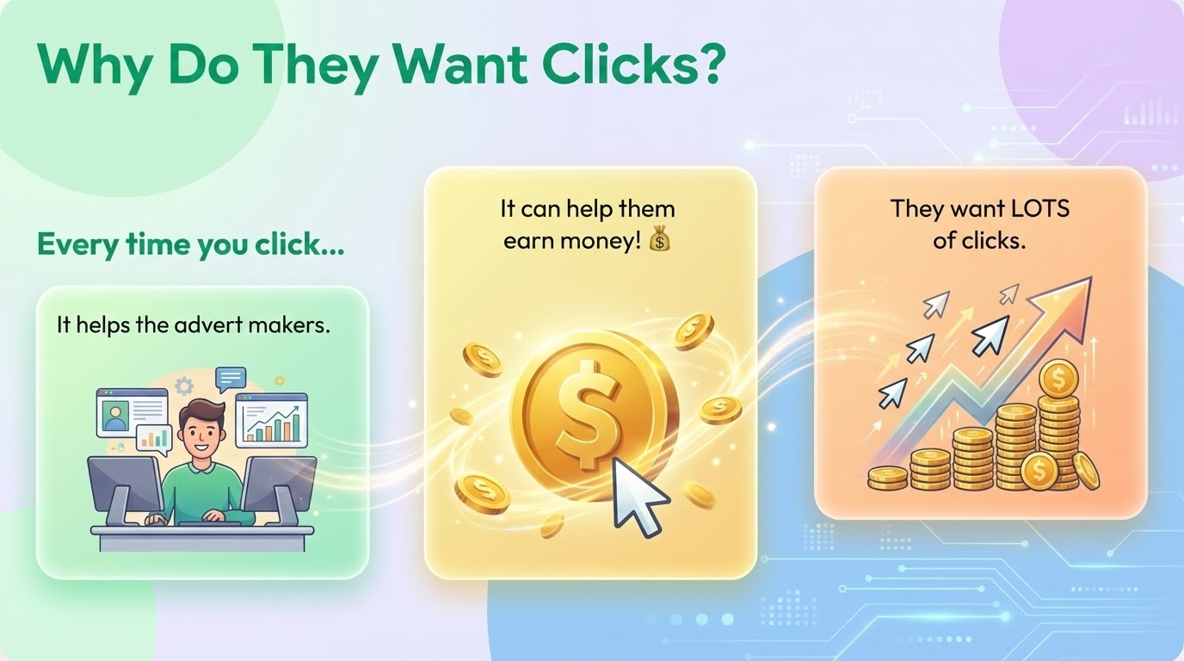
Notes:
“When adverts are online, they often want you to click them.
When you click, it helps the people who made the advert.
More clicks can mean more people see it.
More clicks can help them earn money.
That is why some online adverts really want you to click.”
Classroom check question
“Do adverts want lots of clicks, or no clicks?”
(Children respond: lots.)
“Yes. Lots of clicks.”
Transition to next slide
“And because clicks are important, some adverts try very hard to make you click quickly.”

Slide 10
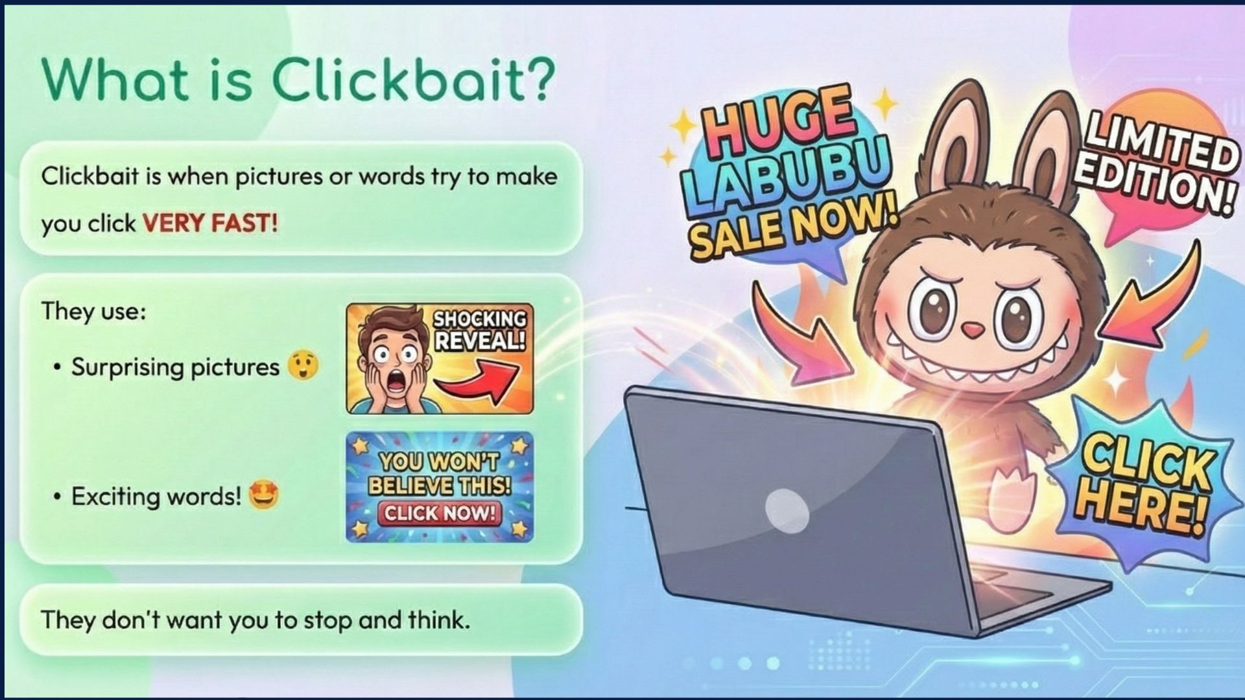
Notes:
Teacher script
“Clickbait is a word we use when pictures or words try to make you click very fast.
They might say things like, ‘Amazing!’
Or ‘You won’t believe this!’
They want you to click before you stop and think.”
Classroom question
“Why do you think they want you to click quickly instead of slowly?”
(Accept answers like: so you don’t think.)
“Yes. Clicking quickly means we might not think first.”
Transition to next slide
“And clicking quickly often happens when our feelings are involved, so let’s talk about feelings.”

Slide 11
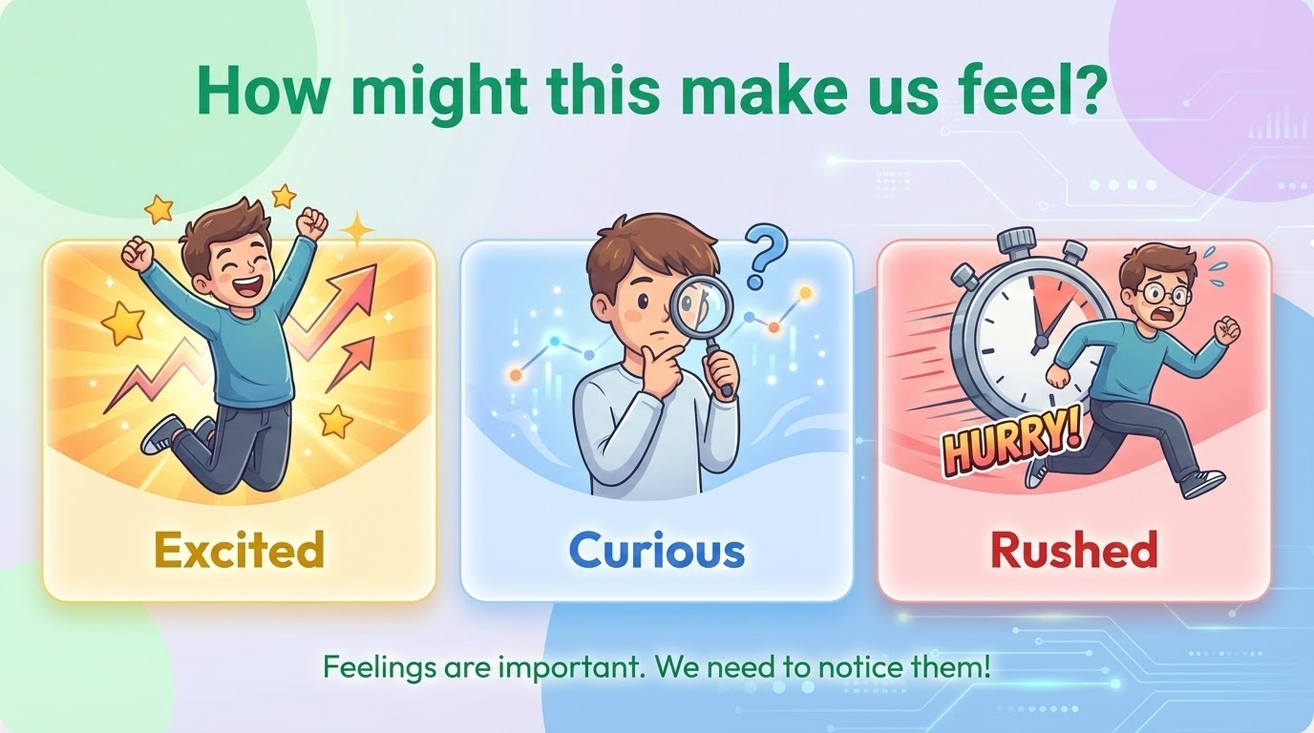
Notes:
“Adverts often try to make us feel something.
They might make us feel excited.
They might make us feel curious.
They might make us feel rushed, like we must click now.
Feelings are not bad.
But when we feel rushed or excited, we might not stop to think.”
Classroom action
“Point to your heart if feelings are important.”
(Wait.)
“Point to your head if thinking is important.”
(Wait.)
“Yes. We need both.”
Transition to next slide
“So now let’s think about something important.
Why was this thing made in the first place?”

Slide 12
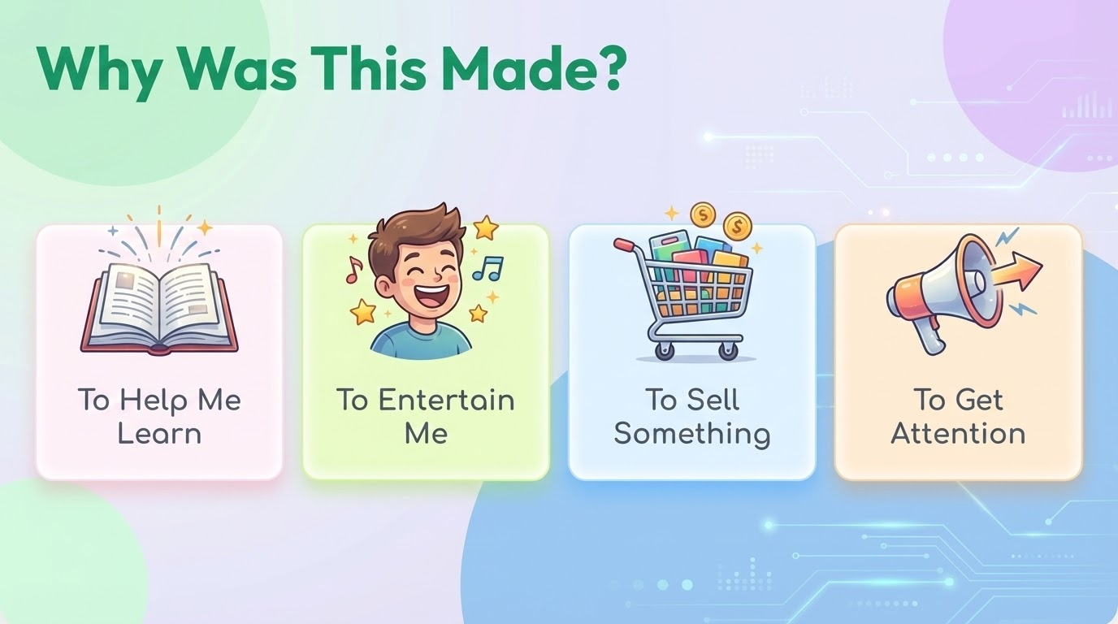
Notes:
“Not everything online is made for the same reason.
Some things are made to help you learn.
Some things are made to entertain you.
Some things are made to sell something.
Some things are made just to get attention.
Knowing why something was made helps us decide what to do.”
Classroom question
“If something was made to sell something, should we click straight away or think first?”
(Children respond: think first.)
Transition to next slide
“So when we are not sure, we use our special rule.”

Slide 13

What Should We Do?
When we are not sure, we use our...
GOLDEN RULE
Notes:
“This is our golden rule.
Say it with me.
Stop. Think. Ask.”
(Repeat once more.)
“Stop means do not click straight away.
Think means ask yourself why this is here.
Ask means talk to a grown-up you trust.”
Classroom check
“Who remembers the first word?”
(Stop.)
“Yes.”
Transition to next slide
“And asking for help is always a good idea.”

Slide 14
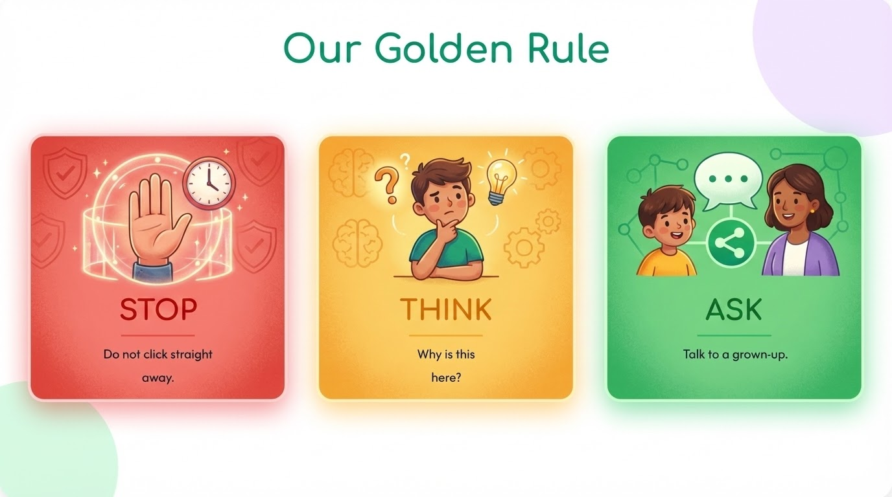
Notes:
Now I want you to listen very carefully, because this part is very important.
When you are online, you are not trapped.
You are not stuck.
You are not forced to click anything.
Even if something looks exciting.
Even if something looks fun.
Even if something really wants your attention.
You still have choices.
You can scroll past it.
You can close it.
You can stop and not press anything.
Just because something is on the screen, it does not mean you have to click it.
That means you are in control, not the advert.”
Classroom check and interaction
“Let’s check our understanding together.
If something pops up and you do not like it, do you have to click it?”
(Children respond: No.)
“If something looks exciting but you are not sure, can you stop and think first?”
(Children respond: Yes.)
“Yes. You are in control of your choices online.”
Transition to next slide (say clearly)
“Being in control is really important.
But sometimes, even when we are careful, we might still feel unsure or confused.
So now let’s talk about what to do when we need help.”

Slide 15
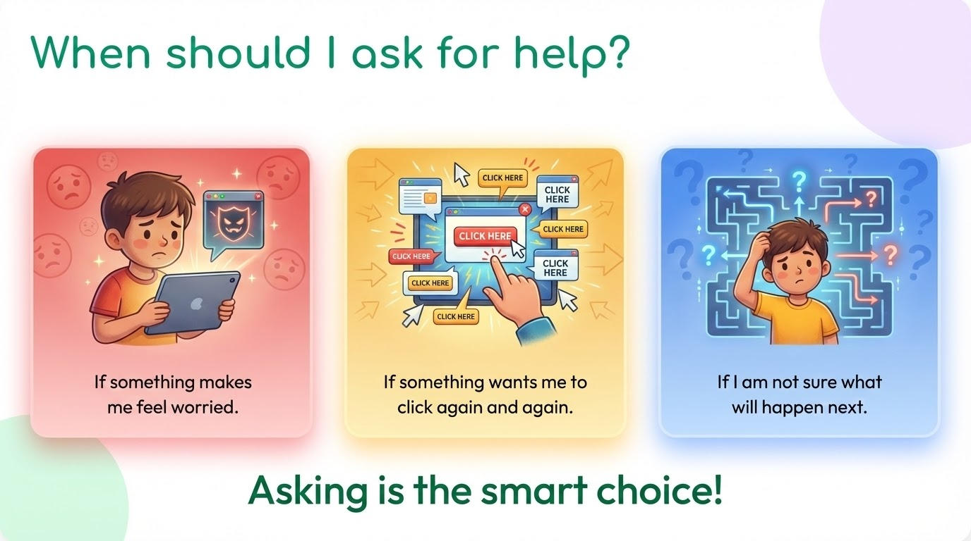
Notes:
ven though you are in control, you are not expected to do everything on your own.
Sometimes things online can feel confusing.
Sometimes they can feel exciting in a way that makes your tummy feel funny.
Sometimes you might not know what will happen if you click.
When that happens, the best thing to do is ask for help.
You should ask for help if:
Something makes you feel worried
Something wants you to click again and again
Something makes you feel rushed
Or you are not sure what will happen next
Asking for help is not a bad thing.
It is not a telling-off thing.
It is a smart and safe thing.”
Classroom question and reassurance
“I want everyone to listen to this part very carefully.
You are never in trouble for asking for help.
Never.
Let’s say that together.”
(Teacher and children say: “I am never in trouble for asking for help.”)
Help-seeking check
“Who could you ask for help if something online felt tricky?”
(Take several answers: parent, carer, teacher, trusted adult.)
“Yes. Those are all good choices.”
Transition to next slide (say clearly)
“So now we know three very important things:
We can stop and think
We are in control of our choices
And we can always ask for help
Let’s finish by thinking about how we will use this when we are online.”

Slide 16
Finish the sentence:
"
Next time I see something exciting online, I will...
Notes:
“We are coming to the end of our lesson now, so this is a time to think quietly.
I want you to look at this sentence on the screen.
It says: Next time I see something exciting online, I will…
You do not need to say your answer out loud straight away.
First, think about it quietly in your head.
Remember everything we have learned today:
That some things online try to get our attention
That some things want us to click quickly
That we are in control
And that we can always ask for help
Take a few seconds to think.”
(Pause for 5–10 seconds.)
“If you would like to share your sentence, you can put your hand up.
You do not have to share if you do not want to.”
(Call on a few children.)
After each response, affirm with:
“That is a smart choice.”
“That shows good thinking.”
“That helps keep you safe.”“I want to remind everyone of this.
There is no perfect answer.
Different people might choose different safe things to do.
What matters is that you:
Stop and think
Notice how you feel
And ask for help when you need it
That is what being safe online looks like.”

