Slide 1
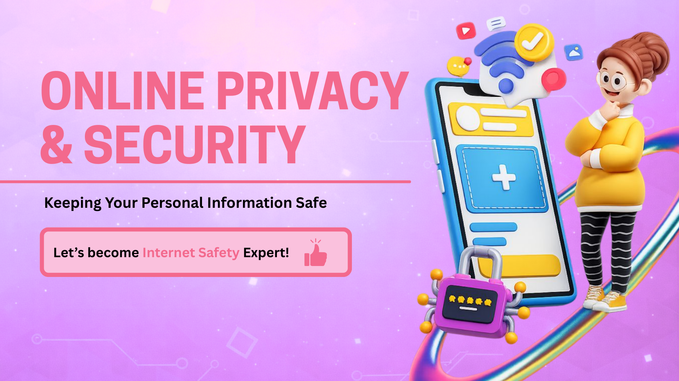
Notes:
Good morning everyone! Today we're going to learn how to be safe and smart online.
You know how your parents teach you not to talk to strangers in the park? Well, the internet has strangers too!
We're going to learn three important things today:
(Count on fingers as you say each one)
ONE: What secrets to keep private - these are like precious puzzle pieces about YOU
TWO: How to spot when you're in a public place online - even when you feel like you're alone in your bedroom
THREE: How to make a password so strong that nobody - not even a super-fast computer - can break it
(Build excitement)
By the end of today, you'll be internet safety experts! You'll know more about staying safe online than lots of adults!
Let me ask you something: Who here uses a tablet, phone, or plays games online?
(Wait for hands - look around and acknowledge)
Wow! Lots of you! Keep your hand up if you've ever played Roblox, Minecraft, or Fortnite.
(Look around)
Okay, hands down. Now, keep your hand up if you've NEVER used the internet much yet or don't play online games.
If your hand is up - that's absolutely perfect! You're learning this NOW so you're ready for when you DO start using the internet more. You're getting a head start!
Are we ready to become Internet Safety Experts?
(Wait for 'Yes!' - if quiet, prompt: 'I can't hear you! Are we READY?')
Brilliant! Let's go!"

Slide 2
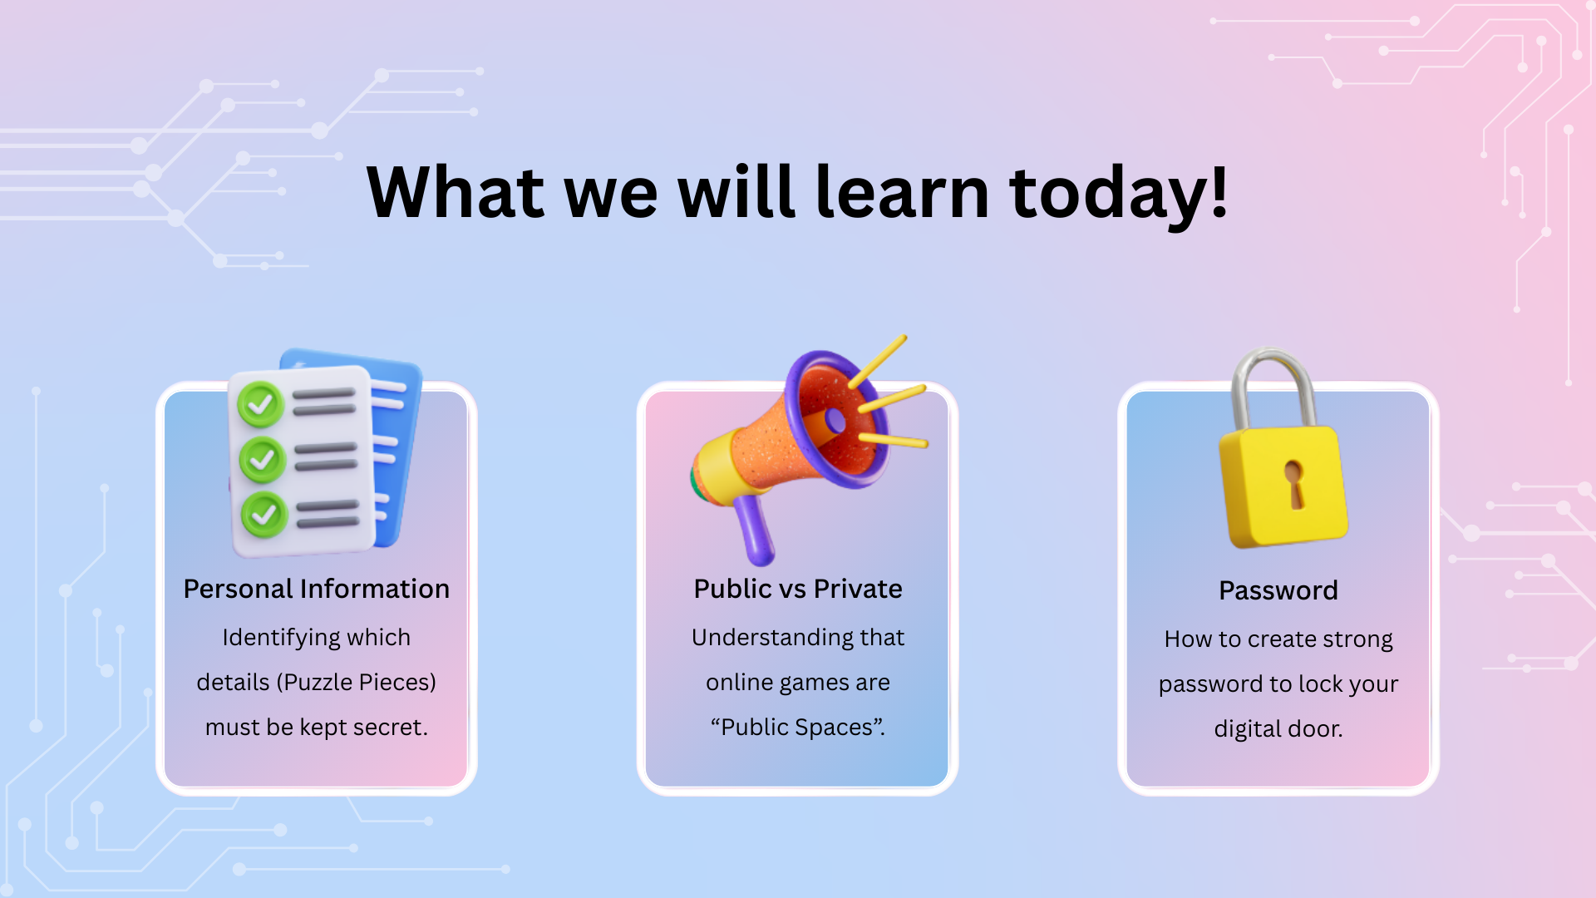
Notes:
Right! So we have three main goals for this lesson. Think of these as three levels in a game and by the end, you'll have completed all three levels!
(Point to objective 1 on screen)
LEVEL ONE: Personal Information
These are special facts about YOU - things like your name, where you live, and what school you go to. These facts are like treasure that belongs in a locked safe. We're going to learn exactly which pieces of information about you need to stay secret and private.
(Check understanding - ask the class)
Can someone give me an example of personal information? What's something about you that should stay private?
(Wait for hands - take 1-2 answers: 'My address,' 'My phone number,' 'My school')
Perfect examples! Well done. Those are all pieces of personal information.
(Point to objective 2 on screen)
LEVEL TWO: Public vs. Private
This is really, really important and it might surprise you!
We're going to learn that when you go online even when you're sitting safely in your home or just classroom you're actually in a PUBLIC space. It's like standing in a busy playground or park with hundreds of strangers around you.
I know! It feels private because you're in your bedroom, right? But we're going to learn why it's actually public. This is one of the biggest secrets about the internet that lots of people don't understand!
(Point to objective 3 on screen)
LEVEL THREE: Passwords
By the end of today, you're going to know how to build what I call a 'Super Password' - a password so strong that even a computer trying a million guesses can't crack it!
And you'll also learn my favorite rule about passwords: the Toothbrush Rule. Anyone want to guess what that might be?
We'll find out later! It's an easy way to remember password safety forever.
(Now do a quick check)
Before we dive in, let me ask you: Who here thinks they already have a super strong password?
(Show of hands - acknowledge)
Okay! By the end of today, we'll all know exactly what makes a password strong. You might find out yours is already great - or you might learn how to make it even better!
Question for the class:
One more thing before we start: Has anyone here ever been told 'Don't share personal information online' but you weren't really sure what that meant or why it mattered?
(Some hands will go up - this is good)
That's EXACTLY why we're here today! We're not just going to say 'Don't do this' - we're going to understand WHY, and learn exactly HOW to stay safe. You'll understand the reasons behind the rules.
Ready to start Level One?
Let's do this!"

Slide 3
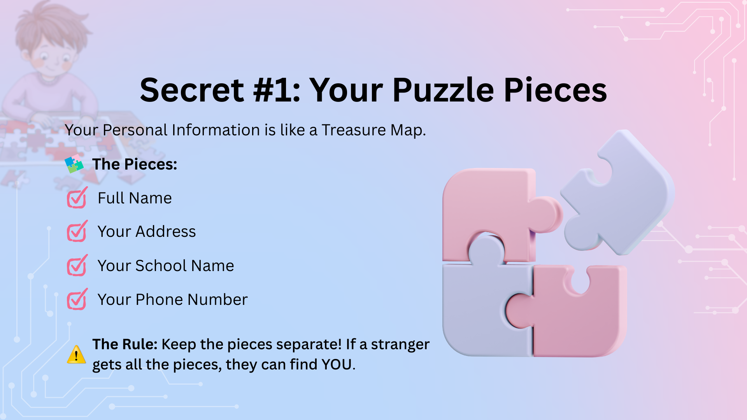
Notes:
"Alright, Level One! Let's talk about YOUR puzzle pieces.
Imagine you have a treasure map that shows where YOU are where you live, where you go to school, who you are, how to contact you. This map has pieces of information on it:
(Point to each bullet point as you read it clearly)
Your FULL NAME - not just 'Sam' but 'Sam Jones'
Your HOME ADDRESS - like '25 Oak Street'
Your SCHOOL NAME - like 'St. Peter's Primary School'
Your PHONE NUMBER - your mobile or home number
These pieces are YOUR private information. They belong to YOU and your family - not to strangers! They're like the password to find you in real life.
Now, here's the really important rule - everybody listen carefully:
(Slow down - make eye contact around the room)
You should NEVER share ANY of these puzzle pieces with strangers online. Not even ONE piece!
Not your name. Not your school. Not your street. Not your age. NOTHING!
Let me explain why with a story. This is really important.
Imagine you're playing a game online maybe Roblox or Minecraft and you're building something cool. Someone you don't know types in the chat:
'Hey! What's your name?'
Now, you might think to yourself: 'Well, my name is just Emma. Lots of people are called Emma. That's harmless, right? What's the problem?'
Here's the problem:
Once you tell them your name, they don't stop asking questions! They keep going! They might say:
(Friendly stranger voice again)
'Cool name, Emma! What school do you go to?'
Or:
'Nice to meet you Emma! Where do you live?'
Or:
'Hey Emma! How old are you?'
Now they're trying to collect MORE pieces! And here's the sneaky part - if you've already answered the first question, you might feel like you should answer the next one too. It feels rude not to answer, right?
That's exactly what strangers online want! They start small just asking your name and then they keep asking for more information.
It's like they're trying to collect all the pieces of the puzzle so they can see the whole picture of YOU.
(Change tone - become serious and protective)
The SAFEST rule - and the rule we're going to follow in this class is this:
NEVER share ANY personal information with strangers online.
Not your name. Not your school. Not your street. Not your age. NOTHING!
(Interactive check - ask the class)
So if a stranger online asks, 'What's your name?' - what should you do?
(Wait for answers - kids should say 'IGNORE!')
Exactly! You IGNORE them!
You don't answer the question. You don't even say 'No, I can't tell you.' You just pretend they don't exist and keep playing your game.
(Demonstrate - pretend to play a game and look at screen, completely ignoring an imaginary person)
See? I'm just playing my game. I didn't see that question. I'm too busy building my house or completing my mission!
But WHY? Why is this so important?
(Use the park analogy)
Because strangers online are exactly like strangers in a park!
If you were in the park playing football, and a stranger walked up to you and said, 'Hi! What's your name? What school do you go to?' - would you tell them?
(Wait for 'No!')
NO! You'd probably step away from them and go find your parent or teacher, right?
The rule is EXACTLY the same online! In real life, you don't talk to strangers. Online, you don't talk to strangers either!

Slide 4
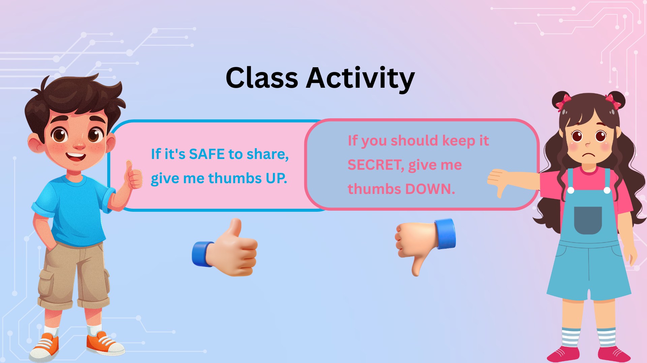
Notes:
Quick Check - Let's Practice:
I'm going to give you some situations. If it's SAFE to share, give me thumbs UP. If you should keep it SECRET, give me thumbs DOWN.
Ready?
Situation 1: Someone in Roblox asks, 'What's your favorite color?'
(Wait - should be THUMBS UP)
Thumbs up! That's safe! Favorite color doesn't help them find you!
Situation 2: Someone in Minecraft asks, 'What's your real name?'
(Wait - should be THUMBS DOWN)
Thumbs down! That's a puzzle piece! Keep it secret!
Situation 3: Someone asks, 'What country do you live in?'
(Wait - this one's tricky - could be thumbs down)
Hmm, this is a tricky one! Country is quite big and vague - millions of people live in the UK! But it's still information about you. The safest answer? Don't respond! Keep your puzzle pieces locked away!
Situation 4: Someone asks, 'What level are you on in this game?'
(Wait - should be THUMBS UP)
Thumbs up! That's about the GAME, not about the real you! Totally safe!
Situation 5: Someone asks, 'What school do you go to?'
(Wait - should be THUMBS DOWN)
BIG thumbs down! That's a really important puzzle piece! NEVER share that!

Slide 5
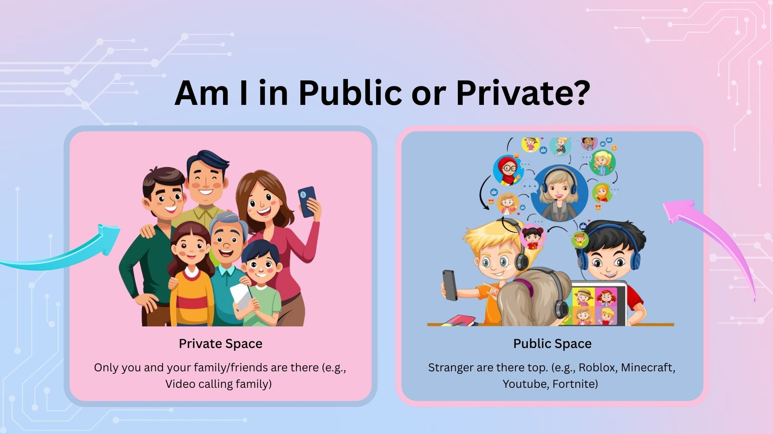
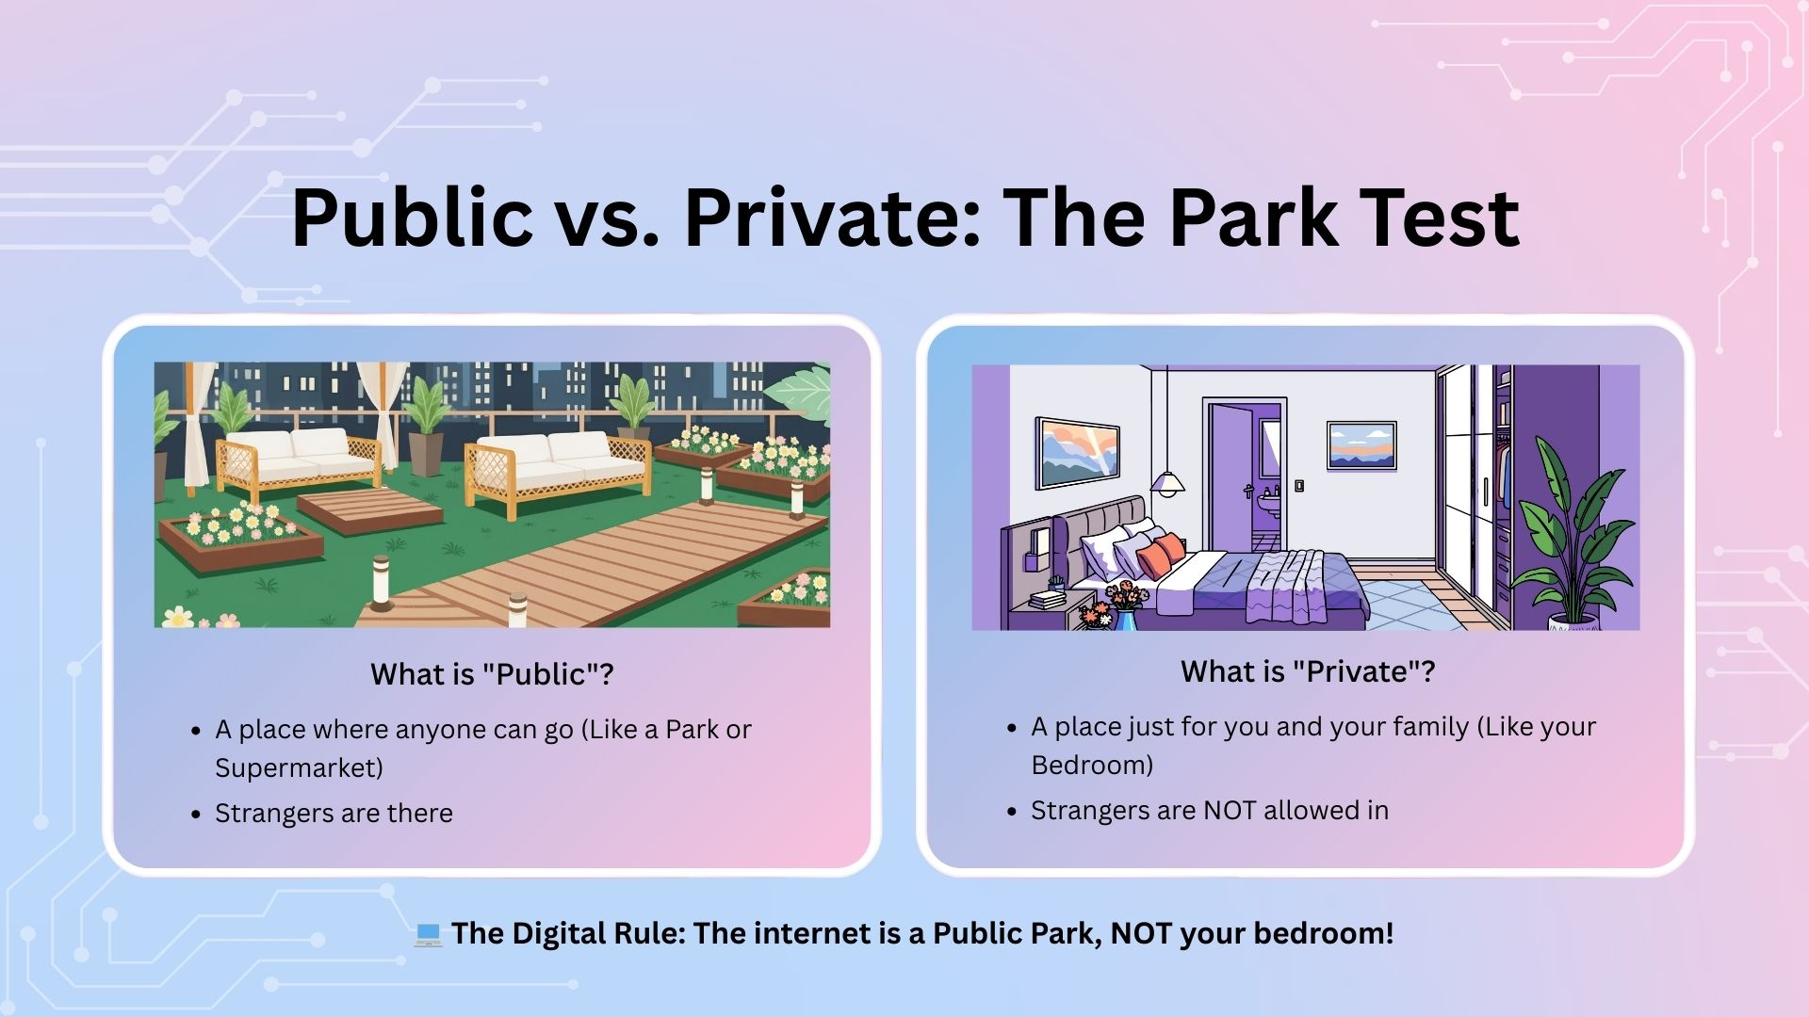
Notes:
"Alright, before we talk more about games and the internet, we need to understand something really, really important.
We need to understand the difference between 'Public' and 'Private.'
This is one of the BIGGEST secrets about the internet - and once you understand this, you'll be safer than most adults online!
Ready? Let's start with the real world first.
What is a PUBLIC place?
(Ask the class) Can someone give me an example of a public place?
(Take answers - should include: park, supermarket, library, street, playground, shopping center)
Brilliant! Yes! All of those!
A public place is somewhere that anyone can go. You don't need permission. You don't need to be invited. Anyone can walk in.
(Use local examples)
Like the park near school - anyone can go there! Families, dog walkers, joggers, people you know, people you don't know. It's open to everyone!
Or like the supermarket - anyone can shop there! You'll see people you know and LOTS of people you don't know!
Now, in a public place, are there strangers?
(Wait for 'Yes!')
Yes! Of course! Strangers are everywhere in public places!
In a public place, is it okay to tell strangers all your secrets?
(Wait for 'No!')
NO! Of course not!
If you're in the park playing football and a stranger is sitting on a bench nearby, you don't walk up to them and say, 'Hi! My name is Emily Jones! I live at 25 Oak Street! I go to St. Peter's School! My phone number is...'
You'd never do that! That would be really strange and really dangerous!
In public places:
We can play and have fun ✓
We behave nicely and politely ✓
But we DON'T share our secrets with strangers ✓
Now - what is a PRIVATE place?
(Ask the class) Can someone give me an example of a private place?
(Take answers - should include: your house, your bedroom, your bathroom, your family's car)
Perfect! Yes!
A private place is somewhere that's just for YOU and your family. It's somewhere that strangers are NOT allowed to enter.
(Point to a student)
Is a stranger allowed to walk into your bedroom whenever they want?
(Student: No!)
Exactly! NO! Your bedroom is PRIVATE! Only people you invite (like your family or best friend) are allowed in there!
In your bedroom, you can:
Tell secrets to your family ✓
Be silly ✓
Talk about personal things ✓
Feel completely safe ✓
Because you know EXACTLY who is there - just people you trust!
So we understand Public vs. Private in the REAL world.
Public = Strangers are there (Park, Supermarket)
Private = Only people you choose (Your bedroom, Your house)
Easy, right?
Now here's where it gets tricky. Here's the BIG SECRET about the internet.
(Slow down - this is the crucial moment)
When you're playing on a tablet or phone or computer in your bedroom, where are you? Are you in a public place or a private place?
(Pause - let them think)
Transition to the next slide

Slide 6
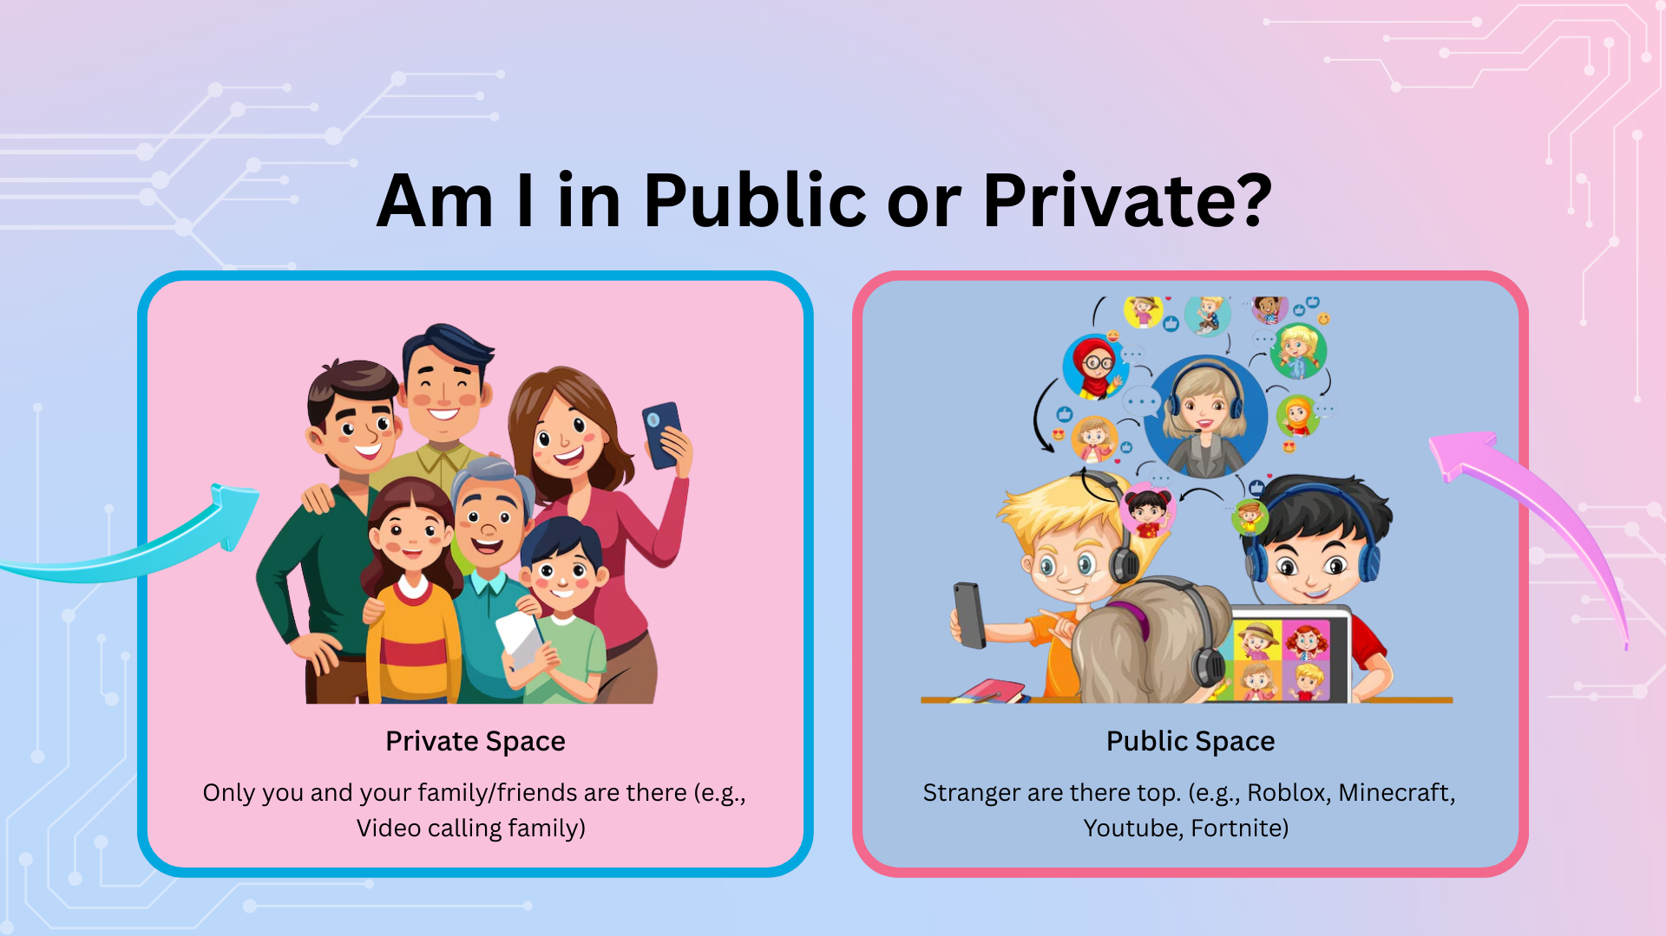
Notes:
"Right! So we know the difference between a House and a Park in real life. But what about on a tablet or computer? Let's figure it out together!
We're going to look at different things you might do online, and you're going to tell me: Is this PUBLIC or PRIVATE?
PRIVATE SPACES - Like Your House
There ARE some private spaces online! Let me give you examples:
Imagine you are video calling your grandma. You press the button, and there's her face on the screen! You can see her, she can see you.
(Ask the class) Who else is in that video call? Can strangers see you?
(Wait for answers - 'No!' 'Just family!')
Exactly! It's just you and Grandma! Nobody else can see or hear you. That is PRIVATE!
Or imagine you're sending a WhatsApp message to your auntie. You type "Hi Auntie! How are you?" and you send it.
(Ask the class) Who can read that message?
(Wait - 'Just my auntie!')
Right! Just your auntie! It goes straight to her phone. Nobody else can read it. That is PRIVATE!
In private online spaces:
Only you and people you chose are there ✓
No strangers can see or hear you ✓
You can be silly ✓
You can share family news ✓
You can tell secrets because you know EXACTLY who is listening ✓
It's like being in your house with your family! Safe and private!
PUBLIC SPACES - Like a Park
Now, imagine you're playing a game like Roblox or Minecraft.
You're sitting in your bedroom, that bit is safe and private. But what about your screen?
(Ask the class) When you're playing Roblox, can you see other players?
(Yes!)
And do you know all of those other players in real life?
(No!)
Are they strangers?
(Yes!)
Then you are in PUBLIC!
Let me make this really clear with a picture:
You're sitting in your bedroom - safe and cozy. (Point to self - comfortable)
But your screen is like a window. (Make rectangle with hands)
Through that window, you are playing with THOUSANDS of other people. People from all over the world. People you've never met. Strangers!
If you type something in the chat, ALL those strangers can read it!
If you speak into your microphone, ALL those strangers can hear you!
Even YouTube!
When you watch a YouTube video and you write a comment, how many people can read your comment?
(Ask class)
MILLIONS! Anyone in the world who watches that video can read what you wrote! That's PUBLIC!
Transition to the next slide

Slide 7
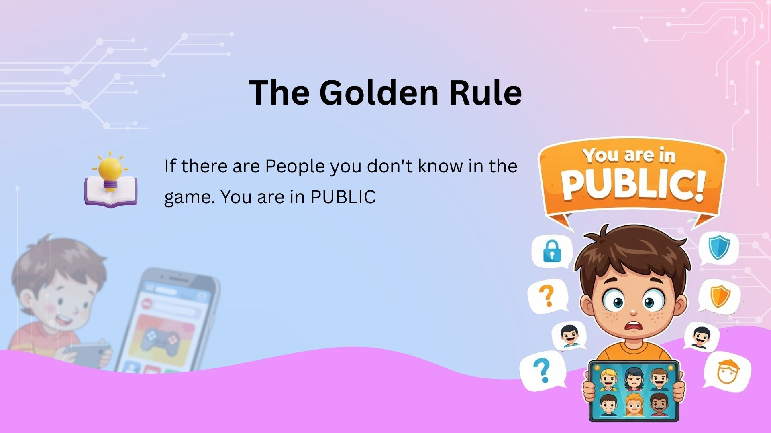

Slide 8
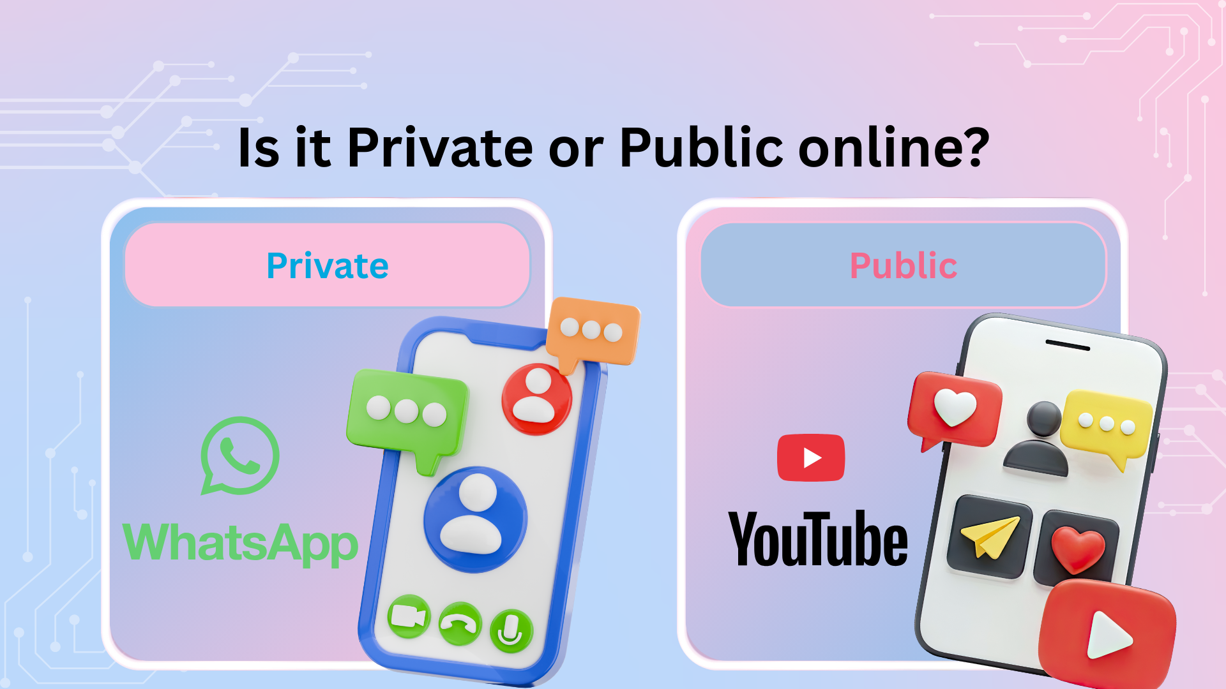
Notes:
"Right! So we know the difference between a House and a Park in real life. But what about on a tablet or computer? Let's figure it out together!
We're going to look at different things you might do online, and you're going to tell me: Is this PUBLIC or PRIVATE?
PRIVATE SPACES - Like Your House
There ARE some private spaces online! Let me give you examples:
Imagine you are video calling your grandma. You press the button, and there's her face on the screen! You can see her, she can see you.
(Ask the class) Who else is in that video call? Can strangers see you?
(Wait for answers - 'No!' 'Just family!')
Exactly! It's just you and Grandma! Nobody else can see or hear you. That is PRIVATE!
In private online spaces:
Only you and people you chose are there ✓
No strangers can see or hear you ✓
You can be silly ✓
You can share family news ✓
It's like being in your house with your family! Safe and private!
PUBLIC SPACES - Like a Park
Now, imagine you're playing a game like Roblox or Minecraft.
You're sitting in your bedroom - that bit is safe and private. But what about your screen?
(Ask the class) When you're playing Roblox, can you see other players?
(Yes!)
And do you know all of those other players in real life?
(No!)
Are they strangers?
(Yes!)
Then you are in PUBLIC!
Other Examples of Public Online Spaces
“Let’s think of other public places online.” Can you think of any other public space online?
“YouTube comments: Anyone can comment, even people you don’t know.”
“Online games with chat or voice.”
“Public profiles or pages.”
“Any time strangers are there, it is public.”
The Big Safety Rule
“This is the most important rule to remember:
Public online spaces follow public rules.”
In public spaces online:
Do not share personal information
Do not share passwords
Do not share where you live or go to school
Do not talk to strangers like they are friends
“It’s the same as a real park. You wouldn’t tell strangers your address or invite them home. The rules are the same online.”
Quick Check for Pupils
Teach them a simple question to ask themselves:
“Can strangers see me or message me right now?”
If yes → Public space
If no → Private space
Reassurance and Safeguarding Link
“If you ever feel confused, uncomfortable, or unsure whether a space is public or private, that is okay.”
“Stop, close the app, and tell a trusted adult.”
“You are never in trouble for asking for help.”
Transition to the next slide
How do you think we need to behave in public spaces?

Slide 9
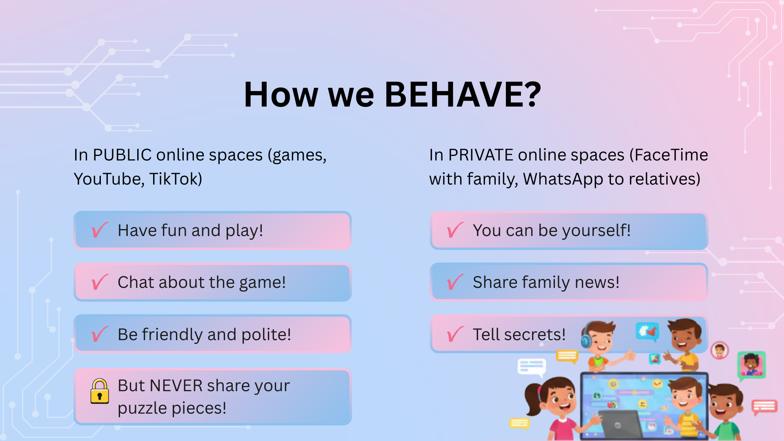
Notes:
What does this mean for how we behave?
In PUBLIC online spaces (games, YouTube, TikTok):
Have fun and play! ✓
Chat about the game! ✓
Be friendly and polite! ✓
But NEVER share your puzzle pieces! ✗ Ask the class -What are your puzzle pieces? Remind them, Name, home address, school, phone number
In PRIVATE online spaces (FaceTime with family, WhatsApp to relatives):
You can be yourself! ✓
Share family news! ✓
Tell secrets! ✓
Because only people you trust can see! ✓
Remember: Just because you're in your bedroom doesn't mean you're in a private space online!
Your bedroom is private. Your screen might be showing you a PUBLIC place!
Always ask yourself: "Can strangers see this? Then I'm in PUBLIC!"
Brilliant work everyone!"
TRANSITION CUE: "Now that we know we're standing in a public park when we game online, we need to think about what we're wearing. We need to talk about USERNAMES..."
(Click to next slide)

Slide 10
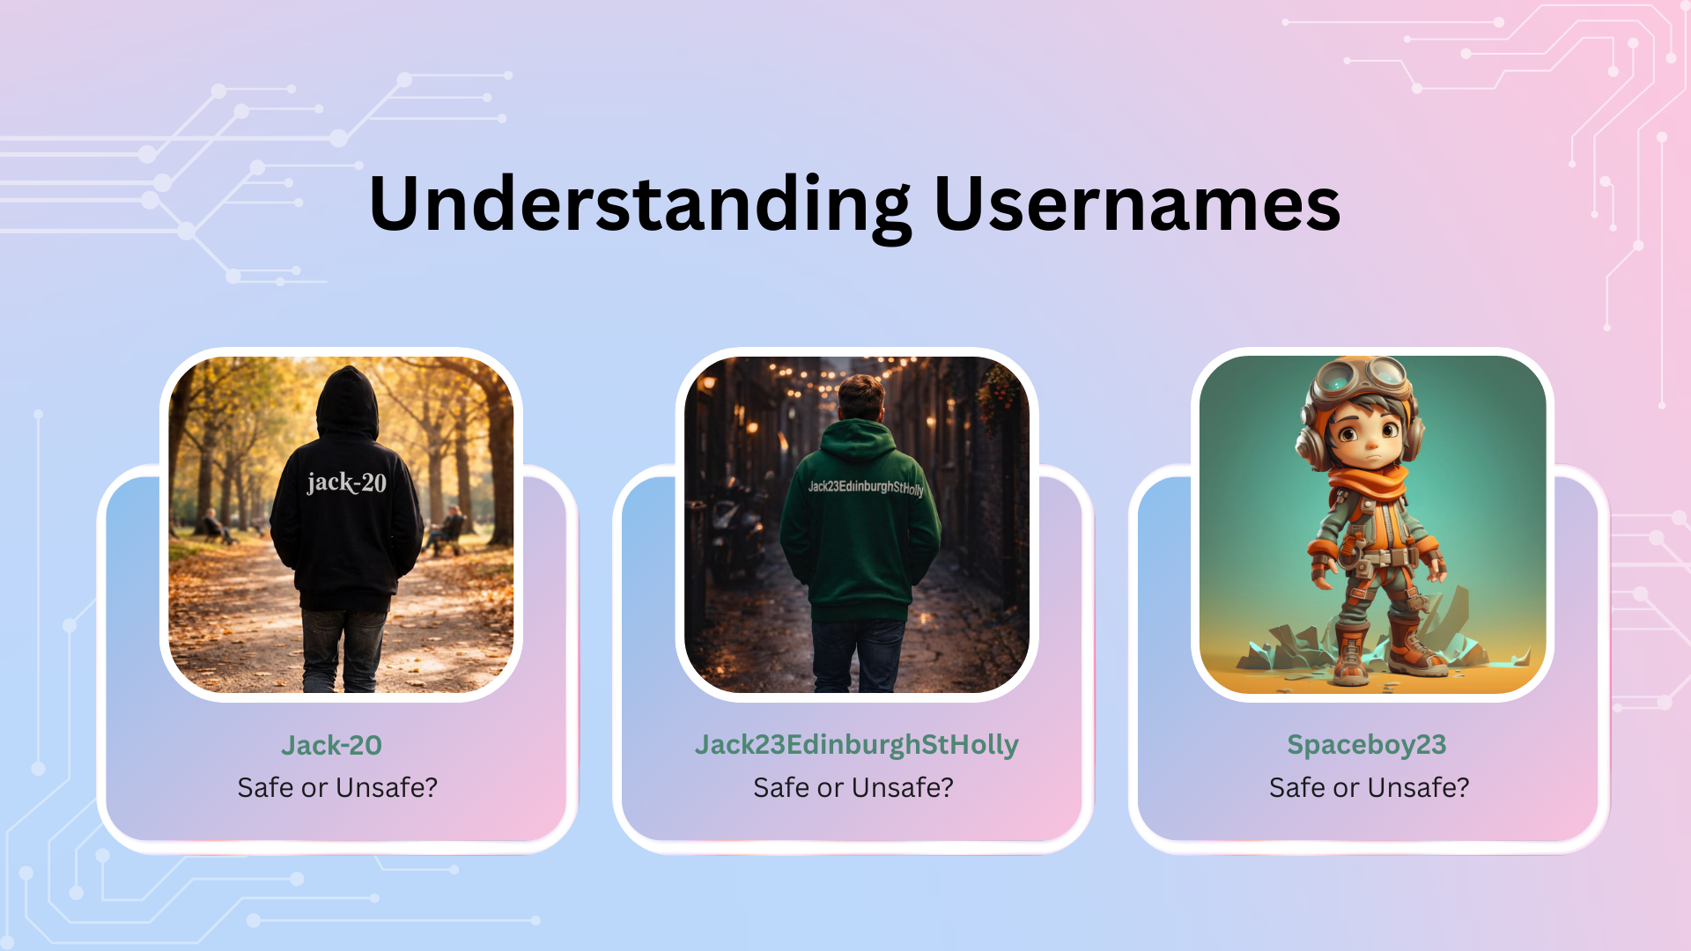
Notes:
"Alright! Now that we know the internet is a giant Public Park, let's think about how we should 'dress' when we go there.
What do I mean by 'dress'? Let me explain!
The T-Shirt Analogy
Imagine you're walking through that busy public park we talked about earlier.
You're wearing a bright white T-shirt with big black writing on it.
Everyone who walks past you can read what's written on your T-shirt, right?
They might not stop and stare, but if they glance at you, they can read it.
Would you put Jack-20 on your hoodie? Why not?
In a video game, your USERNAME is that T-shirt!
When you play games like Roblox or Minecraft or Fortnite, your username floats above your character's head.
(Put hand above your head)
It's like a name tag! Everyone playing the game can see it!
Hundreds of strangers! Thousands of strangers! They all see your username!
So let's think: What should be written on that T-shirt?
Let's look at some examples:
EXAMPLE 1: Username is "Jack23EdinburghStHolly"
What does Jack23EdinburghStHolly tell strangers.
He is Jack, from Edinburgh and what is St Holly, we can probably search that online find out something.
Lets look at more username examples

Slide 11
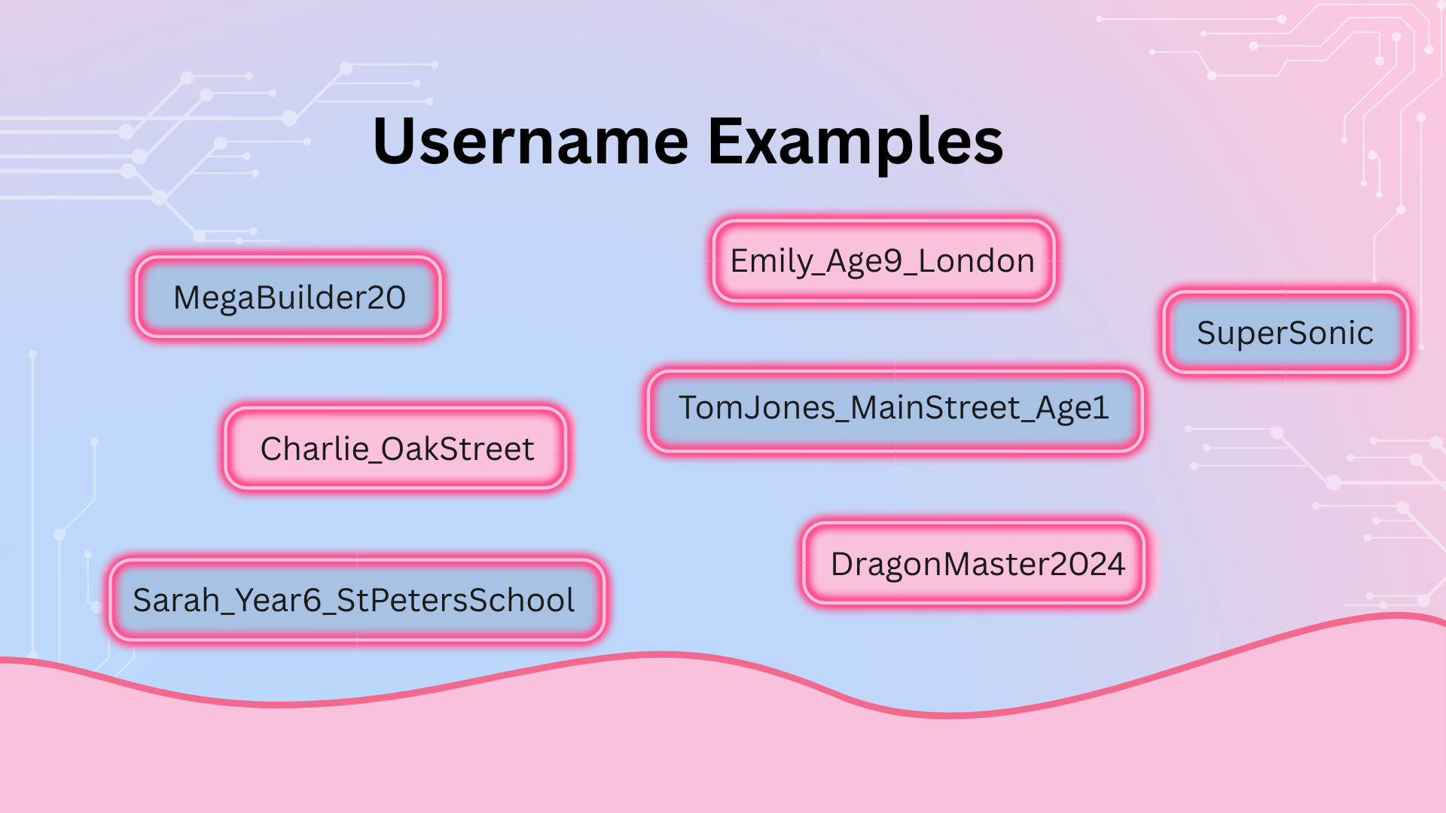
Notes:
EXAMPLE 2: Username is "MegaBuilder20"
If your username is MegaBuilder20, what does that tell strangers about you?
(Wait for answers - 'You like building!' 'You like Minecraft!')
Exactly! It tells them you like building stuff! Maybe you're good at building in games!
But does it tell them your REAL name? (No!)
Does it tell them where you live? (No!)
Does it tell them which school you go to? (No!)
This is a SAFE username!
It's like a T-shirt that says "I like building!" - perfectly fine to wear in a busy park!
EXAMPLE 3: Username is "TomJones_MainStreet_Age10"
Now let's look at this username. What information does this give away?
(Wait for answers - take them one by one)
TomJones = That's your full real name!
MainStreet = That's where you live!
Age10 = That's how old you are!
Imagine wearing a T-shirt in a busy park that says:
"MY NAME IS TOM JONES
I LIVE ON MAIN STREET
I AM 10 YEARS OLD"
(Ask the class) Would you feel safe walking around town wearing that T-shirt?
(NO!)
Of course not! Because now EVERY STRANGER who sees you knows:
Who you are
Where you live
How old you are
They could find your house! They could wait outside your school! They could pretend to know you!
This is a DANGEROUS username!
This person has put ALL their puzzle pieces on their T-shirt!
EXAMPLE 4: Username is "Sarah_Year6_StPetersSchool"
Let's analyze this one together.
(Ask the class) What puzzle pieces has Sarah given away in her username?
(Wait for answers)
Sarah = Her real name
Year6 = Her age (she's about 10-11 years old)
StPetersSchool = Exactly which school she goes to
Now imagine I'm a stranger who sees this username in a game.
I could go to St Peter's School at home time. I could look for a girl called Sarah in Year 6. I could walk up to her and say:
(Put on a creepy voice)
"Hi Sarah! I know you from Roblox! Remember me? We played together!"
Sarah might think, "Oh! They do know me from the game!" and she might trust them!
But this stranger found her because she gave away ALL her puzzle pieces!
This is really, really dangerous!
So here's the Magic Question to ask yourself BEFORE you pick a username:
(Say this slowly and clearly)
"If I wore this on a T-shirt and walked through my town, would I feel safe?"
Let's practice with that question:
Username: "SuperSonic"
If I wore a T-shirt that said "SuperSonic" - would I feel safe?
(Yes!)
Yes! It's just a fun nickname! Nobody knows who I really am!
Username: "Emily_Age9_London"
If I wore a T-shirt that said "Emily, Age 9, London" - would I feel safe?
(No!)
NO! I've just told everyone my name, my age, and where I live!
Username: "DragonMaster2024"
T-shirt test: Would I feel safe?
(Yes!)
Yes! It's creative and fun, but it doesn't reveal who I really am!
Username: "Charlie_OakStreet"
T-shirt test: Would I feel safe?
(No!)
NO! I've given away my name AND my street! Dangerous!
You're all brilliant at this!
The RULE for Usernames:
Your username should be:
✓ Fun and creative
✓ Something that represents your interests (gaming, animals, colors, favorite things)
✓ Easy for you to remember
✗ NEVER your real name
✗ NEVER your age or birthday
✗ NEVER your location or school
✗ NEVER anything that gives away puzzle pieces!

Slide 12
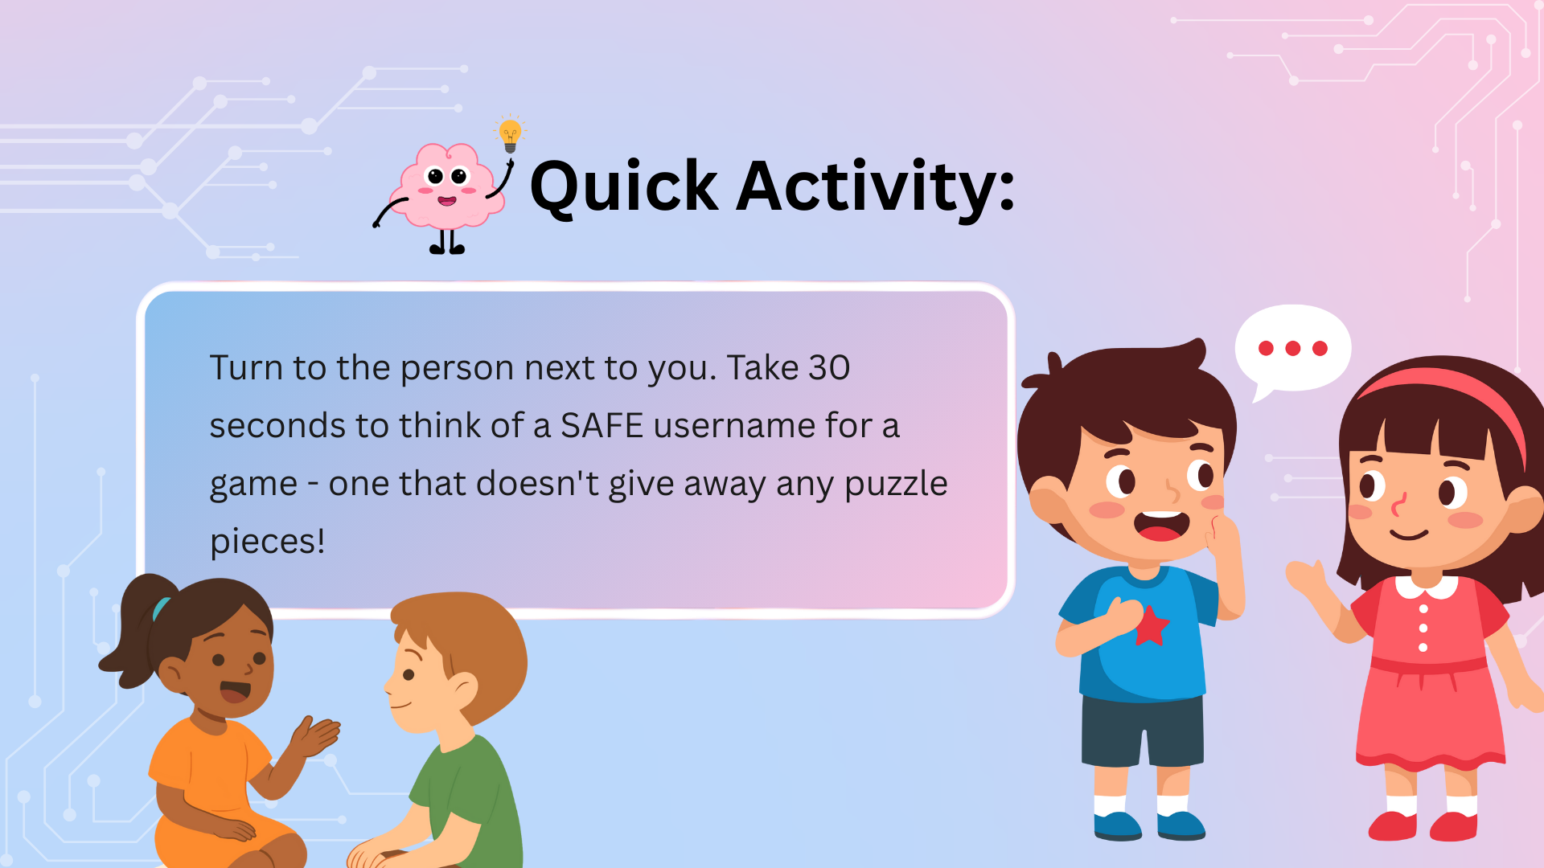
Notes:
Quick activity:
Turn to the person next to you. Take 30 seconds to think of a SAFE username for a game - one that doesn't give away any puzzle pieces!
Then share it with your partner and see if they think it's safe!
(Give students 45 seconds - walk around and listen)
(After time's up) Right! Who wants to share their safe username with the class?
(Take 3-4 examples - praise good choices, gently correct unsafe ones)
Brilliant! You're all thinking like internet safety experts now!
You know how to pick usernames that are fun BUT safe!"
TRANSITION CUE: "Now let's test your skills with a quiz! Can you spot the Safe T-Shirts from the Dangerous ones?"
(Click to next slide)

Slide 13
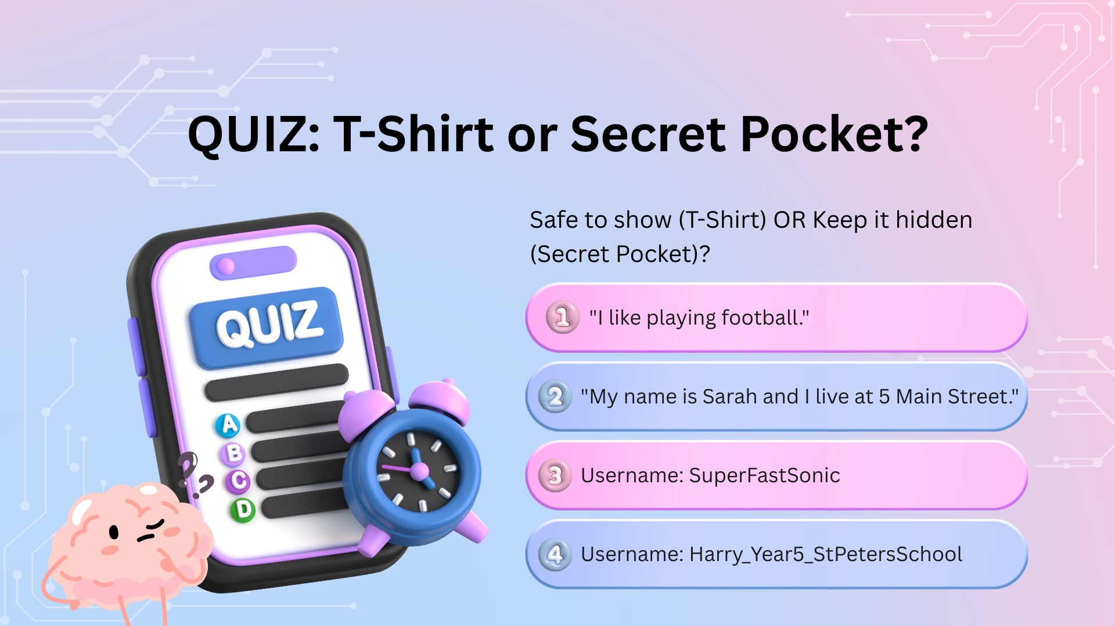
Notes:
Alright everyone! Quiz time! This is where we test if you really understand the difference between SAFE information (that can go on your T-shirt) and PRIVATE information (that stays hidden in your secret pocket)!
Here's how this works:
I'm going to read out a piece of information or a username.
If it's SAFE - meaning you could wear it on a T-shirt in a busy park and feel completely safe - give me a THUMBS UP!
If it's UNSAFE - meaning it gives away puzzle pieces and should stay hidden in your secret pocket - give me a THUMBS DOWN!
Everyone understand? Thumbs ready?
Let's go!
QUESTION 1: "I like playing football"
Imagine this is written on your T-shirt. You're walking through the park wearing a shirt that says "I like playing football."
Thumbs up if it's SAFE. Thumbs down if it's UNSAFE.
(Wait for thumbs - should be UP)
THUMBS UP! That's SAFE!
Why is this safe? Let me ask you:
How many people in the UK like playing football?
(Millions!)
MILLIONS! Maybe tens of millions!
Can a stranger find YOU just by knowing you like football?
(No!)
Exactly! NO! Lots of people like football!
This doesn't give away any puzzle pieces about who you really are or where to find you!
This is totally fine to share!
You can tell people in games:
"I like football"
"I like drawing"
"I like pizza"
"I like reading"
These are general interests! They don't help strangers find you!
QUESTION 2: "My name is Sarah and I live at 5 Main Street"
Imagine wearing a T-shirt that says: "My name is Sarah and I live at 5 Main Street."
Thumbs up if SAFE. Thumbs down if UNSAFE.
(Wait - should be DOWN)
BIG THUMBS DOWN! This is really UNSAFE!
Why? Let's break it down:
What puzzle pieces has this person given away?
(Wait for answers)
"My name is Sarah" = Puzzle piece number 1! Real name!
"I live at 5 Main Street" = Puzzle piece number 2! Full address!
If you walked around town wearing this T-shirt, what could happen?
(Wait for answers - 'Strangers could find your house!')
EXACTLY! A stranger could literally go to 5 Main Street and knock on the door looking for Sarah!
They could wait outside! They could pretend to be a friend! Really dangerous!
NEVER put your address on your T-shirt!
NEVER tell anyone online your address!
Your address is one of the MOST important puzzle pieces to keep secret!
QUESTION 3: Username is "SuperFastSonic"
You're playing a game and your username floating above your head is "SuperFastSonic."
Is this SAFE or UNSAFE?
Thumbs up for SAFE, thumbs down for UNSAFE!
(Wait - should be UP)
THUMBS UP! This is a SAFE username!
Let's analyze it:
Does "Harry_Year5_StPetersSchool" tell me your real name?
This username shares too much personal information that could help strangers find you. Let me show you what it reveals:
What this username tells strangers:
Your first name (Harry)
Your school year group (Year 5, so about 9-10 years old)
Your exact school name (St Peters School)
Why this is risky:
A stranger could find your school and wait near it
They know your age and can pretend to be a classmate
They could use this information to trick you or your friends
Other students at your school would recognize you immediately

Slide 14
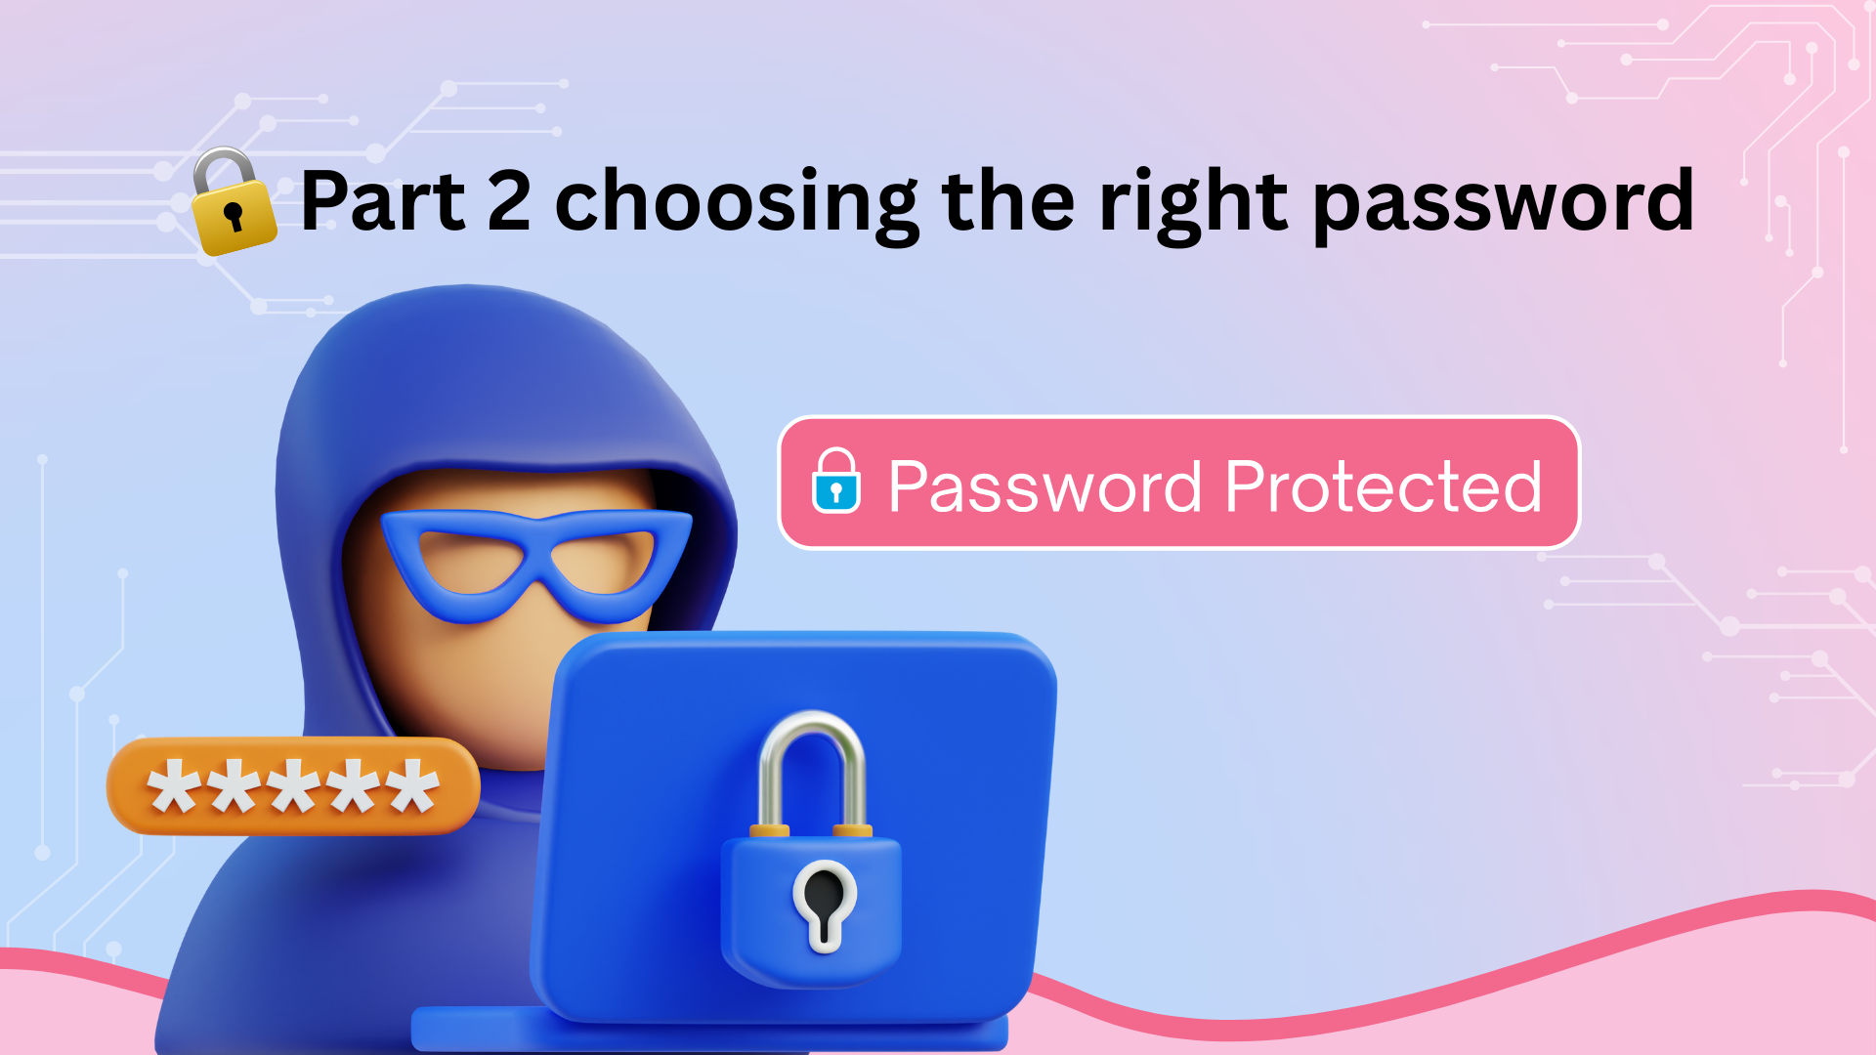

Slide 15
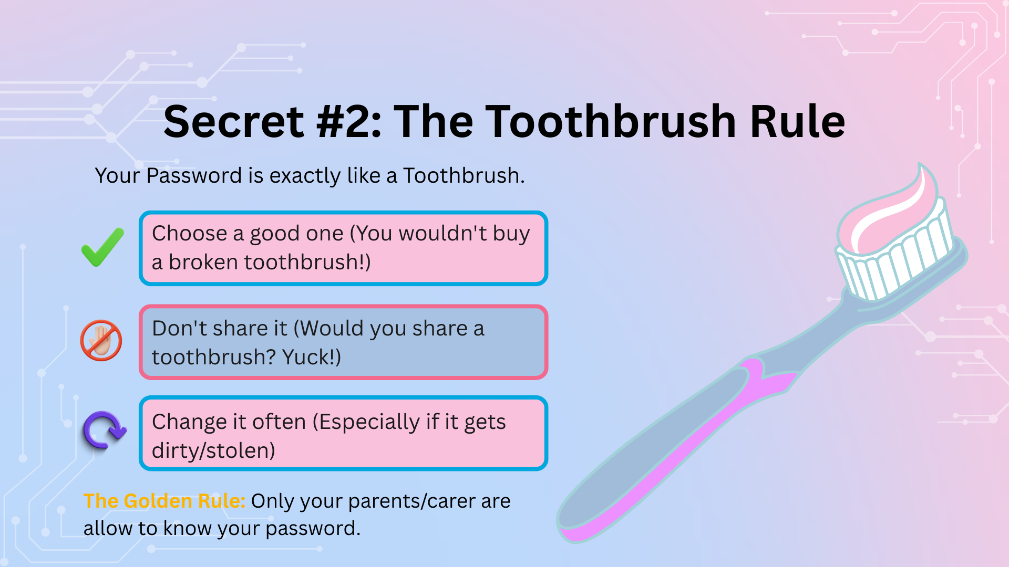
Notes:
Alright everyone! We've learned about keeping our puzzle pieces private. We've learned how to spot public spaces online. We've learned how to create safe usernames.
Now we need to learn about the LOCK that keeps everything safe: PASSWORDS!
And I'm going to teach you the easiest way to remember password safety FOREVER.
It's called: The Toothbrush Rule!
The Toothbrush Rule
This is so simple. Are you ready?
You need to treat your password EXACTLY like a toothbrush!
(Hold up an imaginary toothbrush)
Think about your toothbrush at home. Let me ask you some questions about it:
RULE 1: Choose a GOOD one
When you buy a toothbrush, do you pick one that's broken? One with half the bristles missing? One that's tiny and won't clean your teeth properly?
(No!)
Of course not! You choose a GOOD toothbrush! A strong one that will do the job properly!
It's the same with passwords!
You don't pick a weak, tiny password like "123" or "password." That's like using a broken toothbrush - it won't protect you!
You pick a STRONG password that will actually keep your account safe!
We're going to learn how to build a super strong password in a minute, but first - the other rules!
RULE 2: DON'T SHARE IT
(This is the really important one - slow down)
This is probably the most important rule!
Imagine your best friend comes to school tomorrow and says to you:
(Put on a friend voice)
"Hey! I forgot my toothbrush today. I stayed at my grandma's house and I left mine there. Can I borrow yours?"
What would you say?
(Wait - kids should say NO! or Eww!)
You'd say "NO! That's GROSS! You can't use MY toothbrush! That's disgusting!"
Right?
And your friend would probably agree! They'd say "Yeah, you're right, that IS gross! Sorry I asked!"
Because EVERYONE knows you don't share toothbrushes! That's just... yuck!
Well, it's EXACTLY the same with passwords!
Your password is personal to YOU. It belongs to YOU. Nobody else should use it!
Even your best friend in the whole world should NOT know your password!
But I know what some of you might be thinking:
"But my friend is really nice! They wouldn't do anything bad with my password!"
Let me explain why it's still dangerous, even with nice friends:
If you give your friend your password, they could:
(Count on fingers - be factual, not scary)
1. Lock you out of your own account
They could change your password so YOU can't get back in! Then you'd lose all your progress, all your builds, all your items!
2. Delete everything you've worked on
Imagine you've spent MONTHS building an amazing house in Minecraft. Your friend gets angry about something and deletes it all. Gone!
3. Pretend to be you
They could send messages to other people pretending to be YOU! They could say mean things and everyone would think YOU said them!
4. Spend your game money
If you've saved up V-Bucks or Robux or coins, they could spend them all!
5. Get you banned
If they use your account to break the rules or cheat, YOUR account gets banned! Not theirs - YOURS!
Your password is like your toothbrush - it's YOURS and YOURS ALONE!
Nobody else should use it! Nobody else should even KNOW it!
RULE 3: Change it often
If your toothbrush gets really dirty, or if it falls on the floor of the bathroom, what do you do?
(Wait - 'Get a new one!')
Exactly! You get a fresh toothbrush!
Same with passwords!
If you think someone might have seen your password, or if someone hacks into your account, you need to change it immediately!
Get a fresh password - like getting a fresh toothbrush!
The Golden Rule - The ONLY Exception
(Ask the class)
Now, I've said nobody should know your password except you. But there IS one exception!
Who is the ONLY person in the world allowed to know your password besides you?
(Wait for answers - should say 'Mum,' 'Dad,' 'Parents,' 'Carers')
Exactly! Your Mum, Dad, or Carer!
Why are they the exception?
(Wait for answers - 'Because they look after us!' 'Because they keep us safe!')
Perfect! Because their JOB is to keep you safe!
They're like the security guards of your life!
Parents/Carers can know your password because:
If something goes wrong with your account, they can help you fix it ✓
If you forget your password, they can help you remember it ✓
They can check you're being safe online ✓
They can help if someone is being mean to you ✓
But apart from your parents/carers? Nobody!
Not your best friend.
Not your brother.
Not your sister.
Not your cousin.
NOBODY!

Slide 16
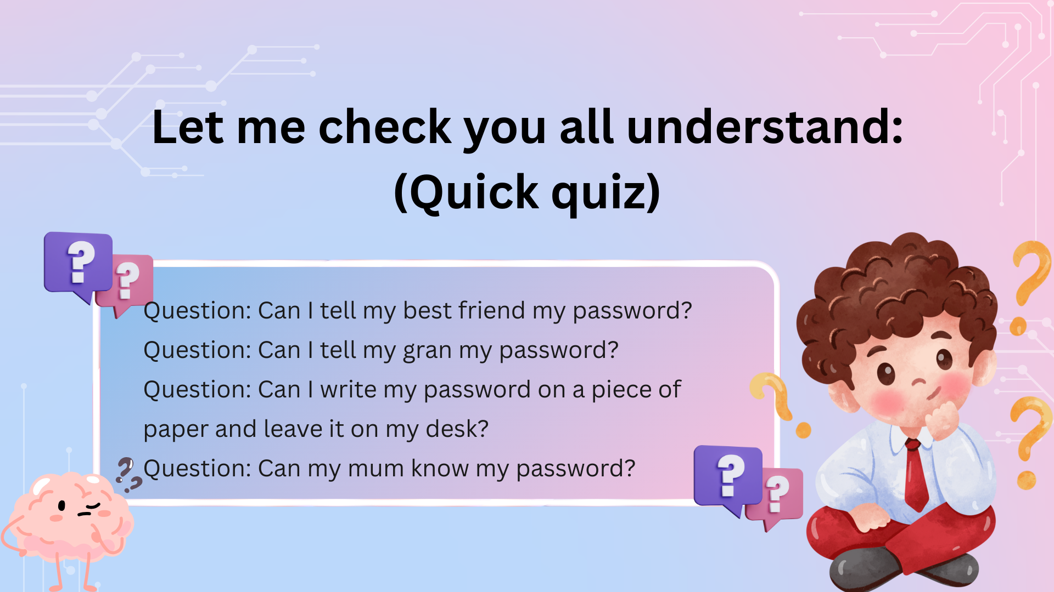
Notes:
Let me check you all understand:
(Quick quiz)
Question: Can I tell my best friend my password?
(No!)
Question: Can I tell my gran my password?
(Hmm - maybe, if she's your carer! But generally, just parents/carers!)
Question: Can I write my password on a piece of paper and leave it on my desk?
(No!)
Question: Can my mum know my password?
(Yes!)

Slide 17
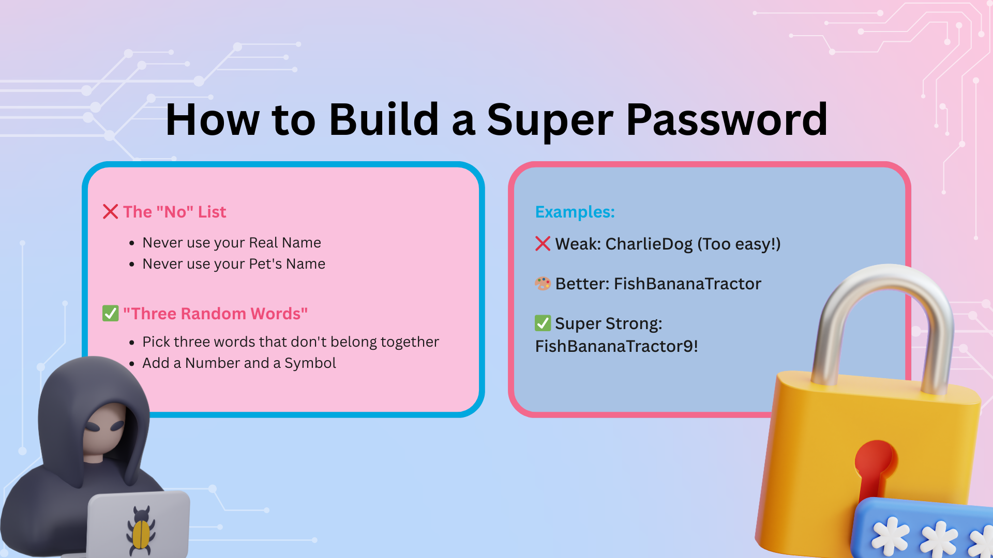
Notes:
"Alright, before we talk more about games and the internet, we need to understand something really, really important.
We need to understand the difference between 'Public' and 'Private.'
This is one of the BIGGEST secrets about the internet - and once you understand this, you'll be safer than most adults online!
Ready? Let's start with the real world first.
What is a PUBLIC place?
(Ask the class) Can someone give me an example of a public place?
(Take answers - should include: park, supermarket, library, street, playground, shopping center)
Brilliant! Yes! All of those!
A public place is somewhere that anyone can go. You don't need permission. You don't need to be invited. Anyone can walk in.
(Use local examples)
Like the park near school - anyone can go there! Families, dog walkers, joggers, people you know, people you don't know. It's open to everyone!
Or like the supermarket - anyone can shop there! You'll see people you know and LOTS of people you don't know!
Now, in a public place, are there strangers?
(Wait for 'Yes!')
Yes! Of course! Strangers are everywhere in public places!
In a public place, is it okay to tell strangers all your secrets?
(Wait for 'No!')
NO! Of course not!
If you're in the park playing football and a stranger is sitting on a bench nearby, you don't walk up to them and say, 'Hi! My name is Emily Jones! I live at 25 Oak Street! I go to St. Peter's School! My phone number is...'
You'd never do that! That would be really strange and really dangerous!
In public places:
We can play and have fun ✓
We behave nicely and politely ✓
But we DON'T share our secrets with strangers ✓
Now - what is a PRIVATE place?
(Ask the class) Can someone give me an example of a private place?
(Take answers - should include: your house, your bedroom, your bathroom, your family's car)
Perfect! Yes!
A private place is somewhere that's just for YOU and your family. It's somewhere that strangers are NOT allowed to enter.
(Point to a student)
Is a stranger allowed to walk into your bedroom whenever they want?
(Student: No!)
Exactly! NO! Your bedroom is PRIVATE! Only people you invite (like your family or best friend) are allowed in there!
In your bedroom, you can:
Tell secrets to your family ✓
Be silly ✓
Talk about personal things ✓
Feel completely safe ✓
Because you know EXACTLY who is there - just people you trust!
So we understand Public vs. Private in the REAL world.
Public = Strangers are there (Park, Supermarket)
Private = Only people you choose (Your bedroom, Your house)
Easy, right?
Now here's where it gets tricky. Here's the BIG SECRET about the internet.
(Slow down - this is the crucial moment)
When you're playing on a tablet or phone or computer in your bedroom, where are you? Are you in a public place or a private place?
(Pause - let them think)
Transition to the next slide

Slide 18
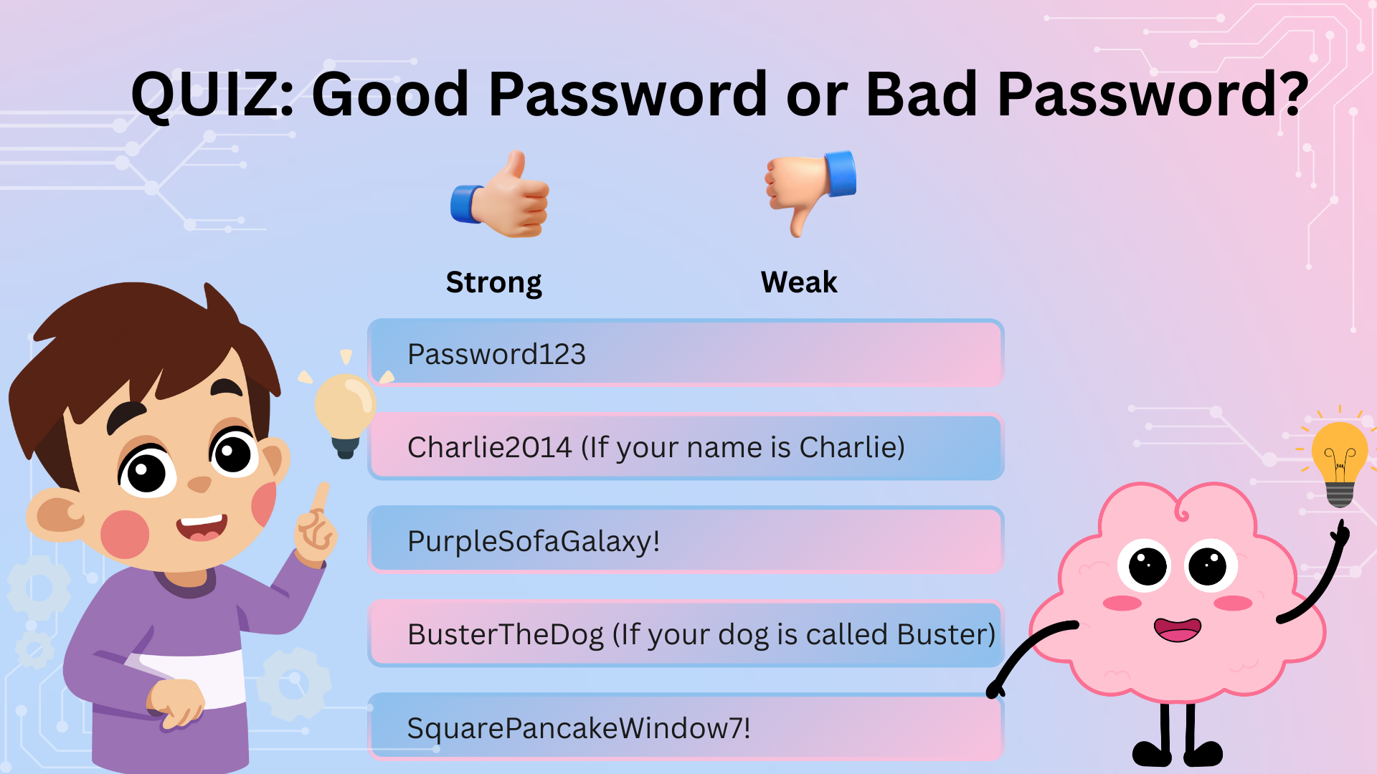
Notes:
Alright everyone! Final quiz! This is where we see if you're true Password Experts!
I'm going to show you five passwords. For each one, you need to decide:
Is it WEAK and easy for a stranger or computer to guess? → THUMBS DOWN!
Is it a SUPER STRONG password that would take years to crack? → THUMBS UP!
Think about what we've learned:
Does it use your name, pet's name, or birthday? = BAD!
Does it have three random words, a number, and a symbol? = GOOD!
Everyone ready? Thumbs ready?
Let's go!
PASSWORD NUMBER 1: Password123
Thumbs up if it's STRONG. Thumbs down if it's WEAK.
(Wait for thumbs - should be DOWN)
THUMBS DOWN! This is REALLY, REALLY WEAK!
This is actually THE most common password in the ENTIRE WORLD!
Millions and millions of people use "Password123"!
(Make this dramatic)
Do you know what that means?
It means it's the VERY FIRST password a hacker will try!
They don't even need a computer to guess it! They just type "Password123" and - BOOM! - they're in your account!
How long would it take a computer to crack this?
Less than 0.1 seconds! Faster than a blink!
If this was a lock on your door, it would be made of wet tissue paper!
This is the WORST password you could possibly choose!
PASSWORD NUMBER 2: Charlie2014
Imagine your name is Charlie and you were born in 2014.
Thumbs up for STRONG. Thumbs down for WEAK.
(Wait - should be DOWN)
THUMBS DOWN! This is dangerous!
Let's break down why this is such a bad password:
Problem 1: It uses your real name!
"Charlie" is your name! If someone knows your name (and they might, from your username or from talking to you), that's the first thing they'll try!
Computers also try EVERY name! Charlie, Sarah, Oliver, Emma - they try them all!
Problem 2: It uses your birth year!
"2014" is when you were born! If someone knows your age, they can guess the year!
Computers also try every year! 2010, 2011, 2012, 2013, 2014, 2015 - they try them all!
Problem 3: It contains PERSONAL INFORMATION!
Even if someone doesn't guess your password, if they somehow found it out (maybe you accidentally typed it in the chat instead of the password box - it happens!), they now know:
Your name is Charlie
You were born in 2014
You're about 10 years old
You've just given away puzzle pieces!
Passwords should NEVER contain personal information about you!
PASSWORD NUMBER 3: PurpleSofaGalaxy!
Thumbs up for STRONG. Thumbs down for WEAK.
(Wait - should be UP)
THUMBS UP! This is a STRONG password!
Let's analyze why this is brilliant:
✓ Purple = Random word
✓ Sofa = Random word
✓ Galaxy = Random word
Do these three words make sense together?
(No!)
NO! What does a purple sofa have to do with a galaxy? Nothing!
And that's PERFECT!
✓ ! = Symbol
The only thing that could make it even better is adding a number!
Like: PurpleSofaGalaxy7!
Then it would be PERFECT!
But even without the number, this is still strong!
Could you remember this?
Yes! Just imagine a purple sofa floating in space among the stars!
(Make a silly picture with your hands)
Make a funny picture in your head!
Could a stranger guess this?
NO WAY! There are millions of combinations!
PASSWORD NUMBER 4: BusterTheDog
Imagine your dog is called Buster.
Thumbs up for STRONG. Thumbs down for WEAK.
(Wait - should be DOWN)
THUMBS DOWN! This is WEAK!
Why is this weak?
(Wait for answers - 'Because it's your pet's name!')
Exactly!
Problem 1: You're using your pet's name!
If someone has seen a photo of your dog (maybe you posted it online), they know your dog is called Buster!
They could guess "Buster" or "BusterTheDog" easily!
Problem 2: "Buster" is a REALLY common dog name!
Thousands of dogs in the UK are called Buster!
Computers trying to guess your password will try all the common pet names:
Max
Bella
Charlie
Buddy
Luna
Buster
And CRACK! They're in!
Problem 3: Even if you LOVE your dog, don't use his name!
I know, I know! You love Buster! He's the best dog ever!
But loving your dog and keeping your account safe are two different things!
You can love Buster AND have a strong password - just don't name the password after him!
PASSWORD NUMBER 5: SquarePancakeWindow7!
Thumbs up for STRONG. Thumbs down for WEAK.
(Wait - should be UP)
THUMBS UP! This is a PERFECT, SUPER STRONG password!
Let's see why this is EXCELLENT:
✓ Square = Random word
✓ Pancake = Random word
✓ Window = Random word
✓ 7 = Number
✓ ! = Symbol
This has EVERYTHING we need!
Let's check all the boxes:
✓ Three random words that don't belong together?
YES! What does a square pancake have to do with a window? Nothing!
✓ A number?
YES! 7!
✓ A symbol?
YES! Exclamation mark!
✓ Easy for YOU to remember?
YES! Just imagine eating a square pancake while looking out the window!
✓ Impossible for strangers to guess?
YES! There are MILLIONS of possible combinations!
✓ No personal information?
YES! It doesn't reveal anything about who you are!
This password is a FORTRESS!
How long would it take a computer to crack this?
HUNDREDS of years!
By the time it guessed this password, you'd be a g

Slide 19
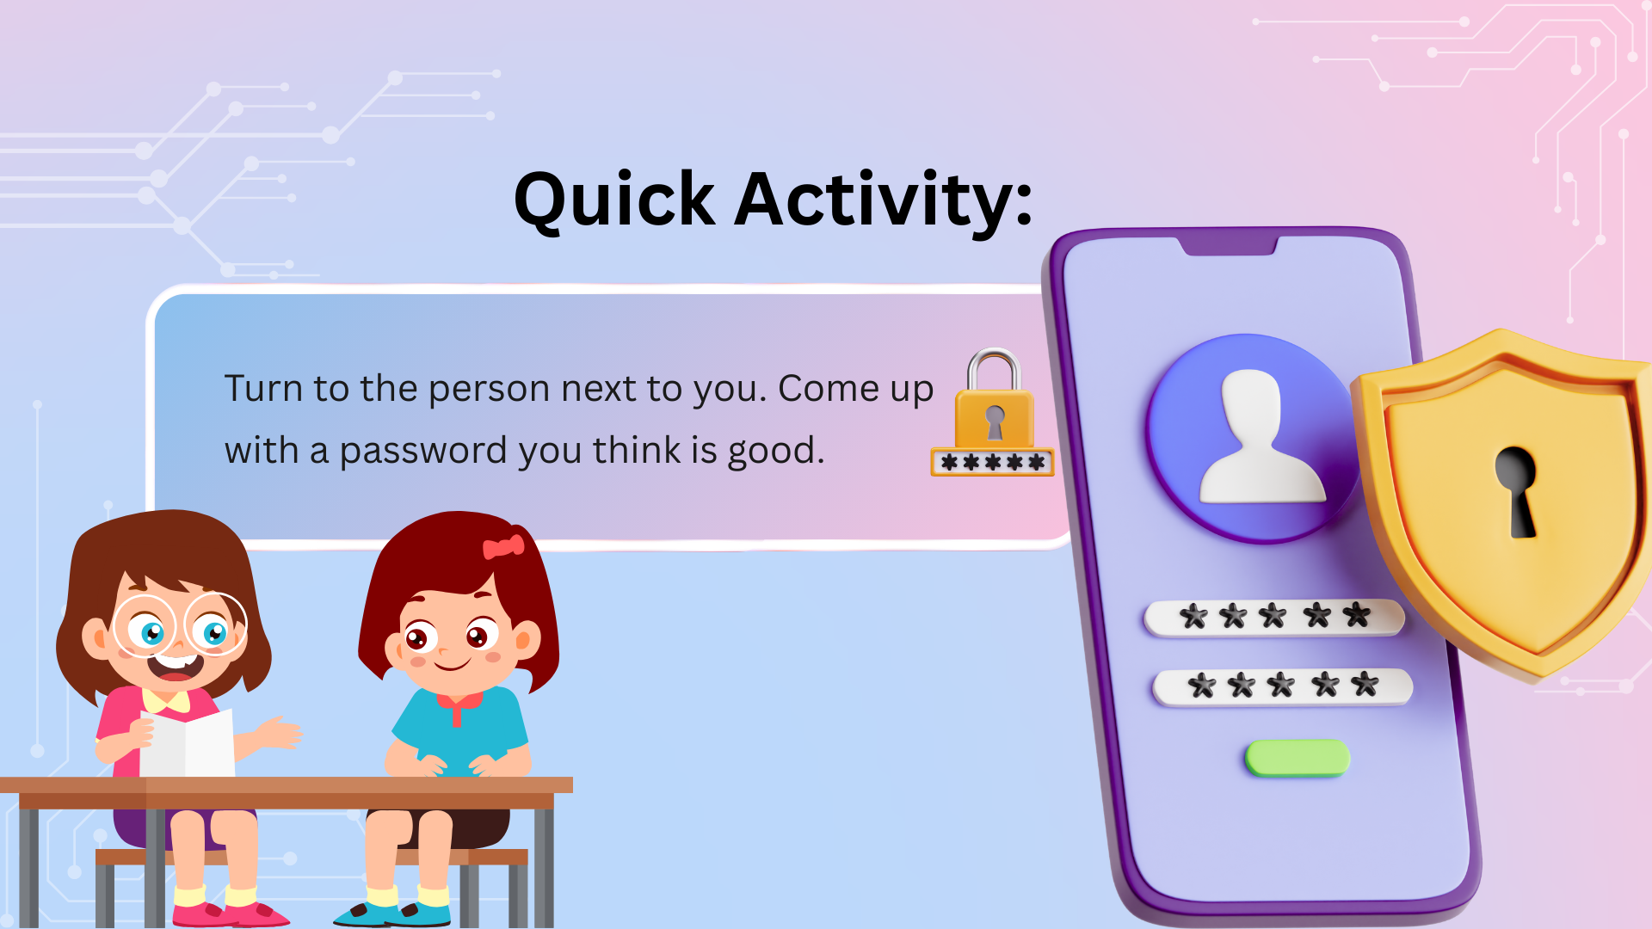
Notes:
Quick activity:
Turn to the person next to you. Take 30 seconds to think of a SAFE username for a game - one that doesn't give away any puzzle pieces!
Then share it with your partner and see if they think it's safe!
(Give students 45 seconds - walk around and listen)
(After time's up) Right! Who wants to share their safe username with the class?
(Take 3-4 examples - praise good choices, gently correct unsafe ones)
Brilliant! You're all thinking like internet safety experts now!
You know how to pick usernames that are fun BUT safe!"
TRANSITION CUE: "Now let's test your skills with a quiz! Can you spot the Safe T-Shirts from the Dangerous ones?"
(Click to next slide)

Slide 20
