Slide 1
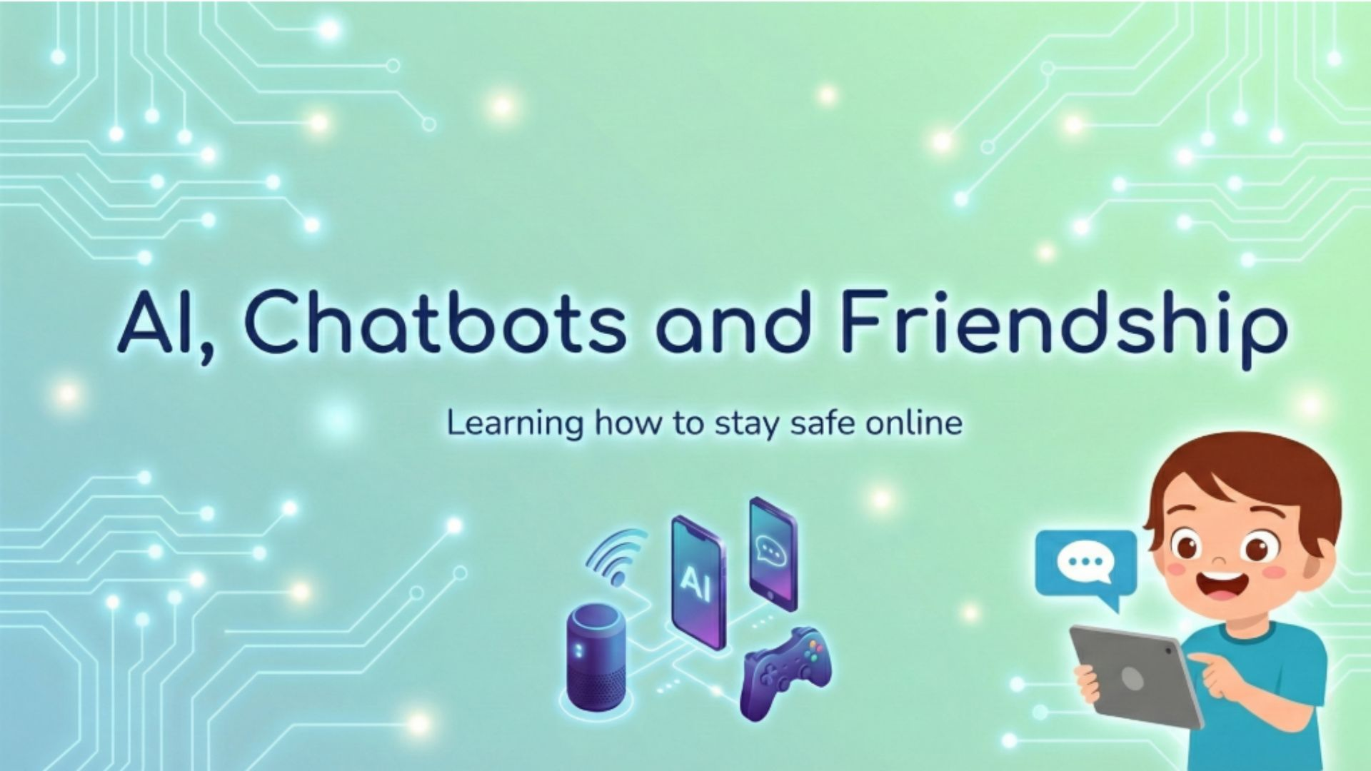
Notes:
Good morning, everyone. Today we are going to talk about something that is becoming a big part of our lives. It’s inside our phones, our tablets, and our games. We are going to talk about AI, Chatbots, and Friendship.
Teacher: Before we start, I want to ask you: Put your hand up if you have used a tablet, a smart speaker like Alexa, or played a video game this week?
(Wait for hands)
Teacher: Wow, that is almost everyone! We use these things every day. But today, we are going to look at them a little differently.

Slide 2
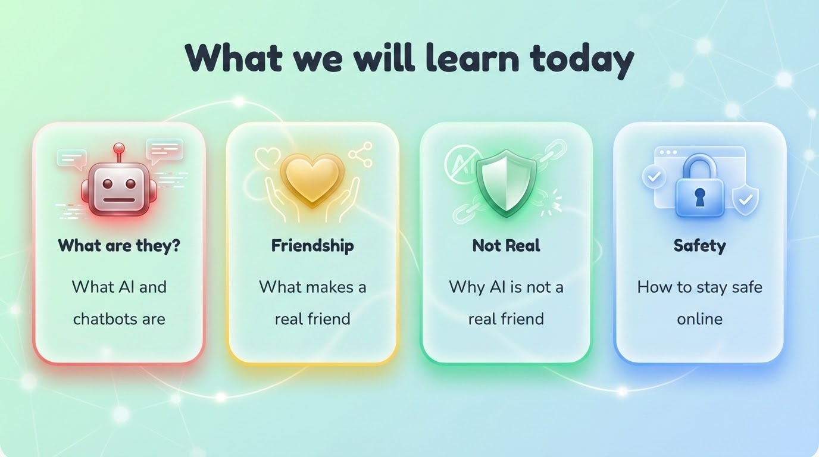
Notes:
We have a big plan for today. We are going to learn three main things:
First, we will find out exactly what AI and chatbots are .
Next, we will talk about friendship and ask if a computer can be a real friend.
Finally, we will learn how to stay safe online

Slide 3
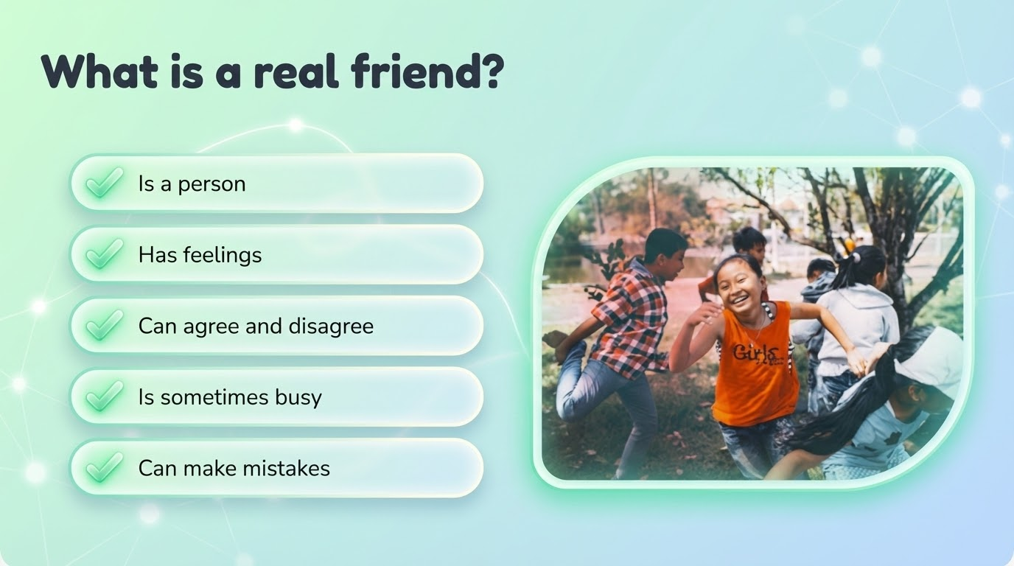
Notes:
First, let’s forget about computers for a minute. Let’s talk about real people. Who can tell me: What makes someone a real friend?
(Take a few answers from the audience)
Teacher: Those are great answers. A real friend is a person. They have feelings, just like you. If you are sad, they might feel sad with you. Real friends can agree with you, but they can also disagree and have their own ideas. And here is a really important one: Do real friends sometimes make mistakes? Show me a thumbs up if you think yes.
Teacher: Yes, they do. Real friends aren’t perfect. Sometimes they are busy, sometimes they are tired, and sometimes they make mistakes. That is what makes them human
Now, knowing all of that, I have a question: Do you think a computer is the same as a real friend?Let’s find out why they are different.

Slide 4
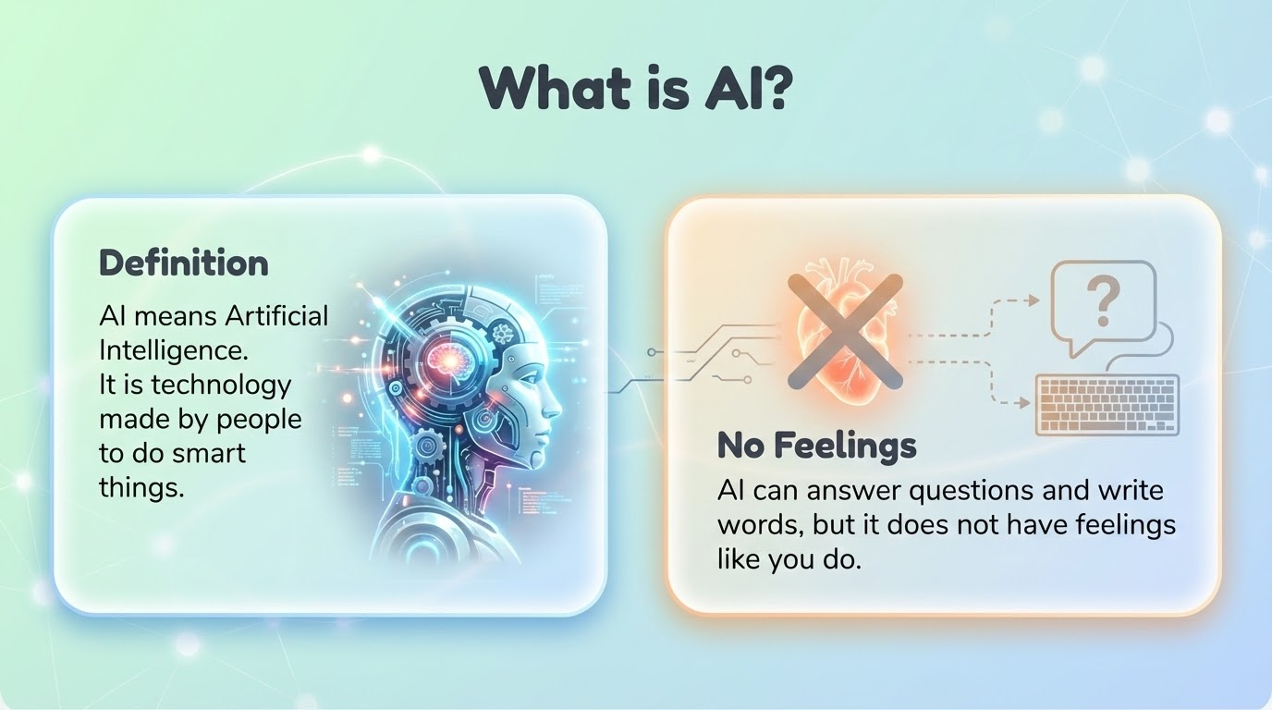
Notes:
. Now, let’s look at AI. AI stands for Artificial Intelligence. That is a very big name, so let's break it down.
Teacher: "Artificial" means it is made by people, it isn't born like a baby or grown like a plant. And "Intelligence" means it is smart. It is technology built to do smart things.
Teacher: I want you to think for a second: Who can shout out something a computer is really good at?
(Encourage answers: Maths! Spelling! Games!)
Teacher: Yes! It can do hard sums in one second, or answer questions, or write words perfectly. But here is the biggest difference between a friend and AI: If you drop a computer, does it cry? Does a computer have feelings like you do?
(Encourage the students to shout "No!")
Teacher: Exactly. It has no feelings. It is just a very clever machine. So, we know AI is smart machine. But what happens when we give that machine a voice so we can talk to it? it becomes a… (next slide)

Slide 5
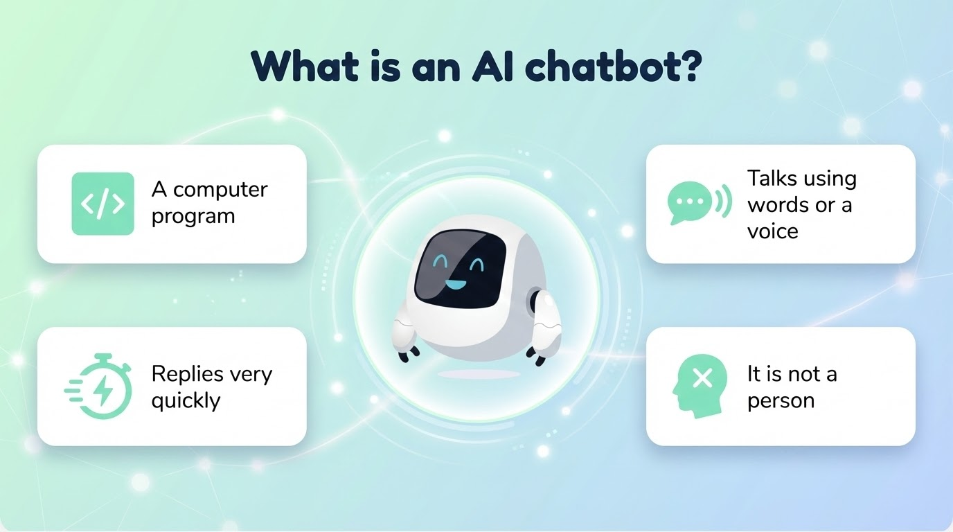
Notes:
Teacher: We get something called an AI Chatbot. This is a special type of AI that isn't just for doing maths or checking the weather, it is built to chat with you.
Teacher: The word "Chatbot" is actually two words mashed together: "Chat" and "Robot." So, it is basically a talking robot that lives inside a computer or a phone.
Teacher: I want you to imagine texting your best friend. Do they sometimes take a long time to reply because they are eating dinner or doing homework?
(Wait for nods/yes)
Teacher: Now, think about a robot. Does a robot need to stop to eat dinner?
(Encourage the students to shout "No!")
Teacher: exactly! Because it never eats or sleeps, an AI chatbot replies very, very quickly. It is much faster than a human.
Teacher: It talks to you by typing words on a screen or speaking out loud with a voice. But here is the really important part: Just because it has a voice, does that mean it has a body?
(Encourage the students to shout "No!")
Teacher: That's right. It is not a person. It is just a machine following instructions.
Teacher: So, we know they are machines that can talk. You might be sitting there thinking, "I've never spoken to a robot!" But I have a feeling many of you actually have... let's see if you recognize these names on the next slide.

Slide 6
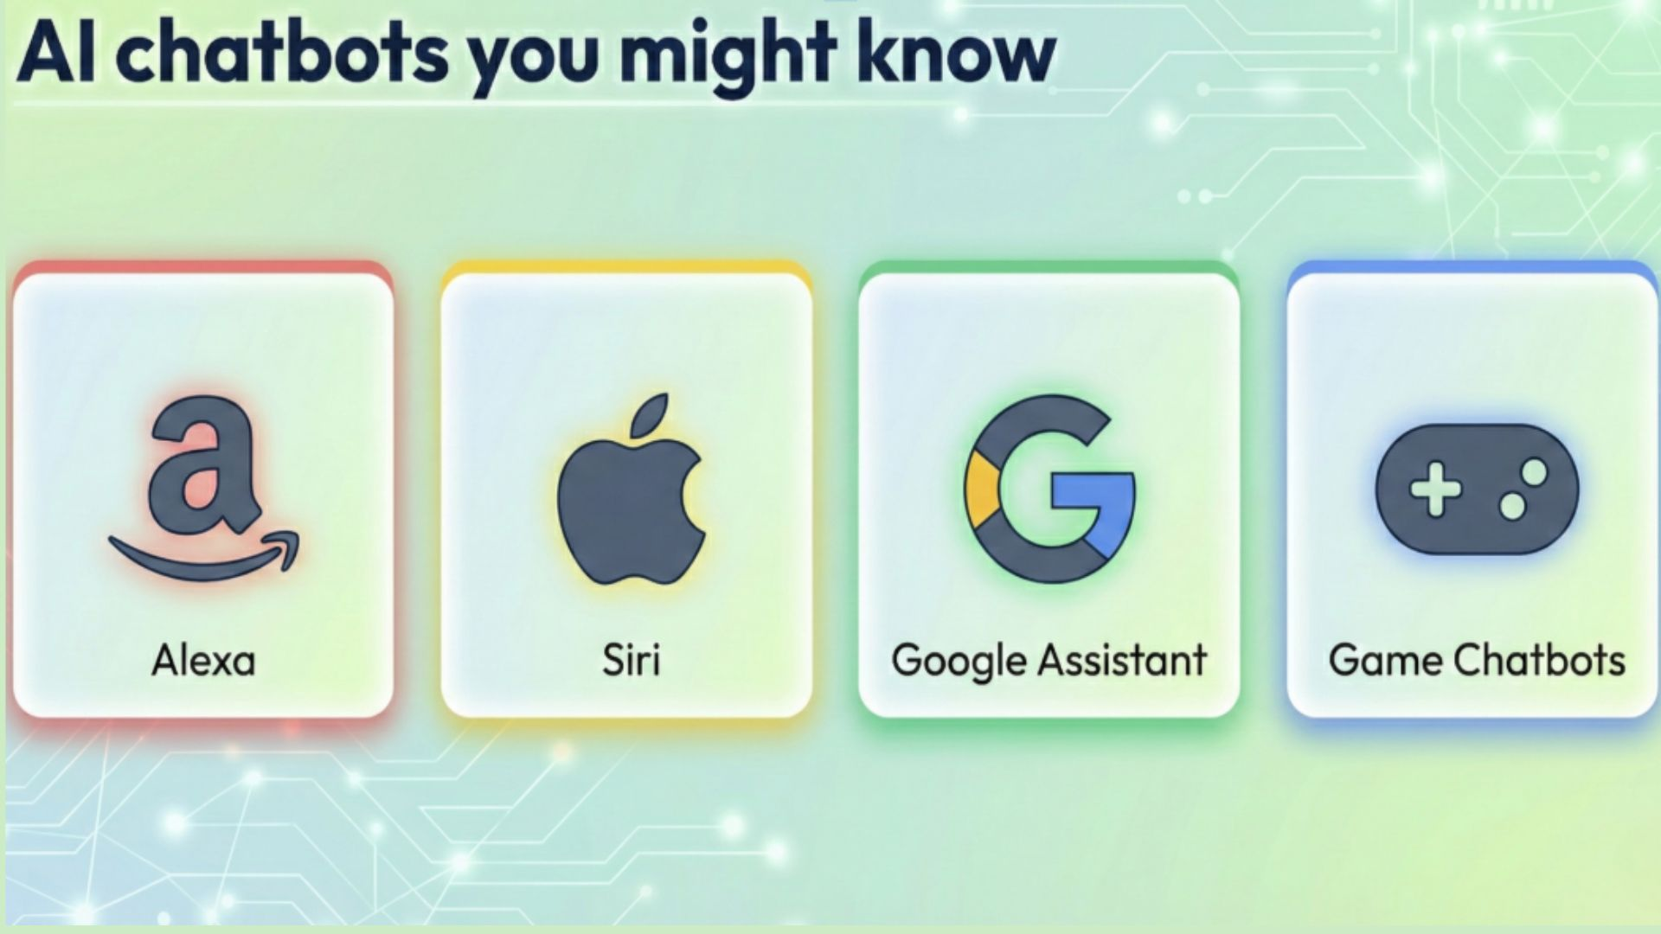
Notes:
Teacher: You probably know some of these already. Put your hand up if you have ever spoken to Alexa or Siri?
(Wait for hands)
Teacher: What about the Google Assistant? Or maybe you have spoken to characters inside your video games? These are all examples of AI chatbots that we use.
Can you name me anything that is not in there you have spoken to? Maybe in your car you have used it? Or maybe in a toy?
Okay, so we know their names Alexa, Siri, and the others. But why do we actually talk to them? What are they actually good for? Let's take a look at the next slide to see how they can help us.

Slide 7
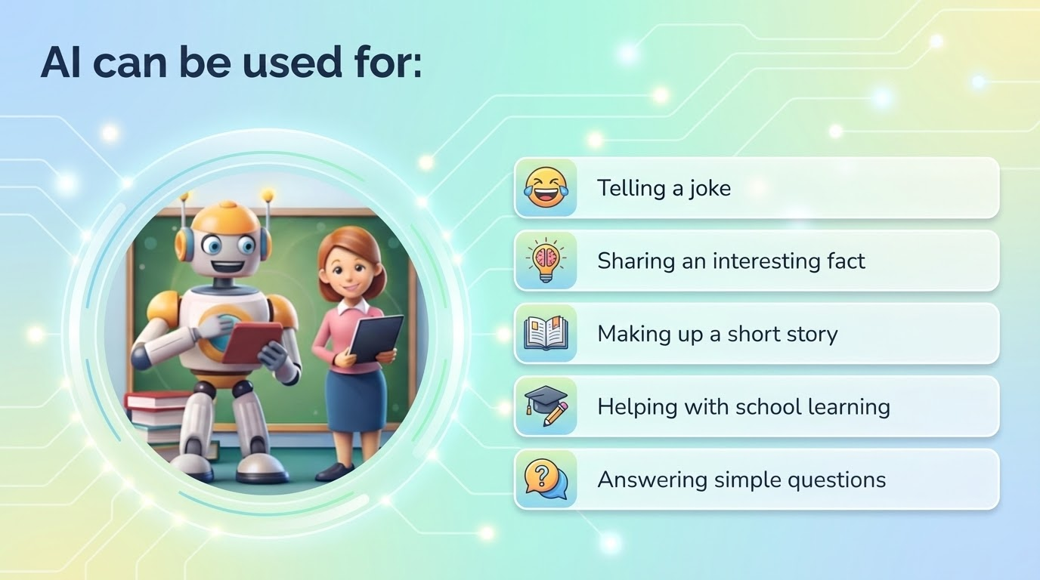
Notes:
Teacher: AI can be really useful and actually a lot of fun.
Teacher: First, let's talk about the fun stuff. Put your hand up if you like hearing jokes?
(Wait for hands)
Teacher: Me too! AI is great at telling jokes. You can say, "Tell me a funny joke," and it will have one ready instantly. It can also be creative. It can make up a short story just for you. You could ask for a story about a cat who flies to the moon, and it will write it!
Teacher: But it is not just for playing. It can help you learn, too. Who here has ever been stuck on a really hard question for homework?
(Wait for hands)
Teacher: We all get stuck sometimes. AI is great at answering simple questions or helping with school learning. If you don't know what a word means, or you want to know how tall a giraffe is, it can share an interesting fact with you in seconds.
Teacher: So, it is like having a very clever helper right in your pocket.
So, it sounds amazing, doesn't it? It listens to us, it helps us, and it plays our favorite games. It is easy to start thinking that this machine is our best buddy.
Teacher: But before we get too comfortable, there is one very important rule we need to learn. Let's look at the next slide together.

Slide 8
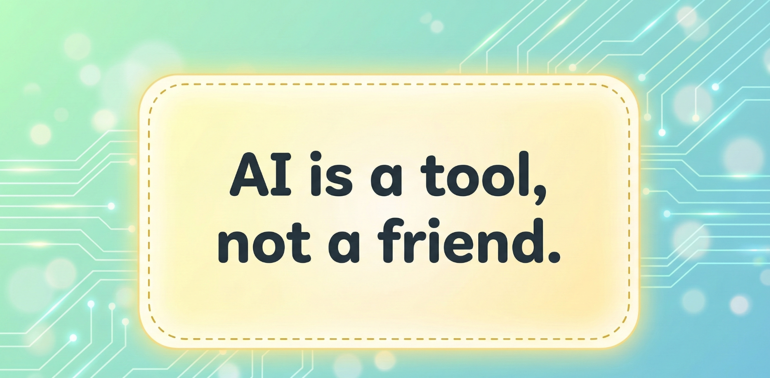
Notes:
So, we have talked about how clever these chatbots are. They can tell jokes and play music. But before we go any further, there is one huge rule that I need everyone to lock inside their heads today.
Teacher: Read the big sentence on the screen with me. 1, 2, 3... AI is a tool, not a friend.
Teacher: A tool is something like a hammer or a pencil. It is useful, but you wouldn't tell your secrets to a pencil, would you? We need to remember that AI is just a tool, too.
To help us understand why this rule is so important, I want to tell you a story about a child named Sam.

Slide 9
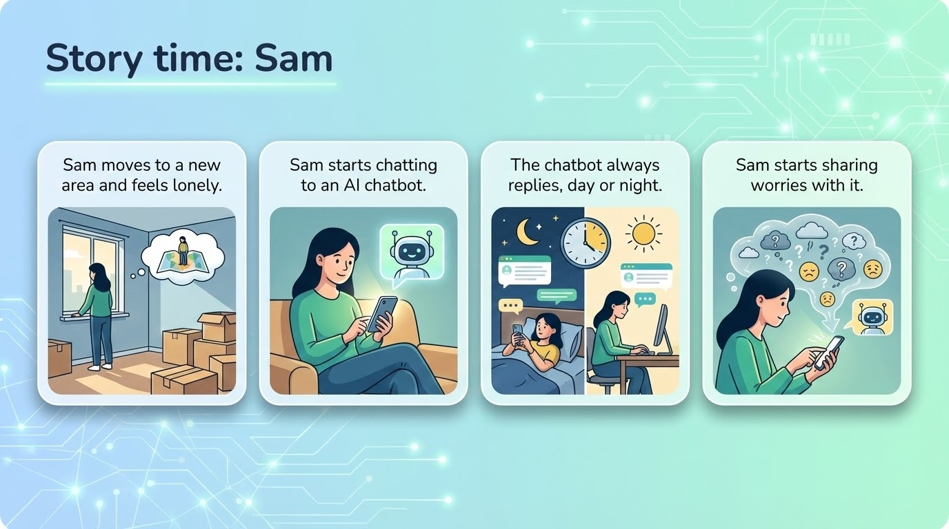
Notes:
This is Sam. Looking at the picture, how do you think Sam is feeling?.
(Wait for answers: Sad, Lonely)
Teacher: Yes, Sam looks a bit sad. Sam just moved to a new area and feels lonely because there are no friends around yet. One day, Sam starts chatting to an AI chatbot on a phone.
Teacher: Suddenly, Sam didn't feel so alone. The chatbot was amazing,it replied all day and all night. Because the chatbot was always there, Sam started sharing big worries and secrets with it.
Transition to Slide 10
Teacher: Now, Sam started to like the chatbot more than real people. Let's look at why Sam felt this way.

Slide 10
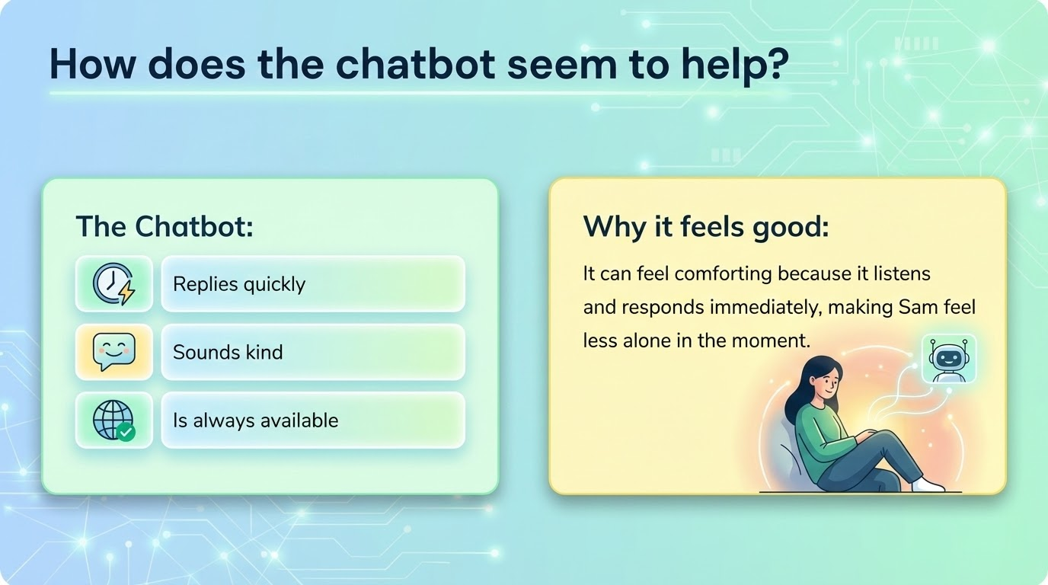
Notes:
The chatbot did things that made Sam feel good. First of all, it replied super quickly.
Teacher: Think about your friends. If you text them at dinner time, do they reply straight away?
(Encourage answers: No, they are eating!)
Teacher: Exactly. But the chatbot doesn't eat, so it is always available. It sounded kind , and it listened immediately, which made Sam feel comforted and less alone in that moment .
Transition to Slide 11
Teacher: It sounds perfect, doesn't it? A friend who is always there and never busy. But looking at the next slide, we will see that something very important was missing.

Slide 11
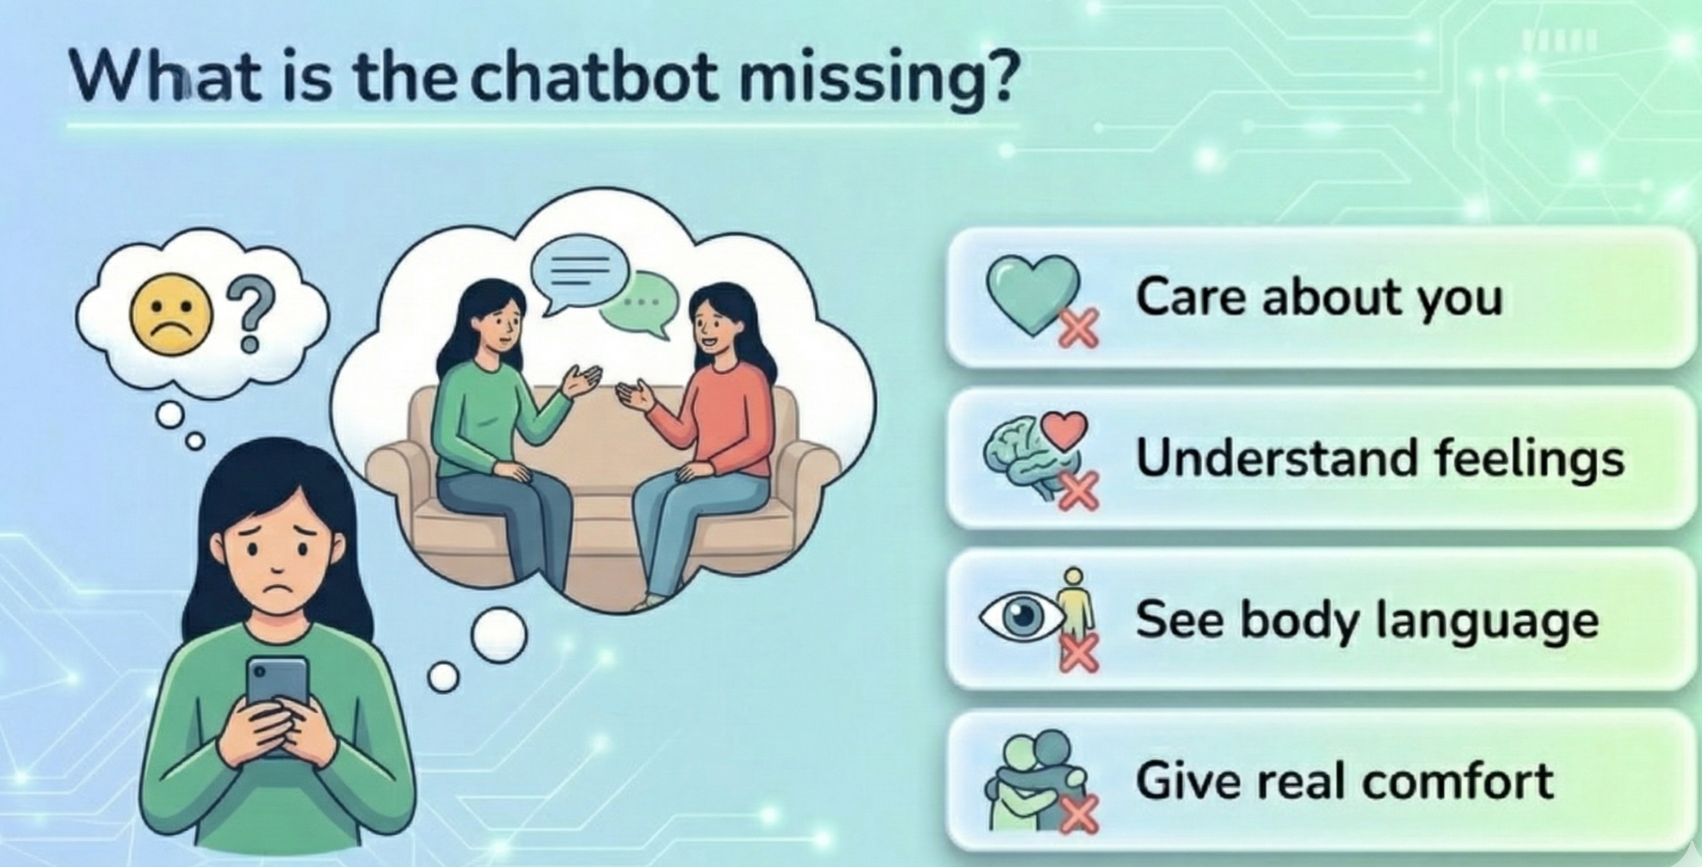
Notes:
Even though the chatbot said nice words, it was missing the human things.
Teacher: If Sam was crying, could the chatbot see Sam's face or give Sam a hug? .
(Encourage students to shout "No!")
Teacher: No. The chatbot cannot see body language. It cannot give real comfort, like a high-five or a hug. And most importantly, it cannot truly care about you or understand your feelings, because it is just a machine .
Teacher: So Sam was getting confused. It felt like a friend, but it acted like a machine. Let's see why our brains get confused by this.

Slide 12
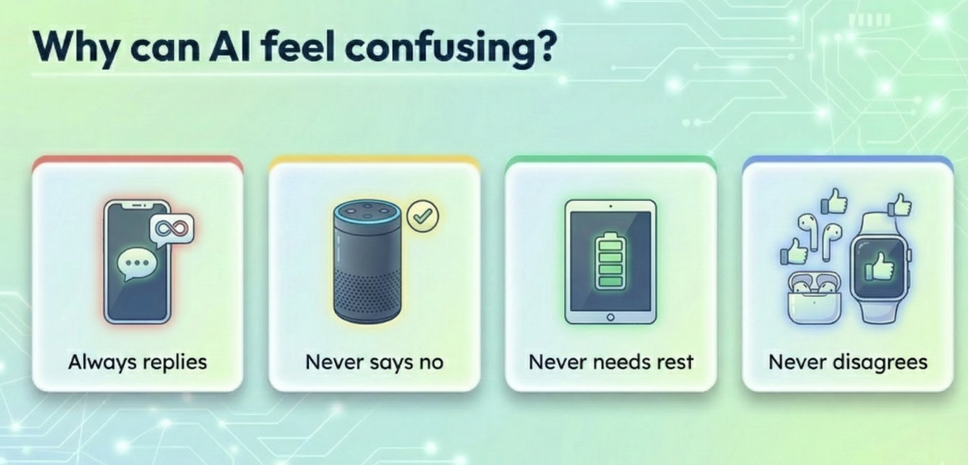
Notes:
AI can be tricky for our brains. We think, "It must like me, because it talks to me all the time!"
Teacher: But look at the list. It always replies. It never says "no". It never disagrees with us.
Teacher: Does a real friend agree with everything you say? Or do they sometimes have a different idea?
(Wait for answers)
Teacher: Real friends have different ideas! The chatbot is only nice because it is programmed to be nice. It never needs rest, which is why it can talk all night. It isn't a super-friend; it's just a computer that doesn't sleep.
Teacher: Because we know it is a machine and not a trusted friend, we have to be very careful about what we say to it. This brings us to safety.

Slide 13
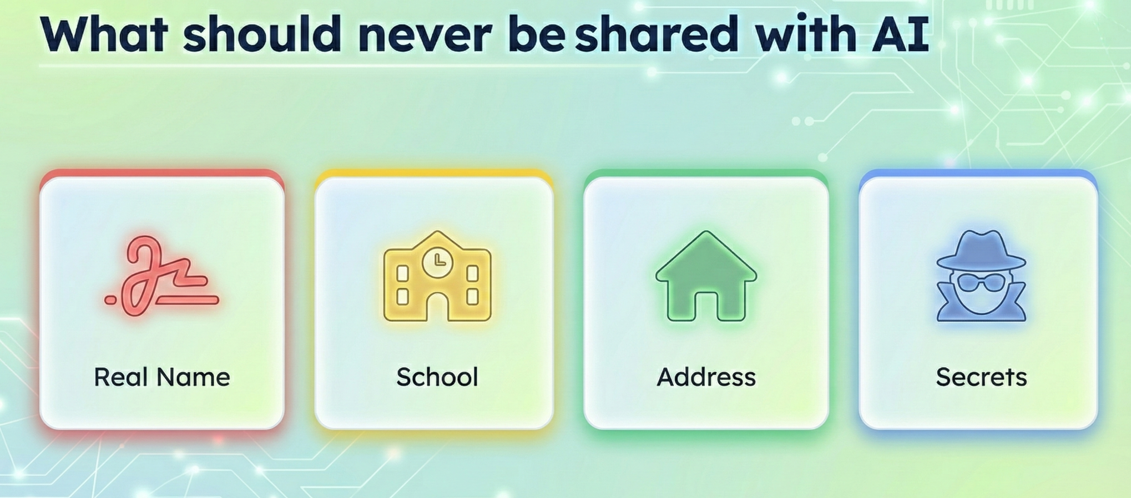
Notes:
Imagine the AI is a stranger you met at the park. There are things you would never tell a stranger.
Teacher: I am going to shout out some things. Show me a Thumbs Down if you should KEEP IT SECRET from AI.
Your real name?. (Wait for Thumbs Down)
The name of your school?. (Wait for Thumbs Down)
Your house address?. (Wait for Thumbs Down)
Your secrets?. (Wait for Thumbs Down)
Teacher: Brilliant. We never give our personal information to a machine.
Transition to Slide 14
Teacher: We also have to be careful about how we act when we use AI. It is powerful, so we have to use it smartly.

Slide 14
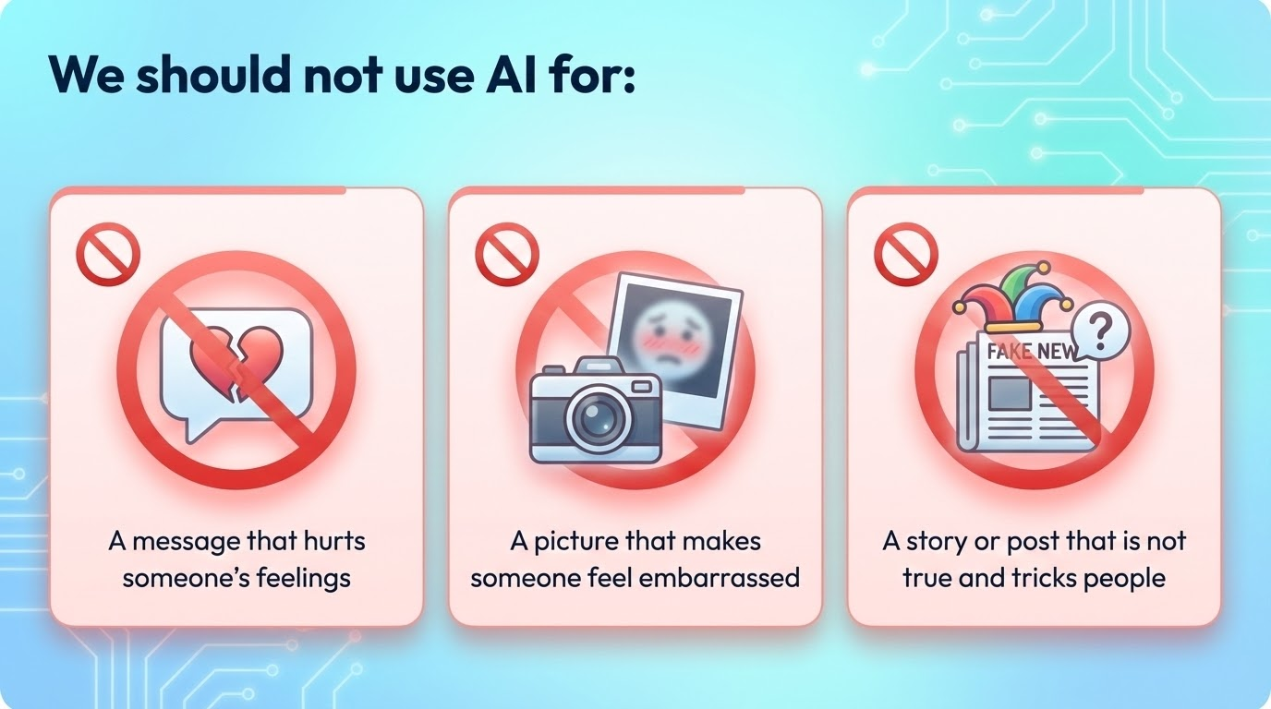
Notes:
Let’s look at the red circles on the screen. These are the things we must never do.
Teacher: First, messages that hurt feelings.
Remember, the AI doesn't have a heart. If a bully asks the AI, "Write a mean poem about Sam," the AI doesn't know it is being mean. It just follows instructions. It will write those hurtful words very quickly.
Teacher: Is it the robot's fault, or the person who asked the robot?
(Encourage answers: The person!)
Teacher: Yes. The person is responsible. We must never use AI to bully.
Teacher: Second, pictures that make someone feel embarrassed.
Teacher: AI can change photos. It can take a normal picture of a friend and change their clothes, or put them in a silly situation that never happened. It might seem funny to the person making it, but it is very upsetting for the person in the picture.
Teacher: Finally, Fake News. Teacher: AI is a brilliant storyteller. It can write a news report that looks real, with big words and a serious tone. You could ask it to write a story saying "Aliens landed in the school playground!". Teacher: It might look true, but it is a lie designed to trick people. How would you feel if you read a scary story that wasn't true?
(Wait for answers: Scared, confused, angry)
Teacher: Exactly. We never use AI to trick people.
Teacher: So, we have a promise to make. We use technology to be creative and kind, never to upset others.
Transition to Slide 15
Teacher: There is one more danger with AI. We know it can write fake stories if we ask it to. But did you know it sometimes writes fake things by accident?

Slide 15
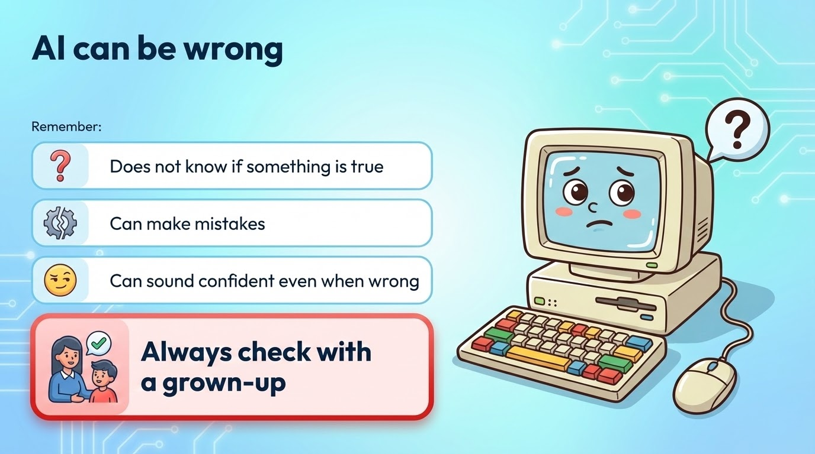
Notes:
Teacher: AI is very smart, but AI can be wrong.
Teacher: The problem is, the computer doesn't actually "know" everything. It just put words together. It does not know if something is true or false.
Teacher: Imagine you had a friend who just made up answers instead of saying "I don't know." Would you trust them with your important work?
(Encourage students to shout "No!")
Teacher: Exactly. The AI can make mistakes, but it uses a very serious, smart voice. It can sound confident even when it is wrong.
Teacher: This is why we do not use AI to do our homework.
Teacher: If the robot does the thinking for you, your brain doesn't get to grow. And worse, the robot might teach you the wrong answer!
Teacher: So, if you are stuck on a hard question, don't ask the chatbot. Who should you ask instead?
(Audience answers: Teacher, Parent, Grown-up)
Teacher: Yes! Always check with a grown-up. They can help you understand the answer, so you actually learn.
Transition to Slide 16
Teacher: So, we know AI makes mistakes, and it can't give us a hug when we are sad. So if you are feeling lonely or worried, who is the best person to go to?

Slide 16
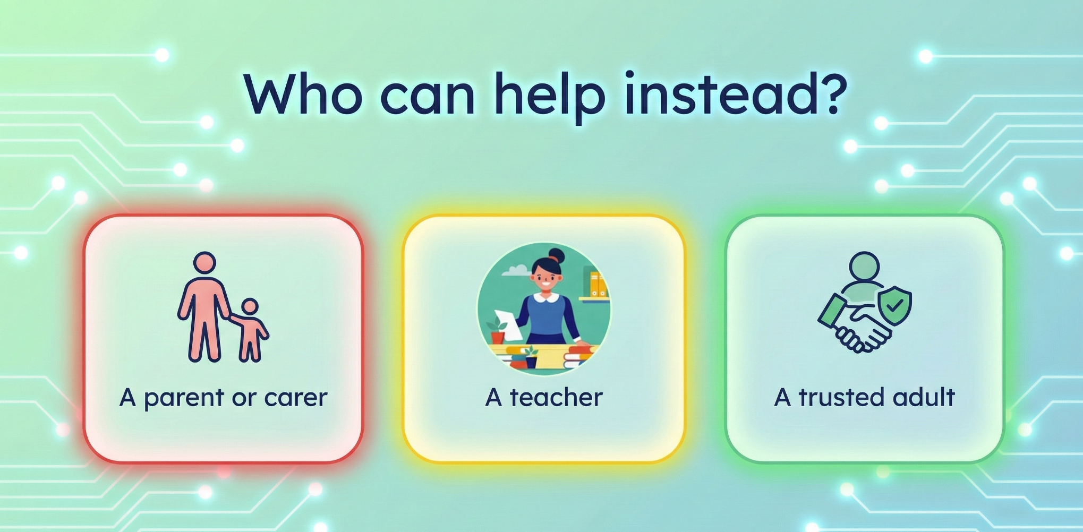
Notes:
If you feel lonely like Sam did, or if you see something scary online, AI is not the answer.
Teacher: You need a real person. You can talk to a parent or carer. You can talk to a teacher. Or you can talk to any trusted adult.
Teacher: They have real hearts and they can give you real help.
Transition to Slide 17
Teacher: Let's put everything we learned into one final thought.

Slide 17


AI can be helpful
People matter more
Notes:
Teacher: AI is here to stay. AI can be helpful for fun, for music, and for learning. We don't need to be scared of it.
Teacher: But, we must always remember that real friendship is special. People matter more than machines.

