Slide 1



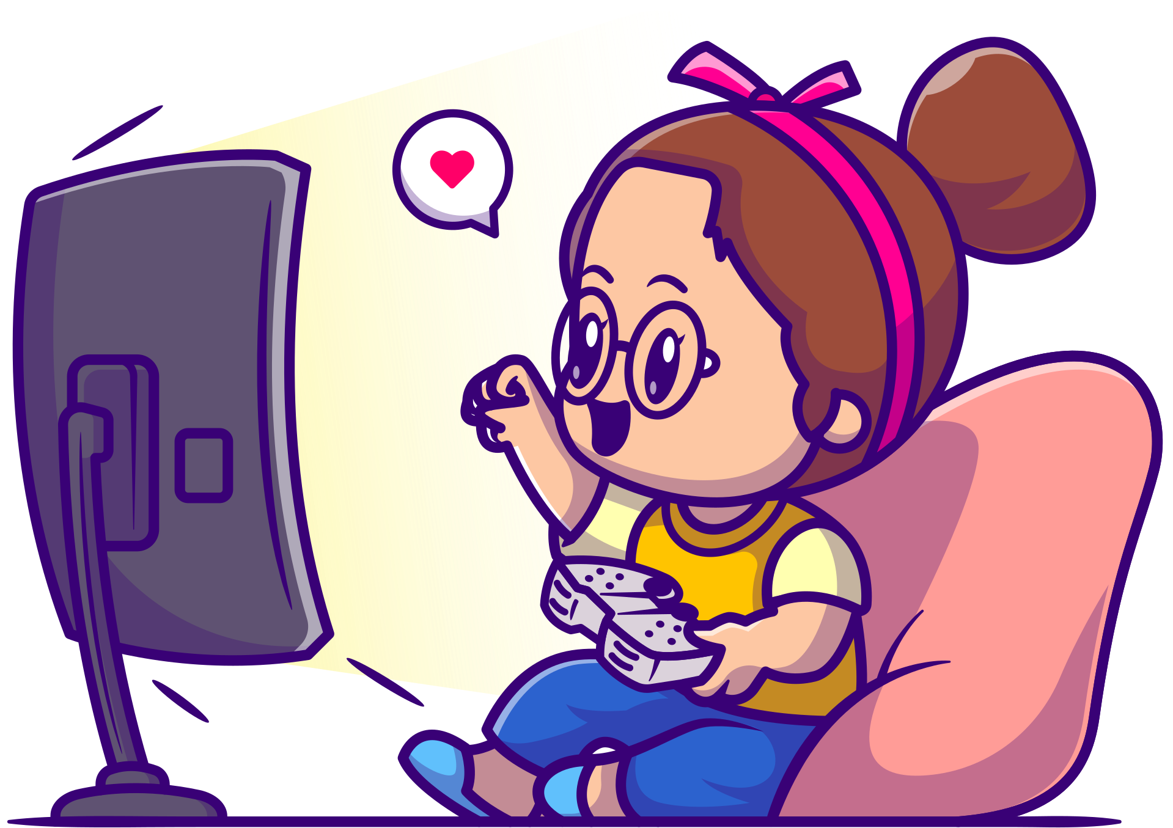




Quiz
Time
Loot Boxes

Slide 2





Question 1
What is the most important rule of a Loot Box?
A. A) You pay money BEFORE you know what is inside.
B. It is always free to open.
C. You always get exactly what you want.
D. You should read terms and consider spending wisely.

Slide 3
Question 2
If you practice a game for a long time, can you get better at opening Loot Boxes?
A.No, it is 100% luck
B. Yes, if you click the button fast.
C. Yes, if you use a special controller.

Slide 4
Question 3
Which of these is a "Loot Box" in disguise?
A. A mystery card pack
B. A specific blue hat in the shop.
C. A trophy you win for coming first.

Slide 5
Question 4
Why do games put countdown timers (like "Only 2 minutes left!") on special offers?
A. To help you tell the time.
B. To make you feel rushed and panicked.
C. To make the game run faster.

Slide 6
Question 5
What is the "Smart Gamer's" trick for handling big feelings like anger or excitement?
A. Scream loudly
B. Buy the item immediately.
C. Hit the PAUSE button and wait 10 minutes

Slide 7
Question 6
Why do games use "Gems" or "Coins" instead of showing the price in real money?
A. Because they look cooler.
B. To confuse you about how much you are spending.
C. Because games don't take real money.

Slide 8
Question 7
We watched a video where a player opened thousands of boxes. What did we learn?
A. He got his money back at the end.
B. He won the best prize every time.
C. Most of the boxes had "junk" or common items

Slide 9
Question 8
What is a good question to ask yourself before buying digital coins?
A. Would I rather have this digital loot or a real toy?
B. Can I click the button fast?
C. Is the picture shiny?

Slide 10
Question 9
If you accidentally spent money without asking, what should you do?
A. Tell a trusted adult immediately.
B. Delete the game.
C. Keep it a secret.

Slide 11
Question 10
What is the best way to "Win" against loot boxes?
A. To be the boss and choose not to buy them.
B. To buy as many as possible.
C. To close your eyes when you open them.

