Slide 1
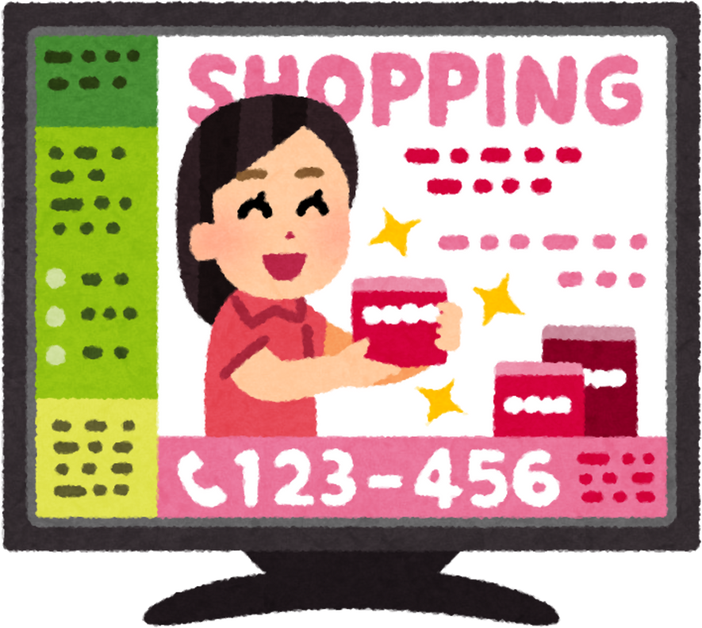





Quiz
Time
Clicks for Cash

Slide 2





Question 1
What is an advert?
A.Something made to get our attention
B. A school rule
C. . A secret message

Slide 3

Question 2
Where can we see adverts?
A.Only on TV
B. On TV and online
C. Only in books

Slide 4
Question 3
Why are adverts loud and colourful?
A.To help us sleep
B.To make the screen heavy
C. To get our attention

Slide 5
Question 4
What does clickbait try to do?
A. Make us bored
B. Make us click fast
C. Help us learn

Slide 6
Question 5
Which feeling might an advert try to give us?
A.Excited
B. Sleepy
C. Cold

Slide 7
Question 6
You see something exciting online
and your body feels rushed.
What is the best thing to do?
A. Click quickly
B. Stop and think
C. Keep watching

Slide 8
Question 7
Which one is safer to click?
A. A video your teacher shared
B. A button that says “PLAY NOW!”.
C. Something you are not sure about

Slide 9
Question 8
Why do some online things really want clicks?
A. To help us sleep
B. To help the people who made it
C. To help us tidy our room

Slide 10
Question 9
You are not sure what will happen next.
What should you do first?
B. Click to find out
A. Ask a grown-up
C. Ignore how you feel

Slide 11
Question 10
Which sentence shows good online thinking?
B. “I clicked quickly so it didn’t go away.”
A. “I clicked because it looked fun.”
C.“I stopped and asked before clicking.”

